Slide 1
Make Mexican Music!
With Maracas!

Slide 2
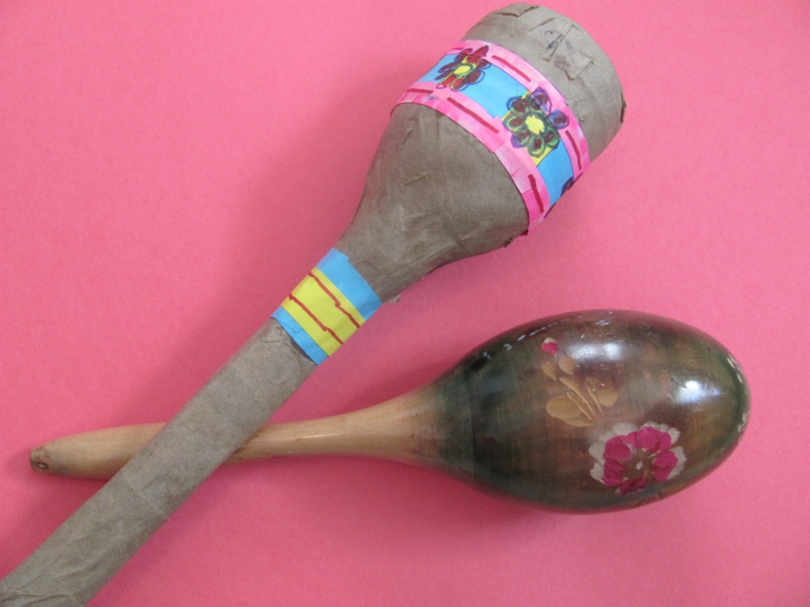
Make your own maraca using papier mache.

Slide 3
Warning!!!
Today our maracas are under construction.
Do you think it is a good idea to shake them today?
Why or why not?

Slide 4
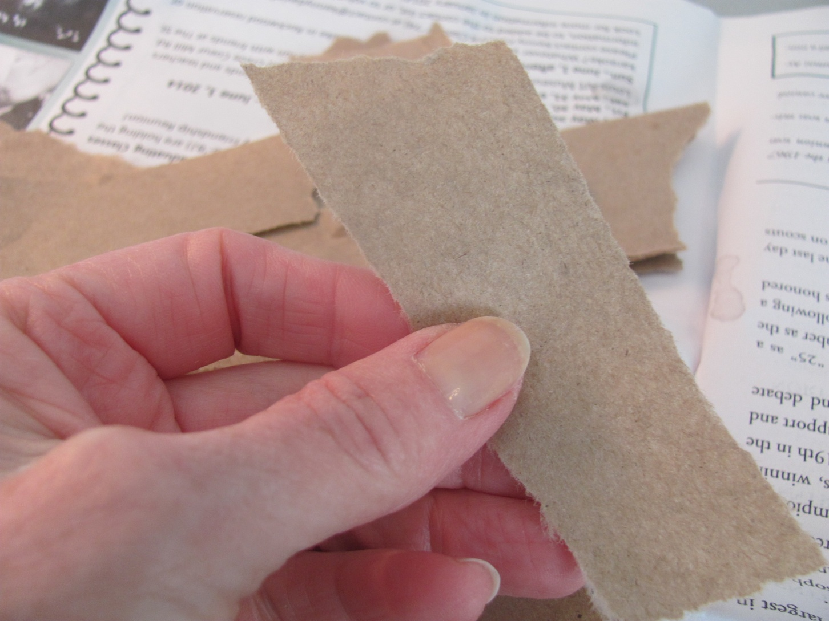
1. Put newspaper down on table.
Tear small strips of brown paper

Slide 5
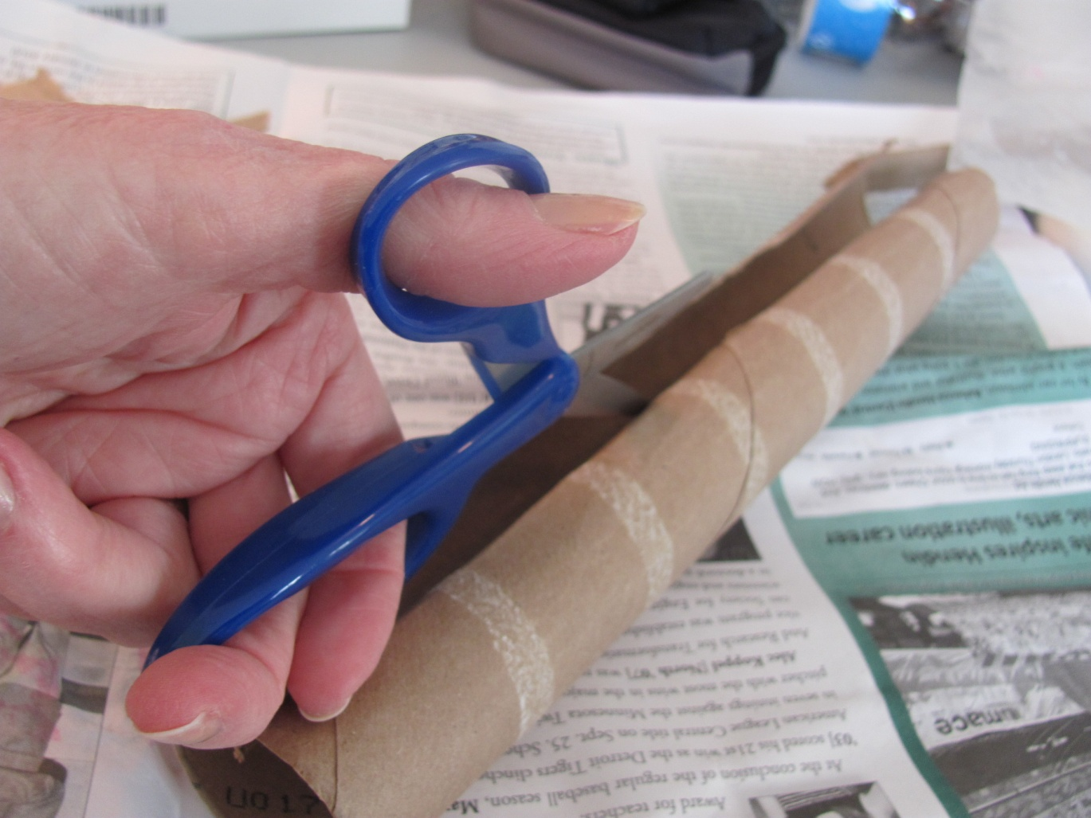
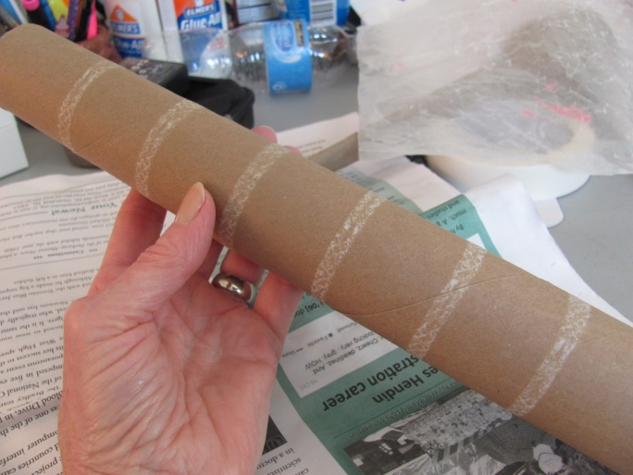
2. Cut down middle of tube

Slide 6
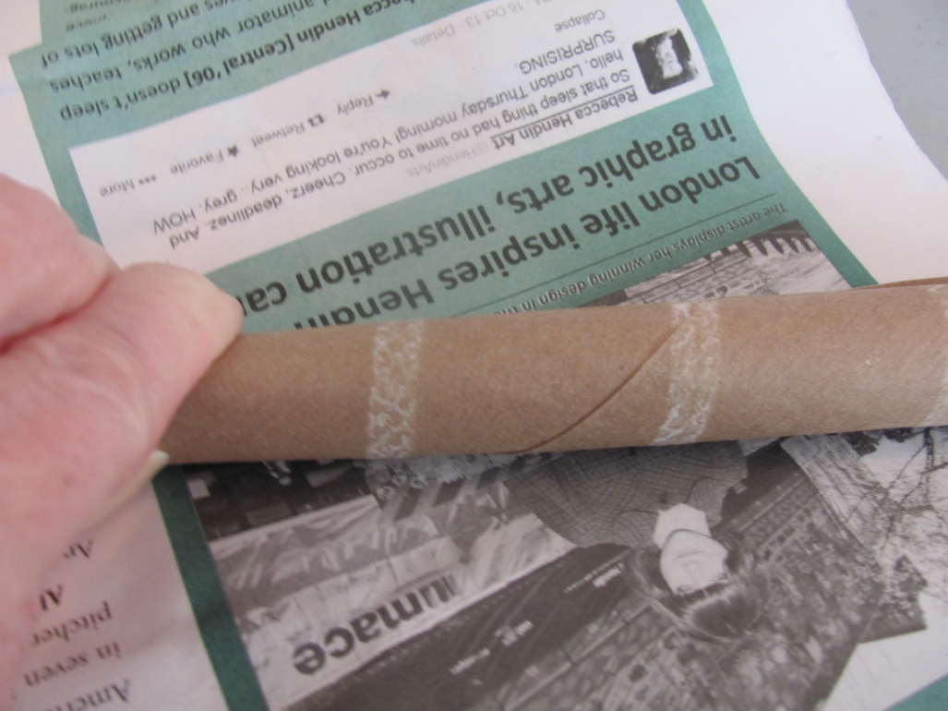
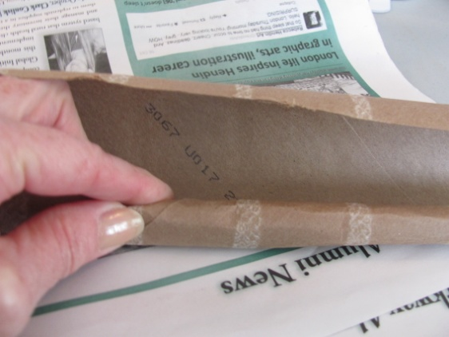
3. Roll tube up real tight!

Slide 7
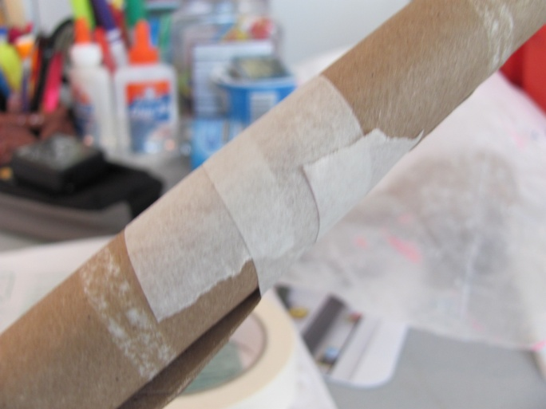
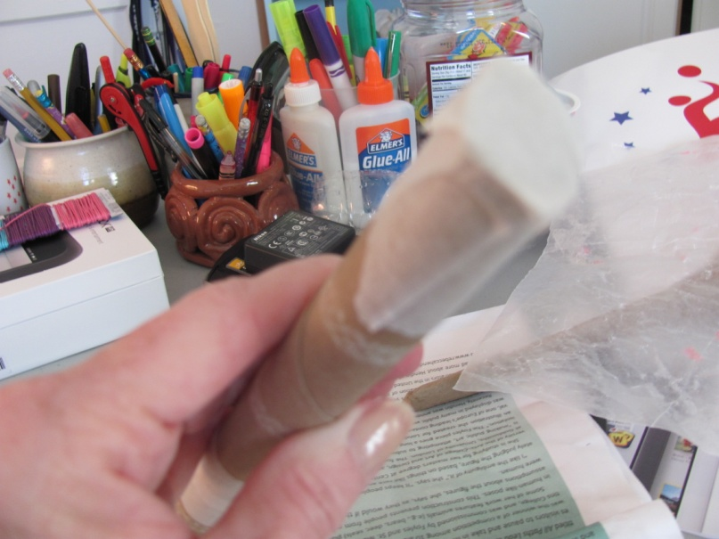
4. Tape middle of tube, tape the ends too!!

Slide 8
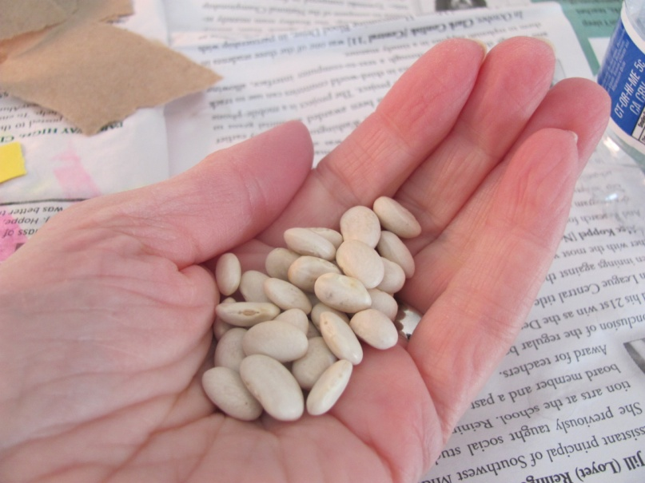
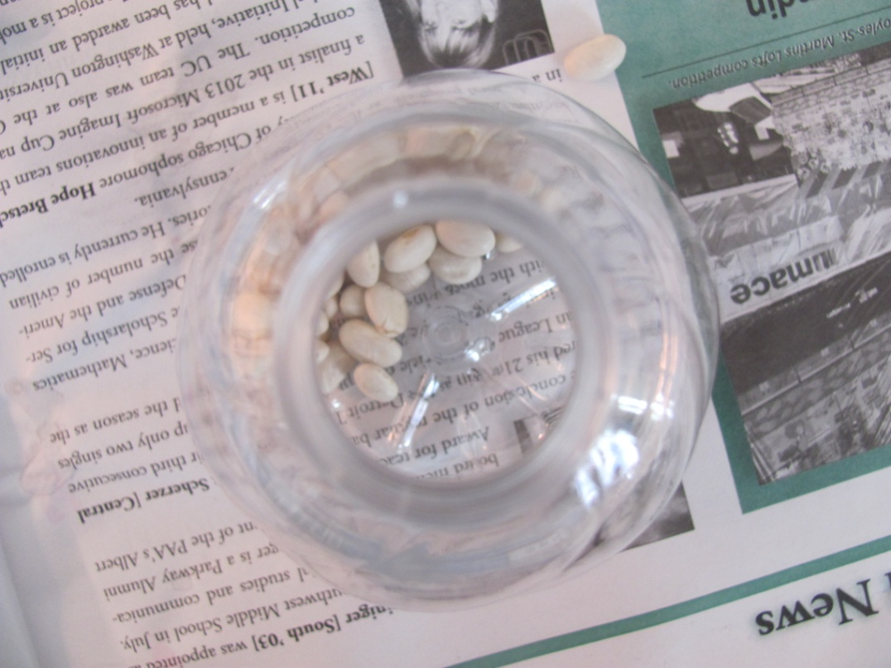
5. Add a handful of beans to the bottle

Slide 9
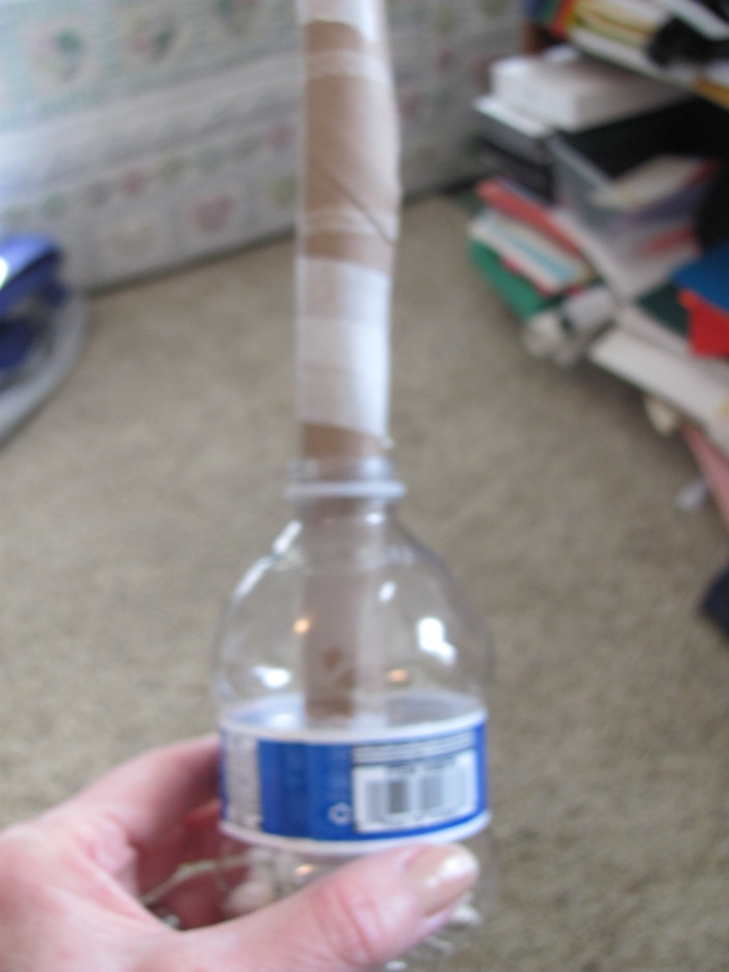
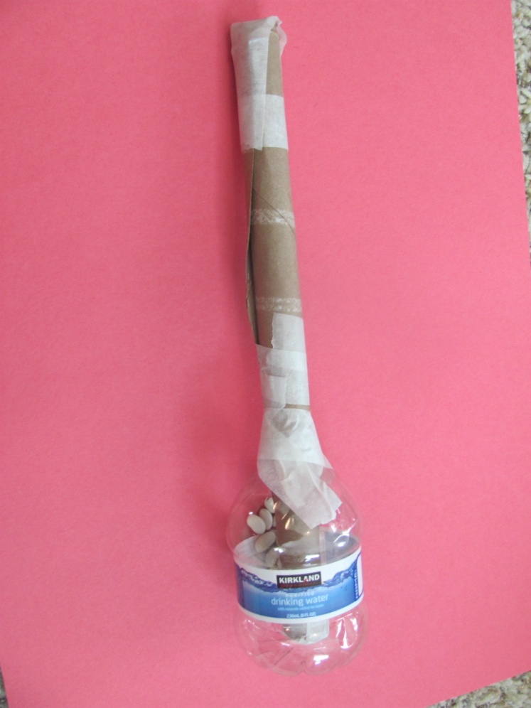
6. Put tube all the way down inside the bottle – tape them together

Slide 10
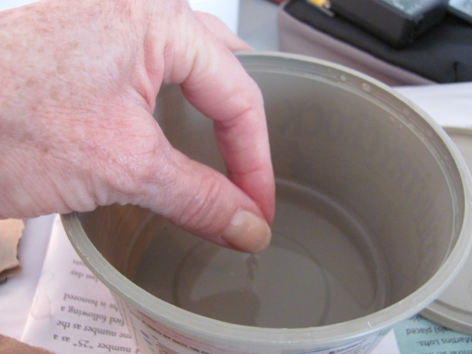
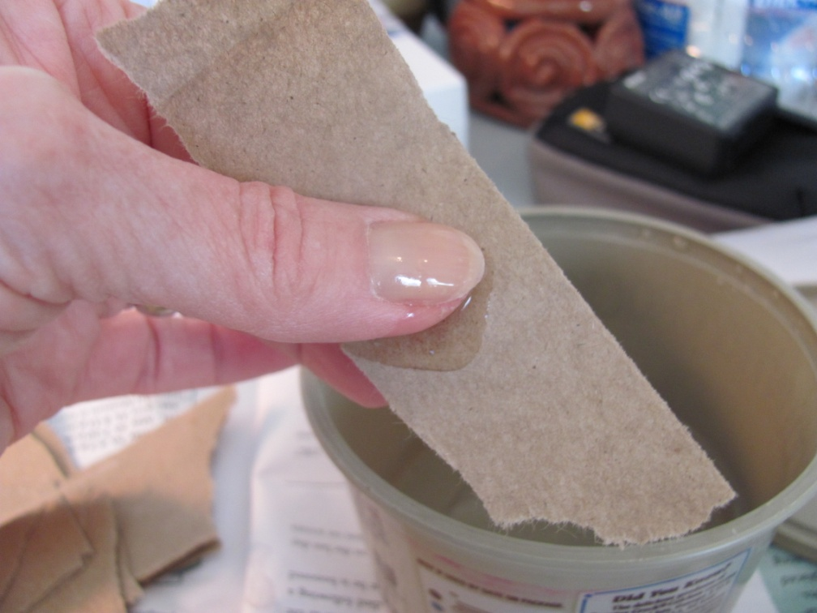
7. Get finger tips wet with a little gel, cover both sides of paper with gel – it should not be drippy wet!

Slide 11
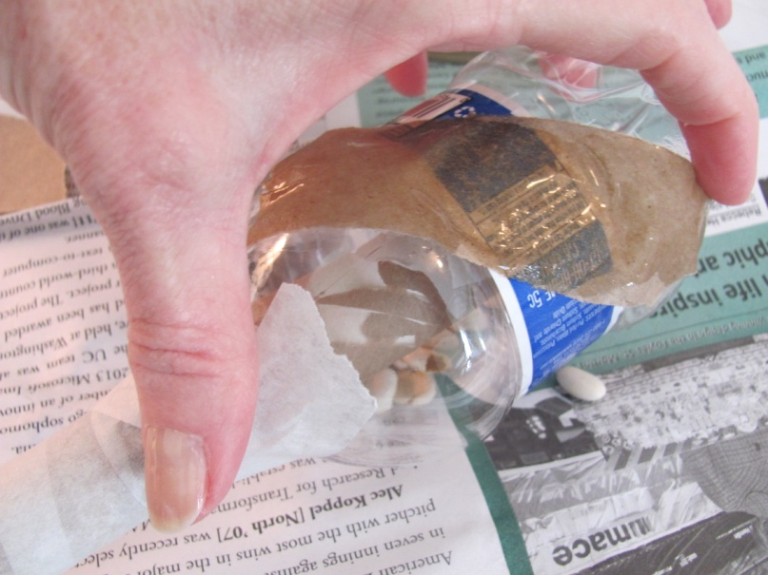
Lay on paper strips on bottle and smooth down with fingers, repeat this until the entire maraca is covered with strips.

Slide 12
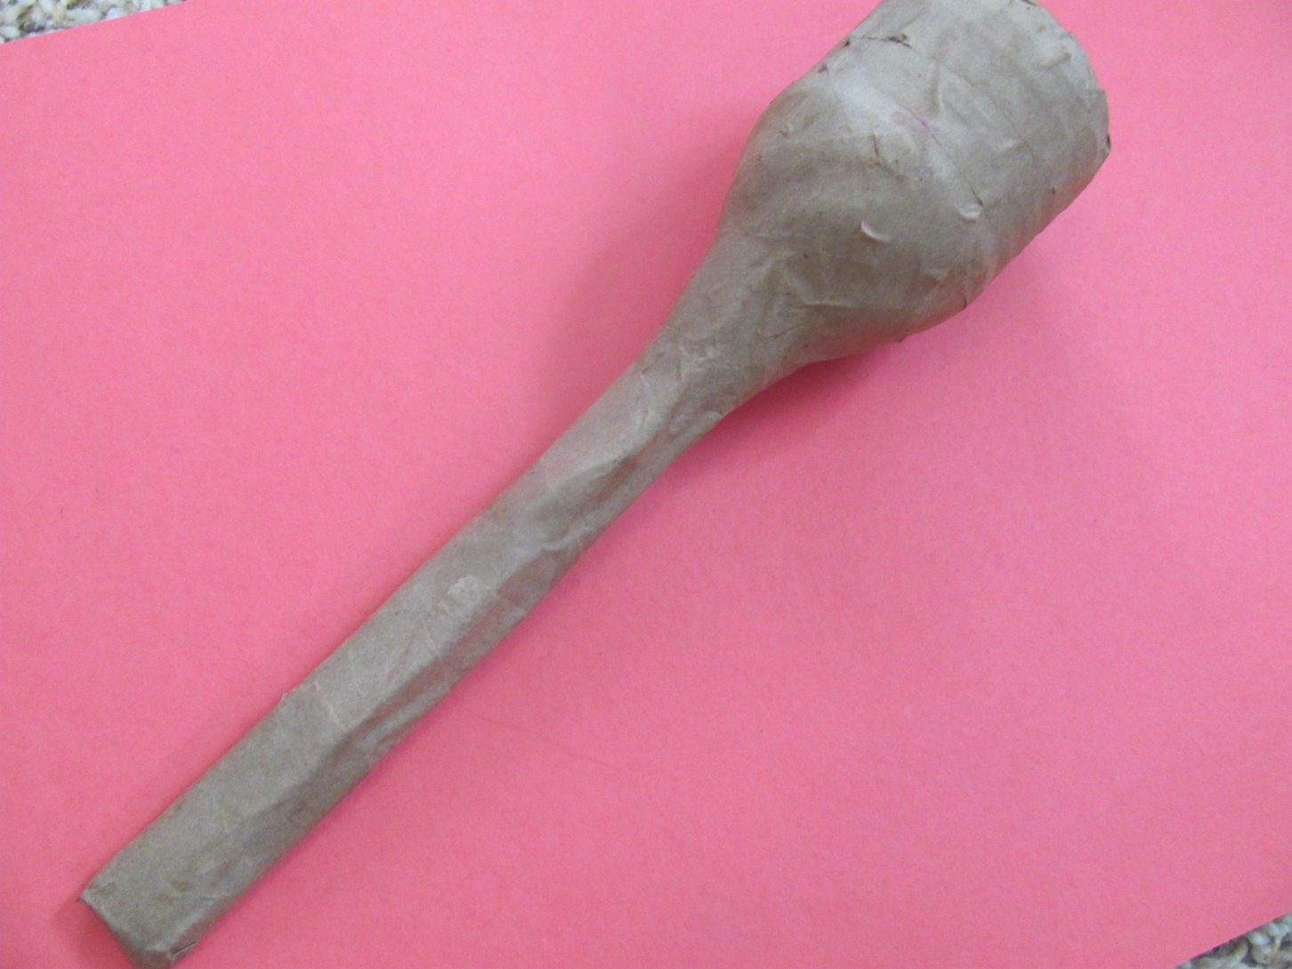
Looks like this!

Slide 13
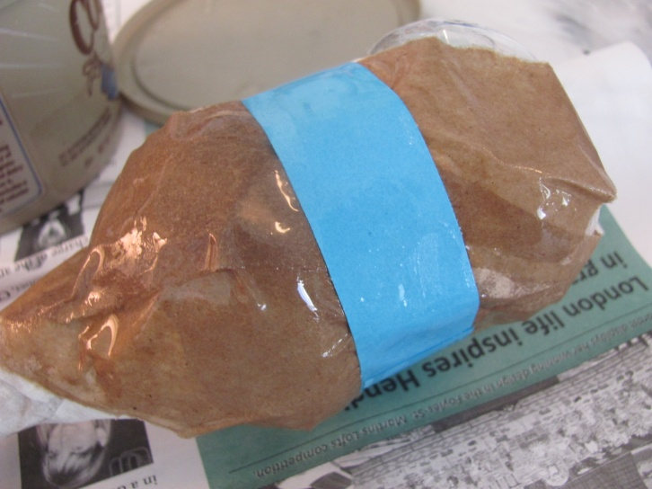
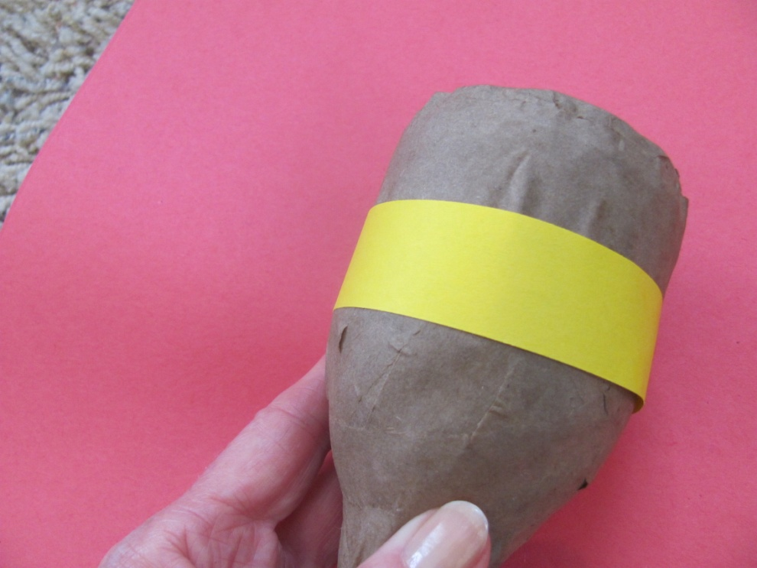
8. Papier mache a couple of colored stripes around your maracas

Slide 14
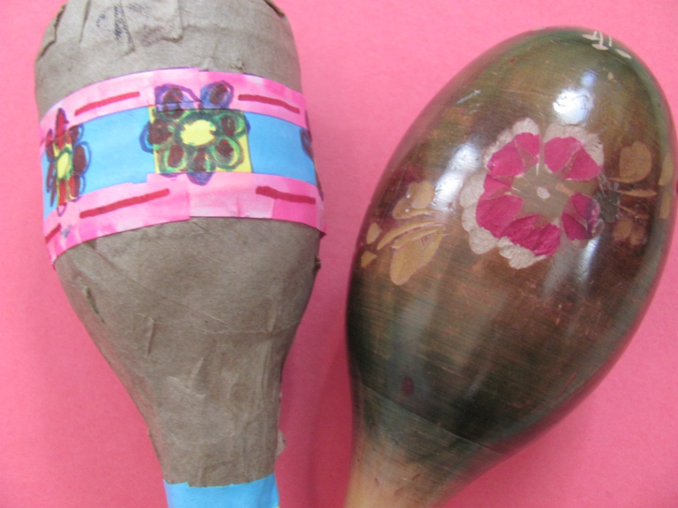
9. Put on drying table with your name tag.
We will add marker designs later!

Slide 15
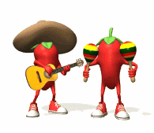
Clean your area and hands!
Follow directions on hand clean up
Return supplies – save left over glue!
Pick up trash off of floor
Throw away newspaper
Good job!!!

