Slide 1
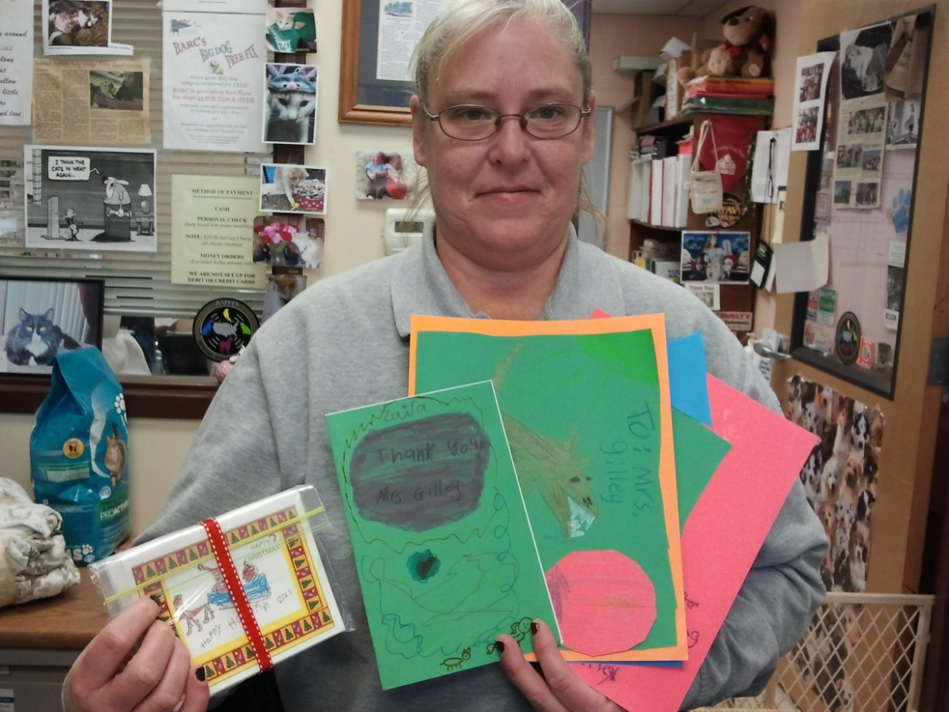
Officer Gilley received your thank you cards for coming to Blackhurst and Lincoln School with Sweetie the dog. She loved your holiday cards! She plans to show your website about PRR’s service learning project and cards to the St. Charles Police Department. They will be interested to see what you’ve been learning about concerning animal protection and care.

Slide 2
All together PRR raised $528 for the animal shelters. We will give half of the money to Five Acres and half to St. Charles Animal Shelter. How much is half?
Five Acres would like the money to use for food and medicine. St. Charles Animal Shelter would rather have pet supplies instead of money.
Both Lincoln and Blackhurst Schools get to shop today for pet supplies. Each school gets to spend half of what we are giving to St. Charles Animal Shelter. How much is that?

Slide 3
We need to invite Ms. Gilley back to Lincoln and Blackhurst Schools so we can give her things we have bought for the animal shelter. We need to invite Miss Brittany from Five Acres too!
Can someone volunteer to write both ladies a letter of invitation we can email???? Maybe they could come next week to a morning assembly????
We also need to decide what pet supplies to buy.
Today’s Learning Activity is called “Pet Supply Store”.
Work with your fellow PRR students to make a list of what to buy to give to Ms. Gilley and the dogs and cats of the St. Charles Animal Shelter.

Slide 4


1. Set up a Pet Supply Store.
2. Put price tags on everything.
3. Use the play money to shop for things the animal shelter needs.
4. Decide on a fair way for everyone to spend the money!
5. Someone needs to make a list on the board to keep track of what you want to buy.
6. Turn in the list to your PRR teacher. They will go to the Dollar Store and buy the things on your list.

Slide 5
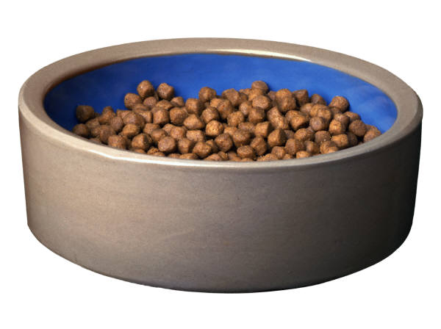
Next week you will get to give your real pet supplies to Ms. Gilley personally when she comes to your school! She will be so surprised at all your hard work!!

Slide 6
Be a Big 3 PRR Student!
Use nice voices. Listen to each other.
Let everyone have a say. Be fair.
Think about what the animals need to live healthy lives.
Treat the supplies with respect!
They cost a lot of money!!!!!!

Slide 7
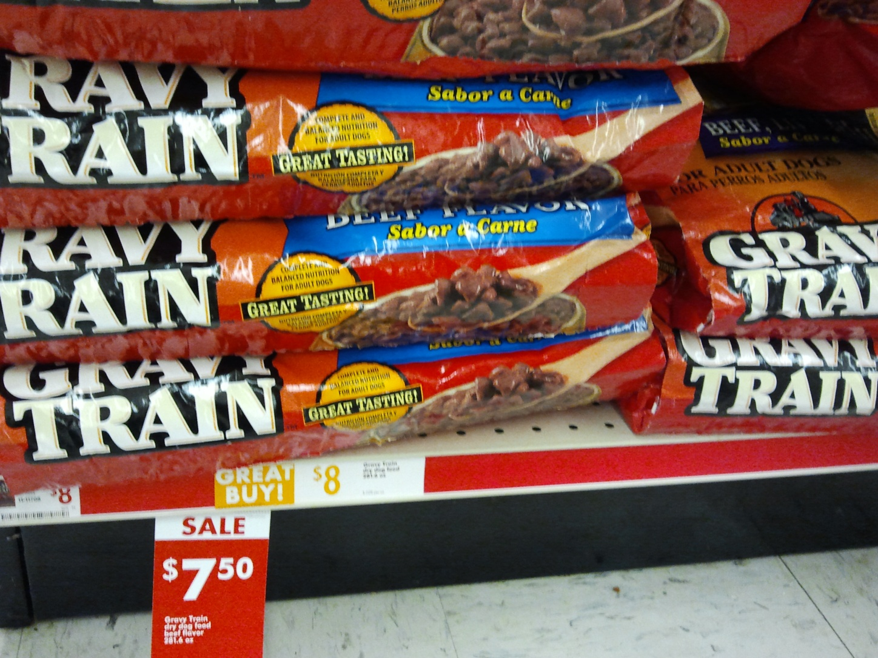
Big bags of dog food - $7.50 each 18 pounds of food in each bag

Slide 8
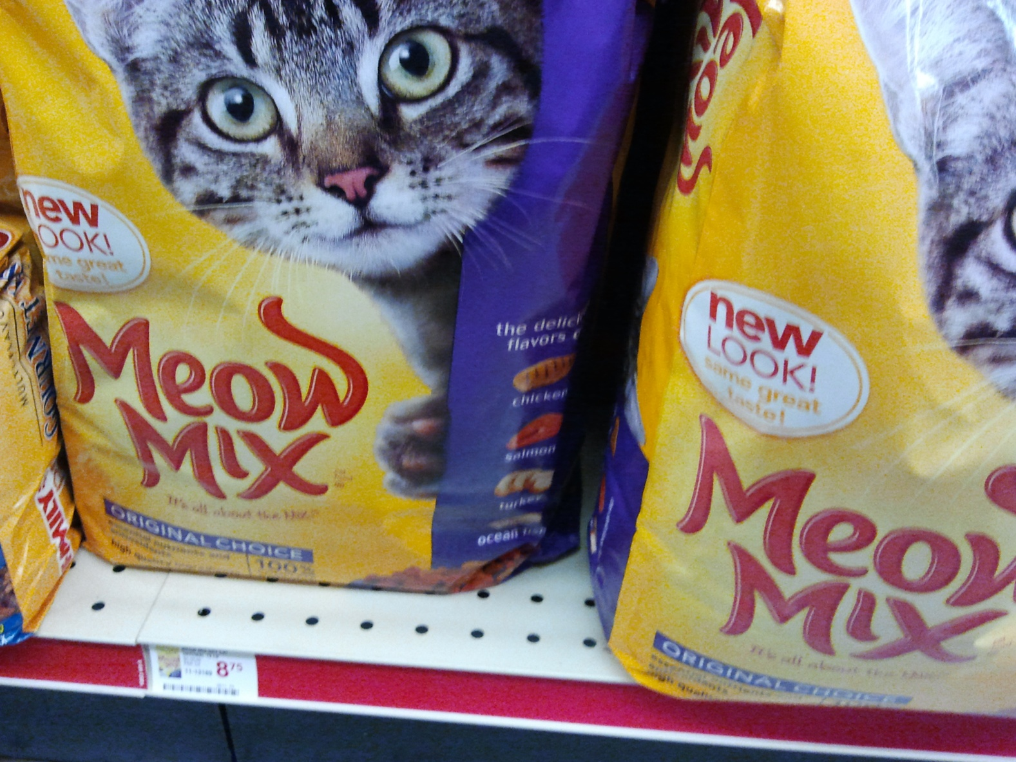
Big Bags of cat food - $10 each 10 pounds of food in each bag

Slide 9
Dog Collars
Four sizes:
Small - $1
Medium $2
Large $2
Extra Large $3

Slide 10
Kitten Chow
$1.85

Slide 11
Puppy Chow
$4.75

Slide 12
Cat Food in a Can
3 Cans for $1

Slide 13
Squeekie Dog Toys
$1

Slide 14
Dog Balls
$1

Slide 15
Dog Leash
$2

Slide 16
Soap for Pet Baths
$2

Slide 17
Cat Toys
$1

Slide 18
Small cat/dog bowl
$1

Slide 19
Medium dog bowls
$1.50

Slide 20
Kitty Cube Toy
$4

Slide 21
Doggie Bisquits
$2.75

