Slide 1
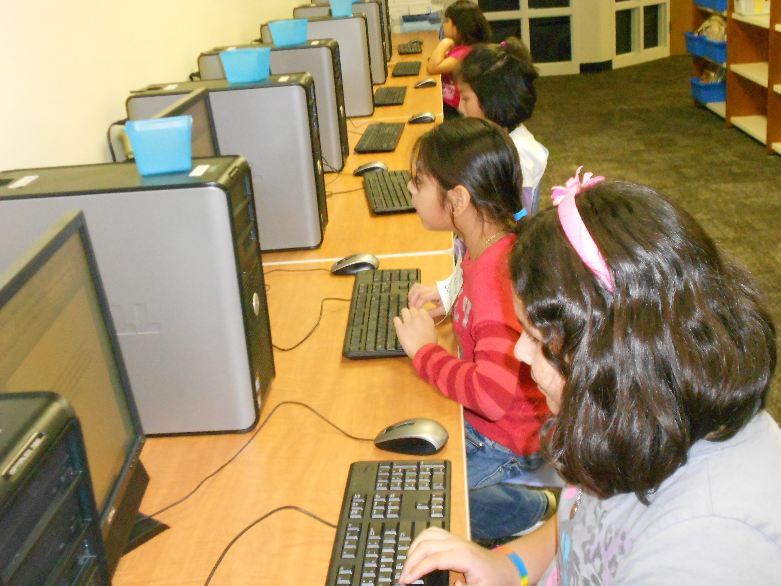

How PRR works!
PRR Training for Kids
Notes:
For all procedures please use the following motto: Teach, Practice, Reteach, Practice if needed, Reteach and Practice again.

Slide 2
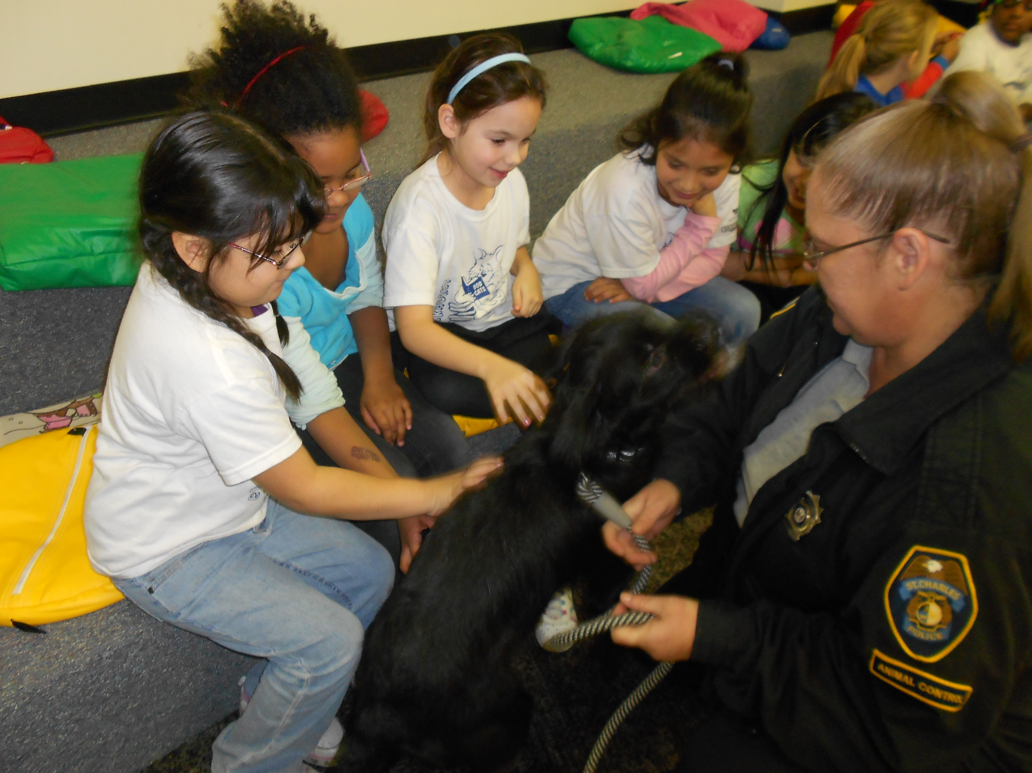
Our Mission is to prepare kids for
“real life”!
Help students become
better readers
Help students become good leaders through character education training in respect, responsibility, honesty, kindness, and other traits
Help students become “global citizens” through service to others
Help students learn about healthy choices

Slide 3
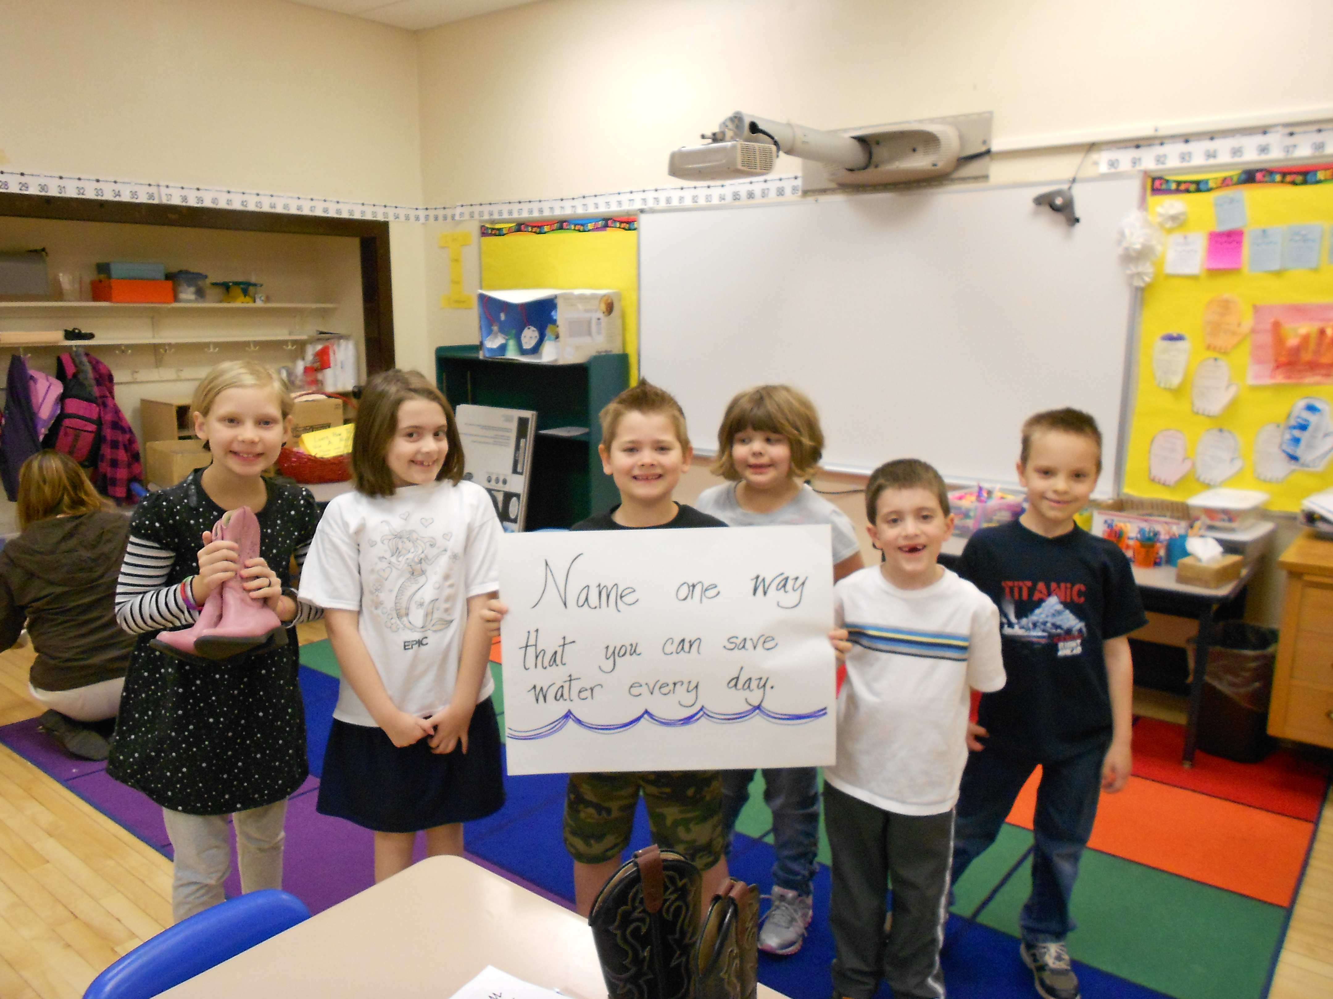
Our Motto:
“We read. We lead. We Serve!”

Slide 4
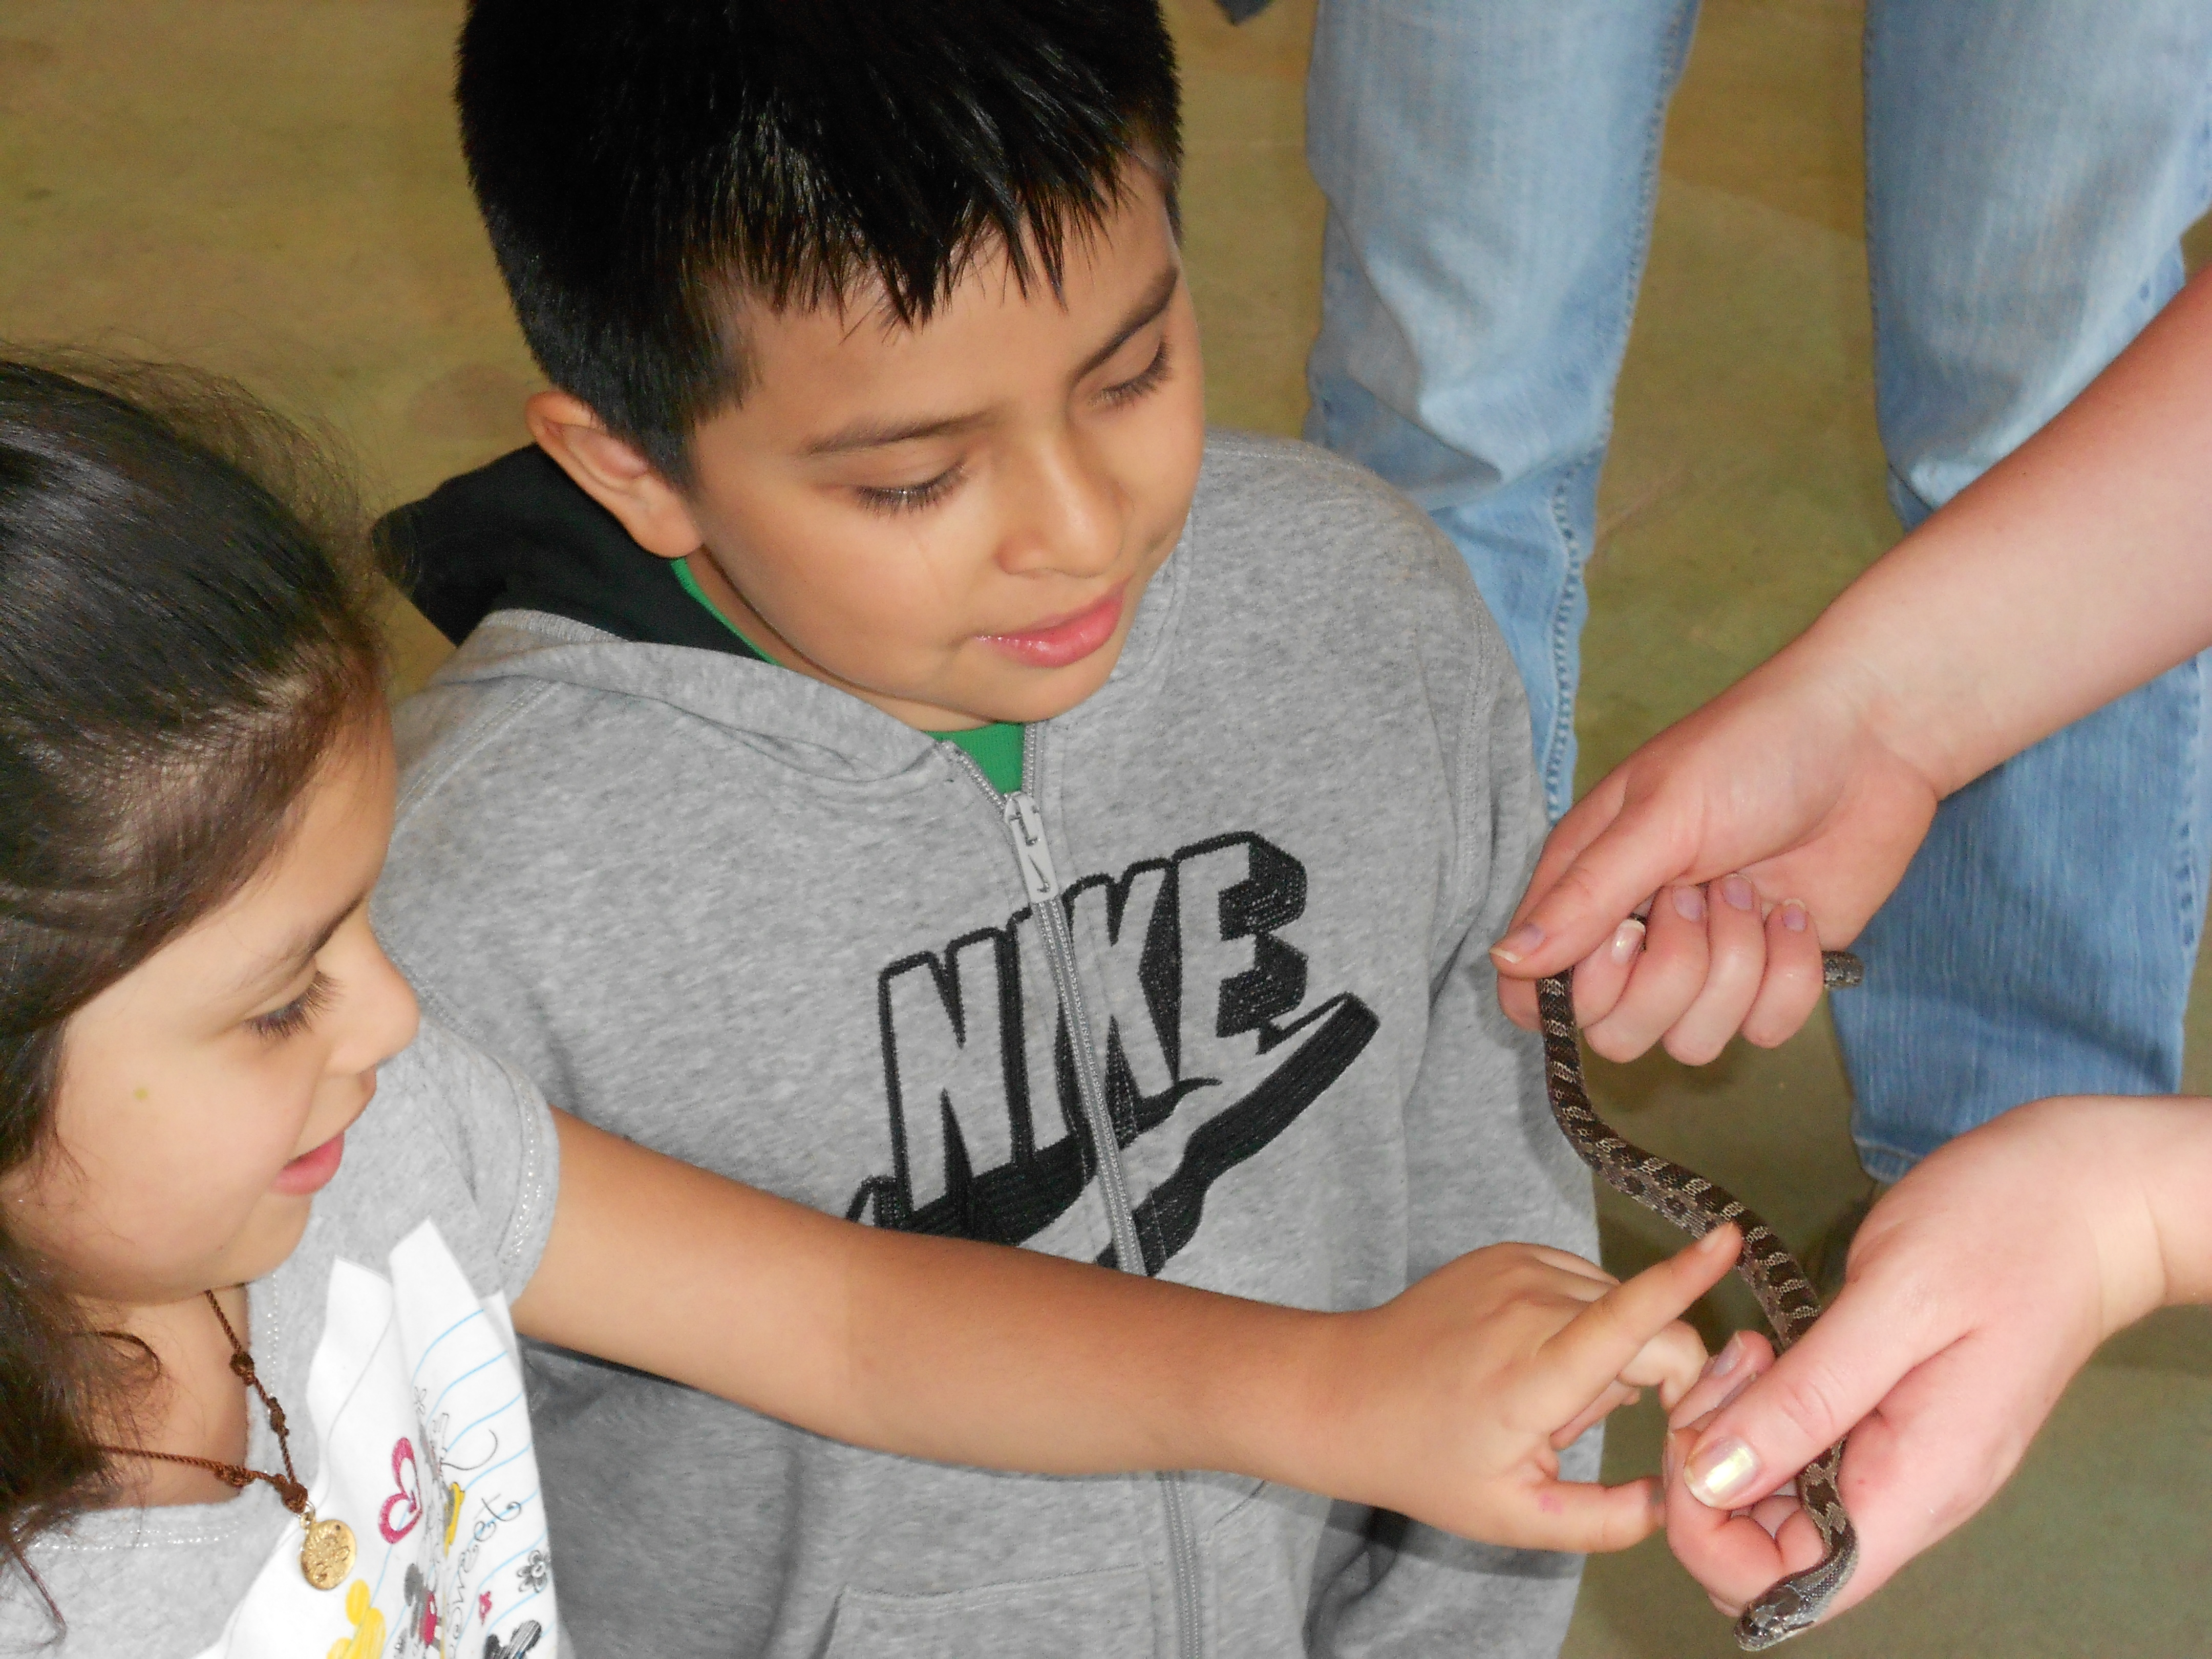
What to expect in PRR
Reading books on Nooks, activities and games, physical exercise, and homework help
To feel safe and respected by all
Opportunities for learning about and solving big community and world problems!
Field Trips to real life learning events!

Slide 5
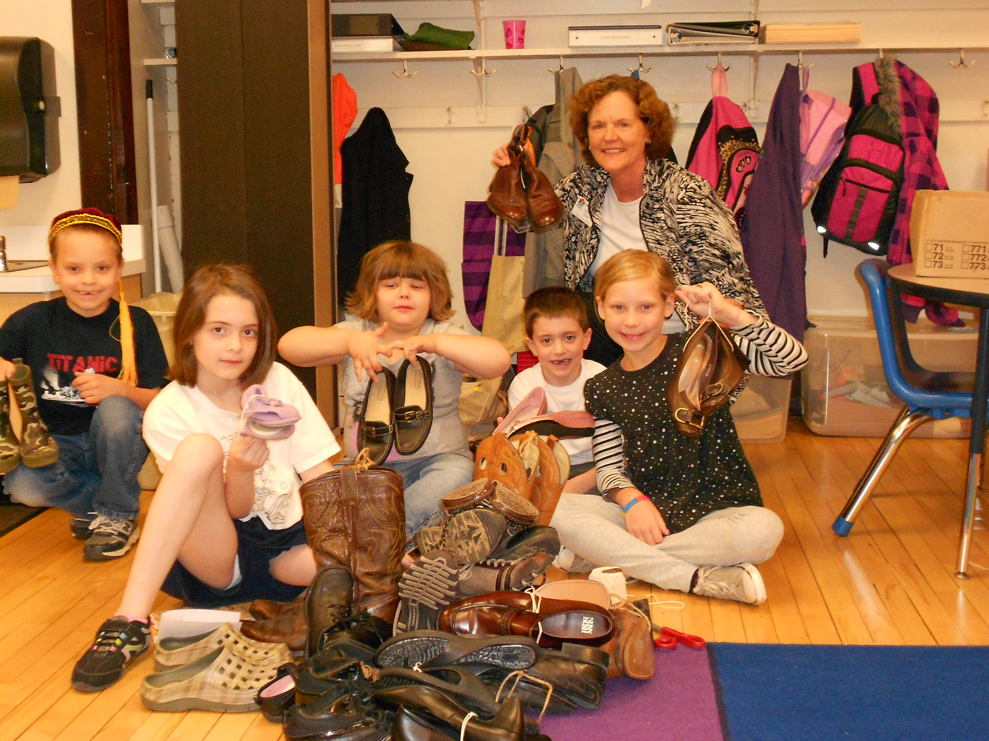
Our Week In PM PRR
Monday – What’s in the News????
Tuesday- Science/Technology/Engineering/Math
Wednesday – Wellness Wednesdays/Catch Healthy Habits
Thursday – Service
Learning
Friday – Funtastic
Fridays!

Slide 6
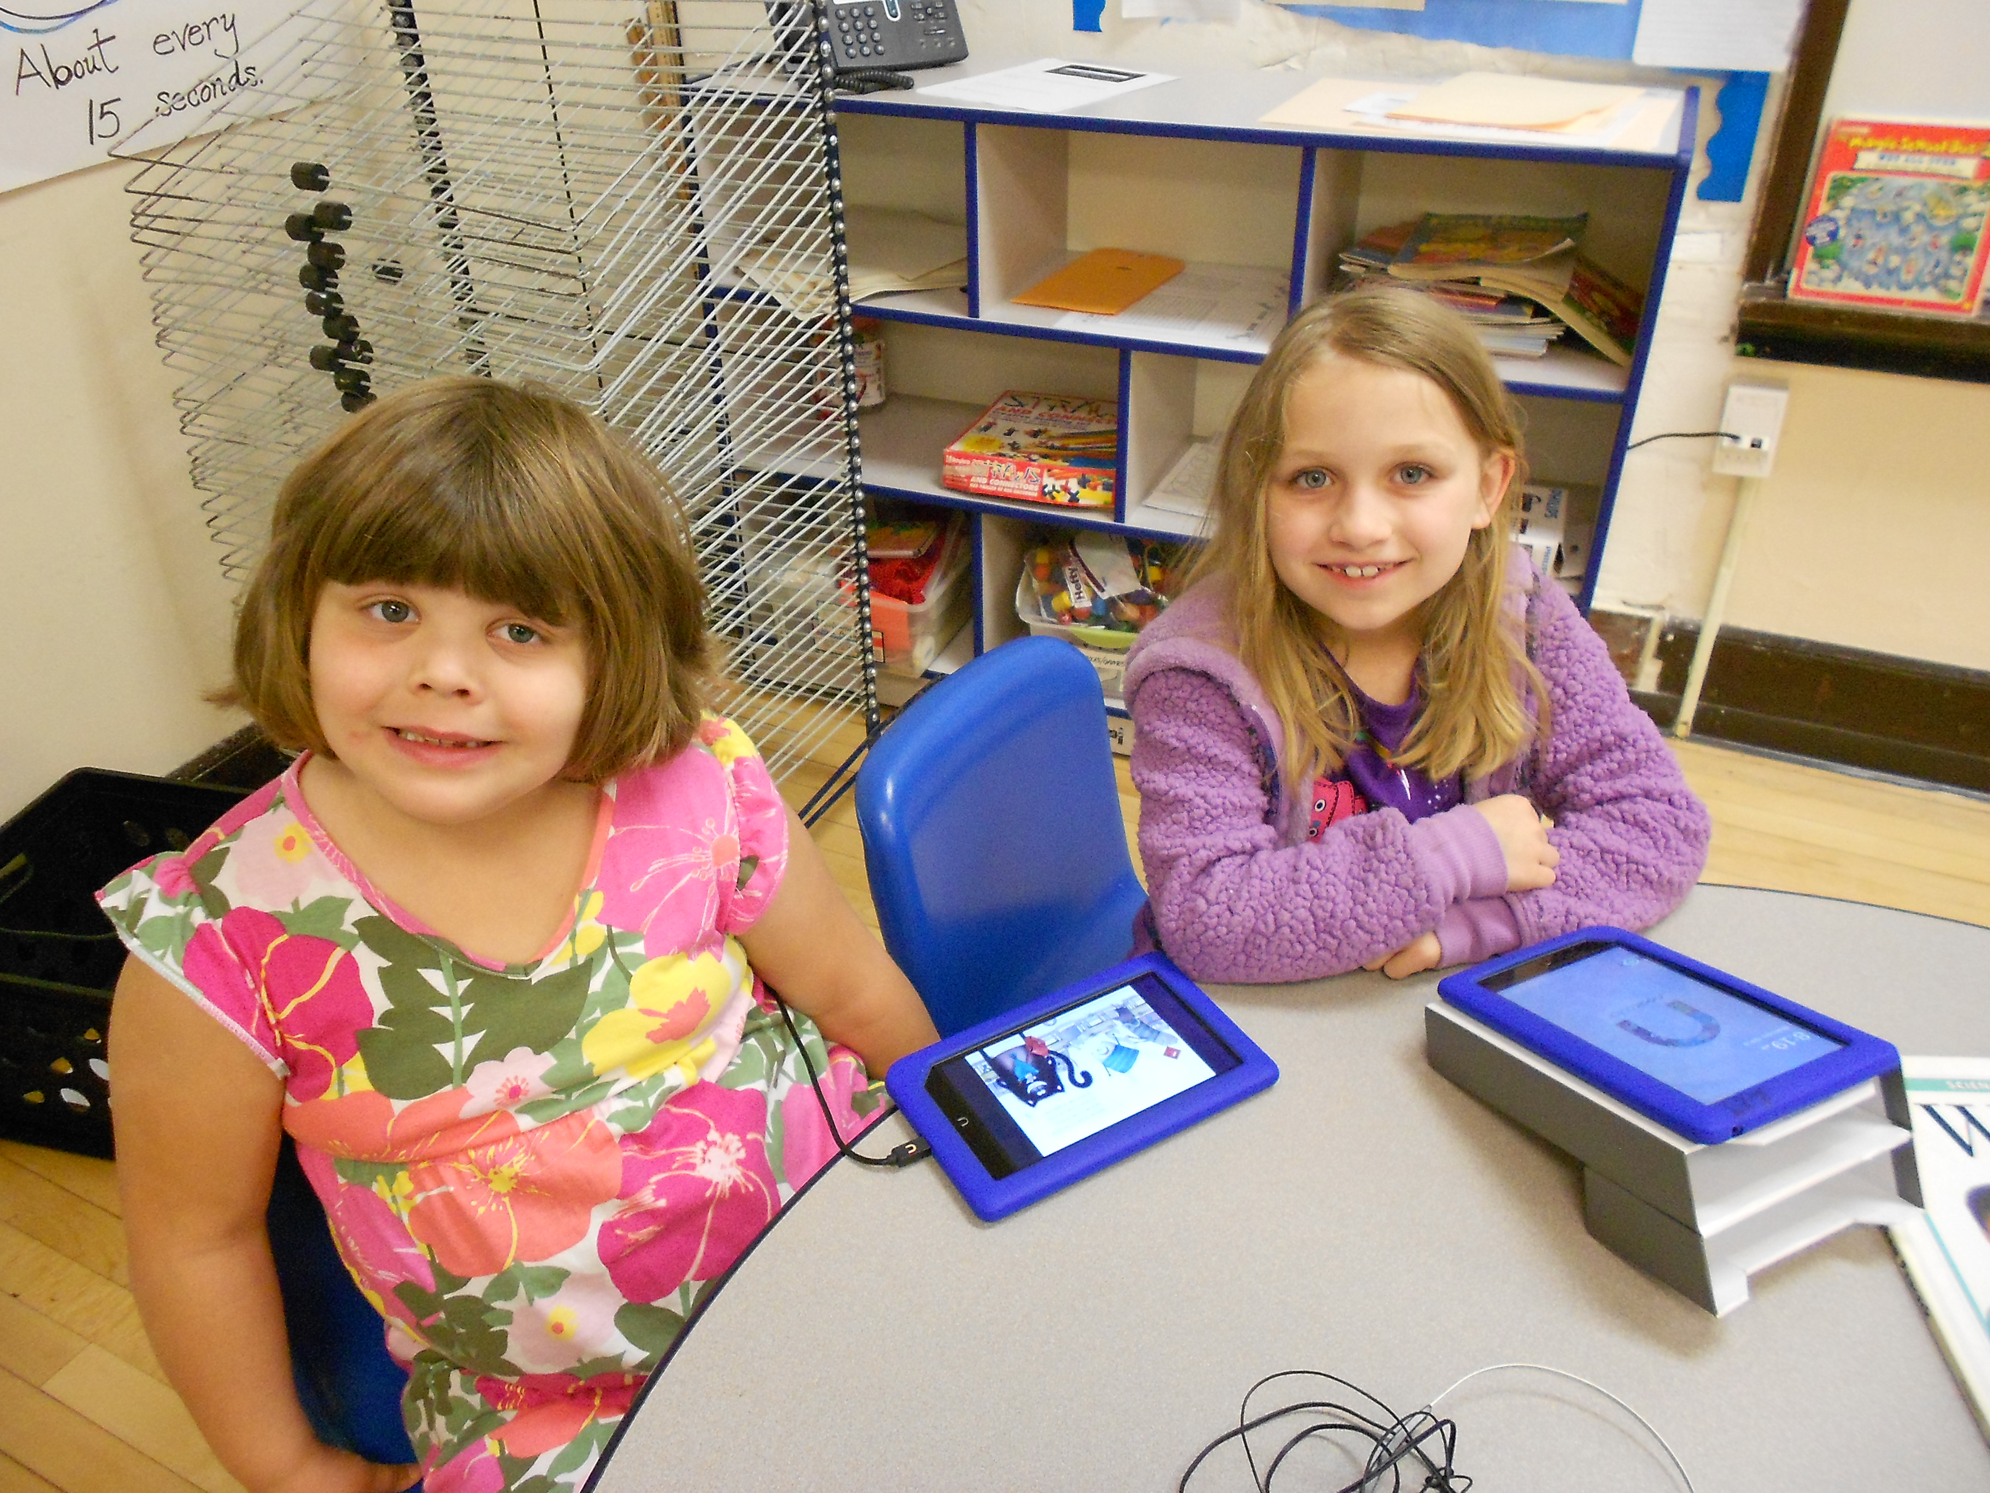
Everyday in AM PRR
Nook Time
Homework Time
Activities in
Character Education
and Service Learning

Slide 7
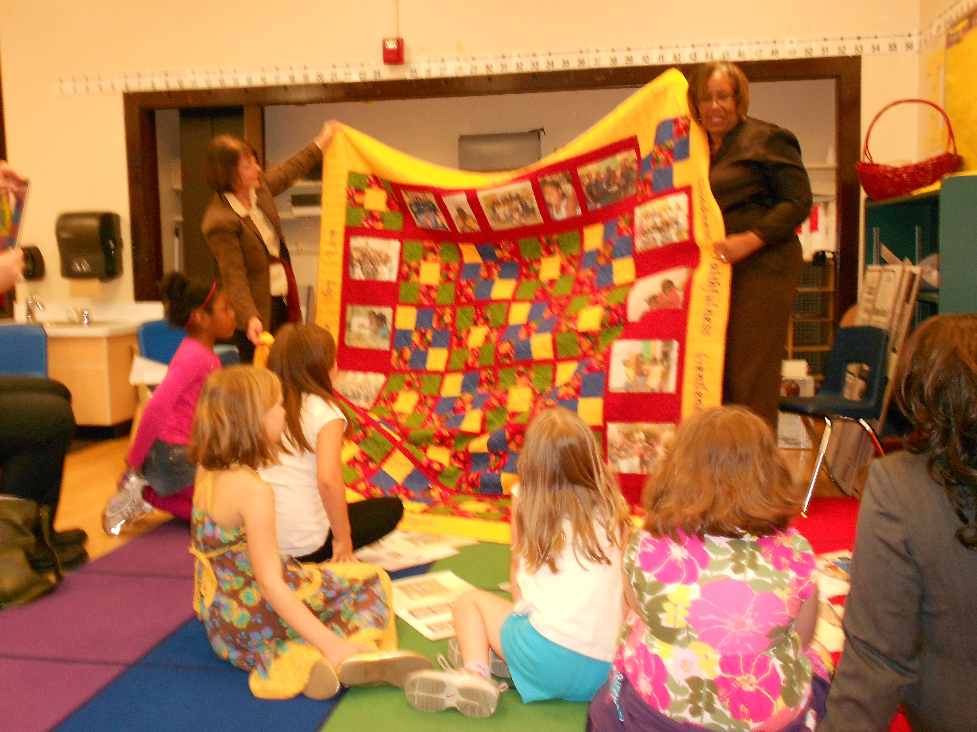
Everyday in PM PRR
Check In Time
Homework/Nook reading time
Bathroom break
Movement time
Learning time
Snack

Slide 8
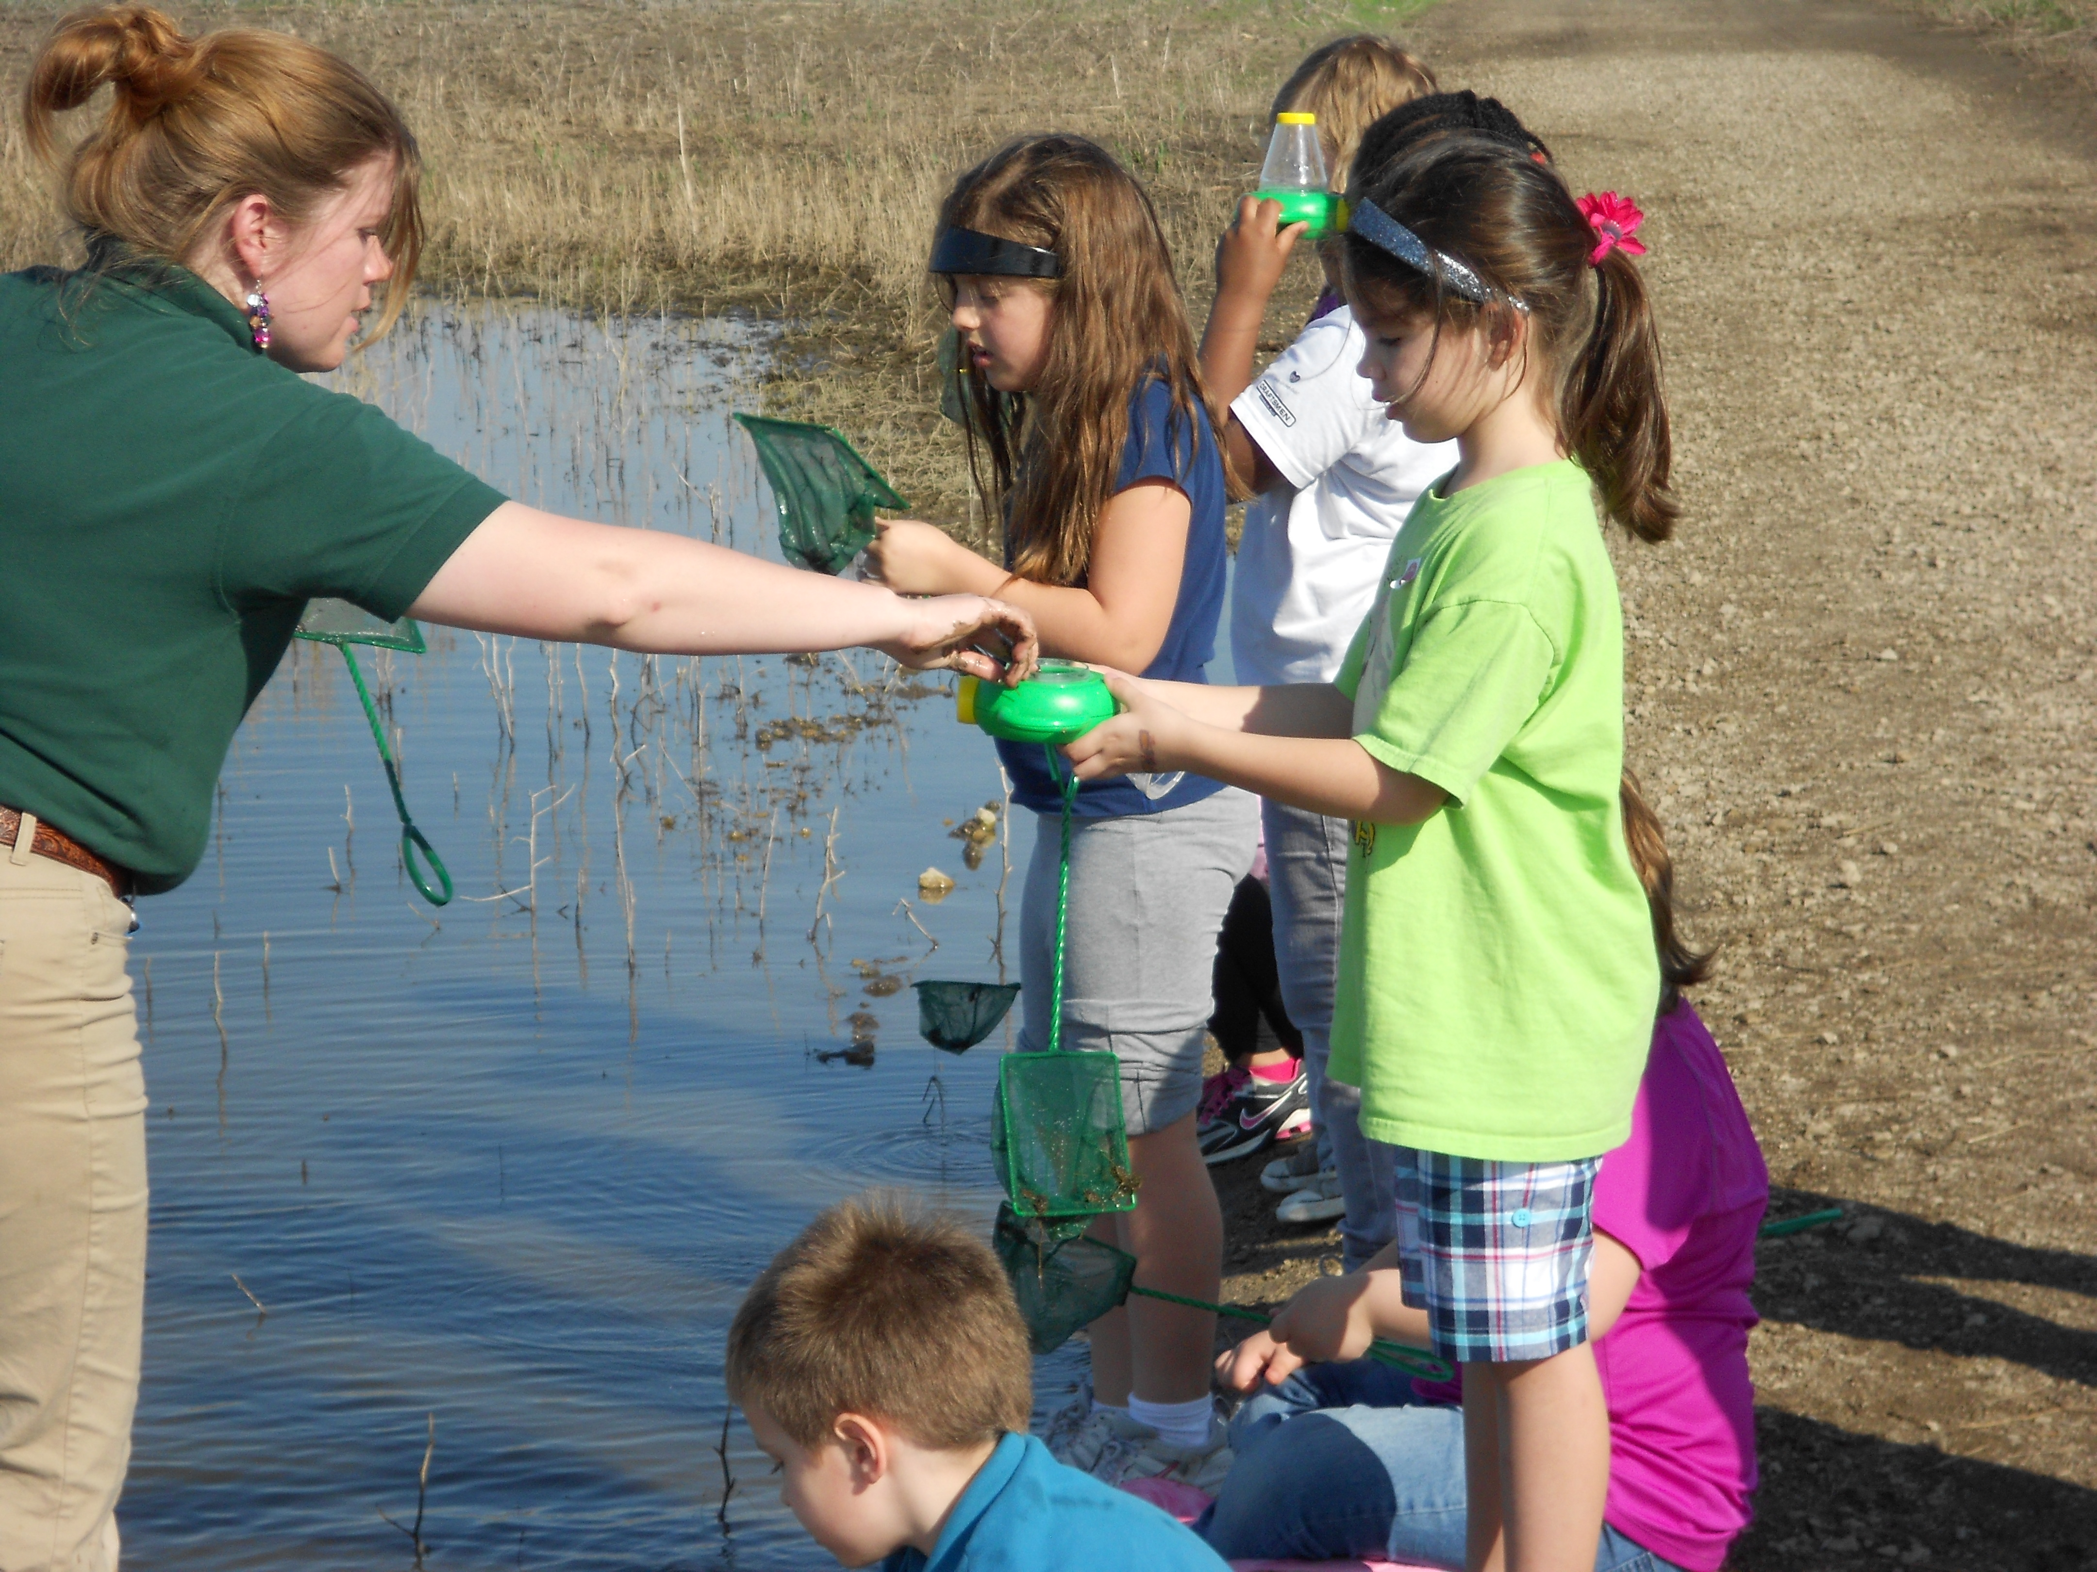
Special Times
Field trips to museums, parks, community places
Guest Speakers from the community
Making special projects for others to watch and learn from PRR
Morning Assembly
Presentations
Art Class
Computer Lab
Special Team Projects

Slide 9
What PRR Expects of Students
Be safe, be respectful, be ready to learn
To follow the daily schedule
To use “I” messages to resolve a problem with another student
To follow the PRR class rules
To clean up on time
To be respectful to visitors of PRR

Slide 10
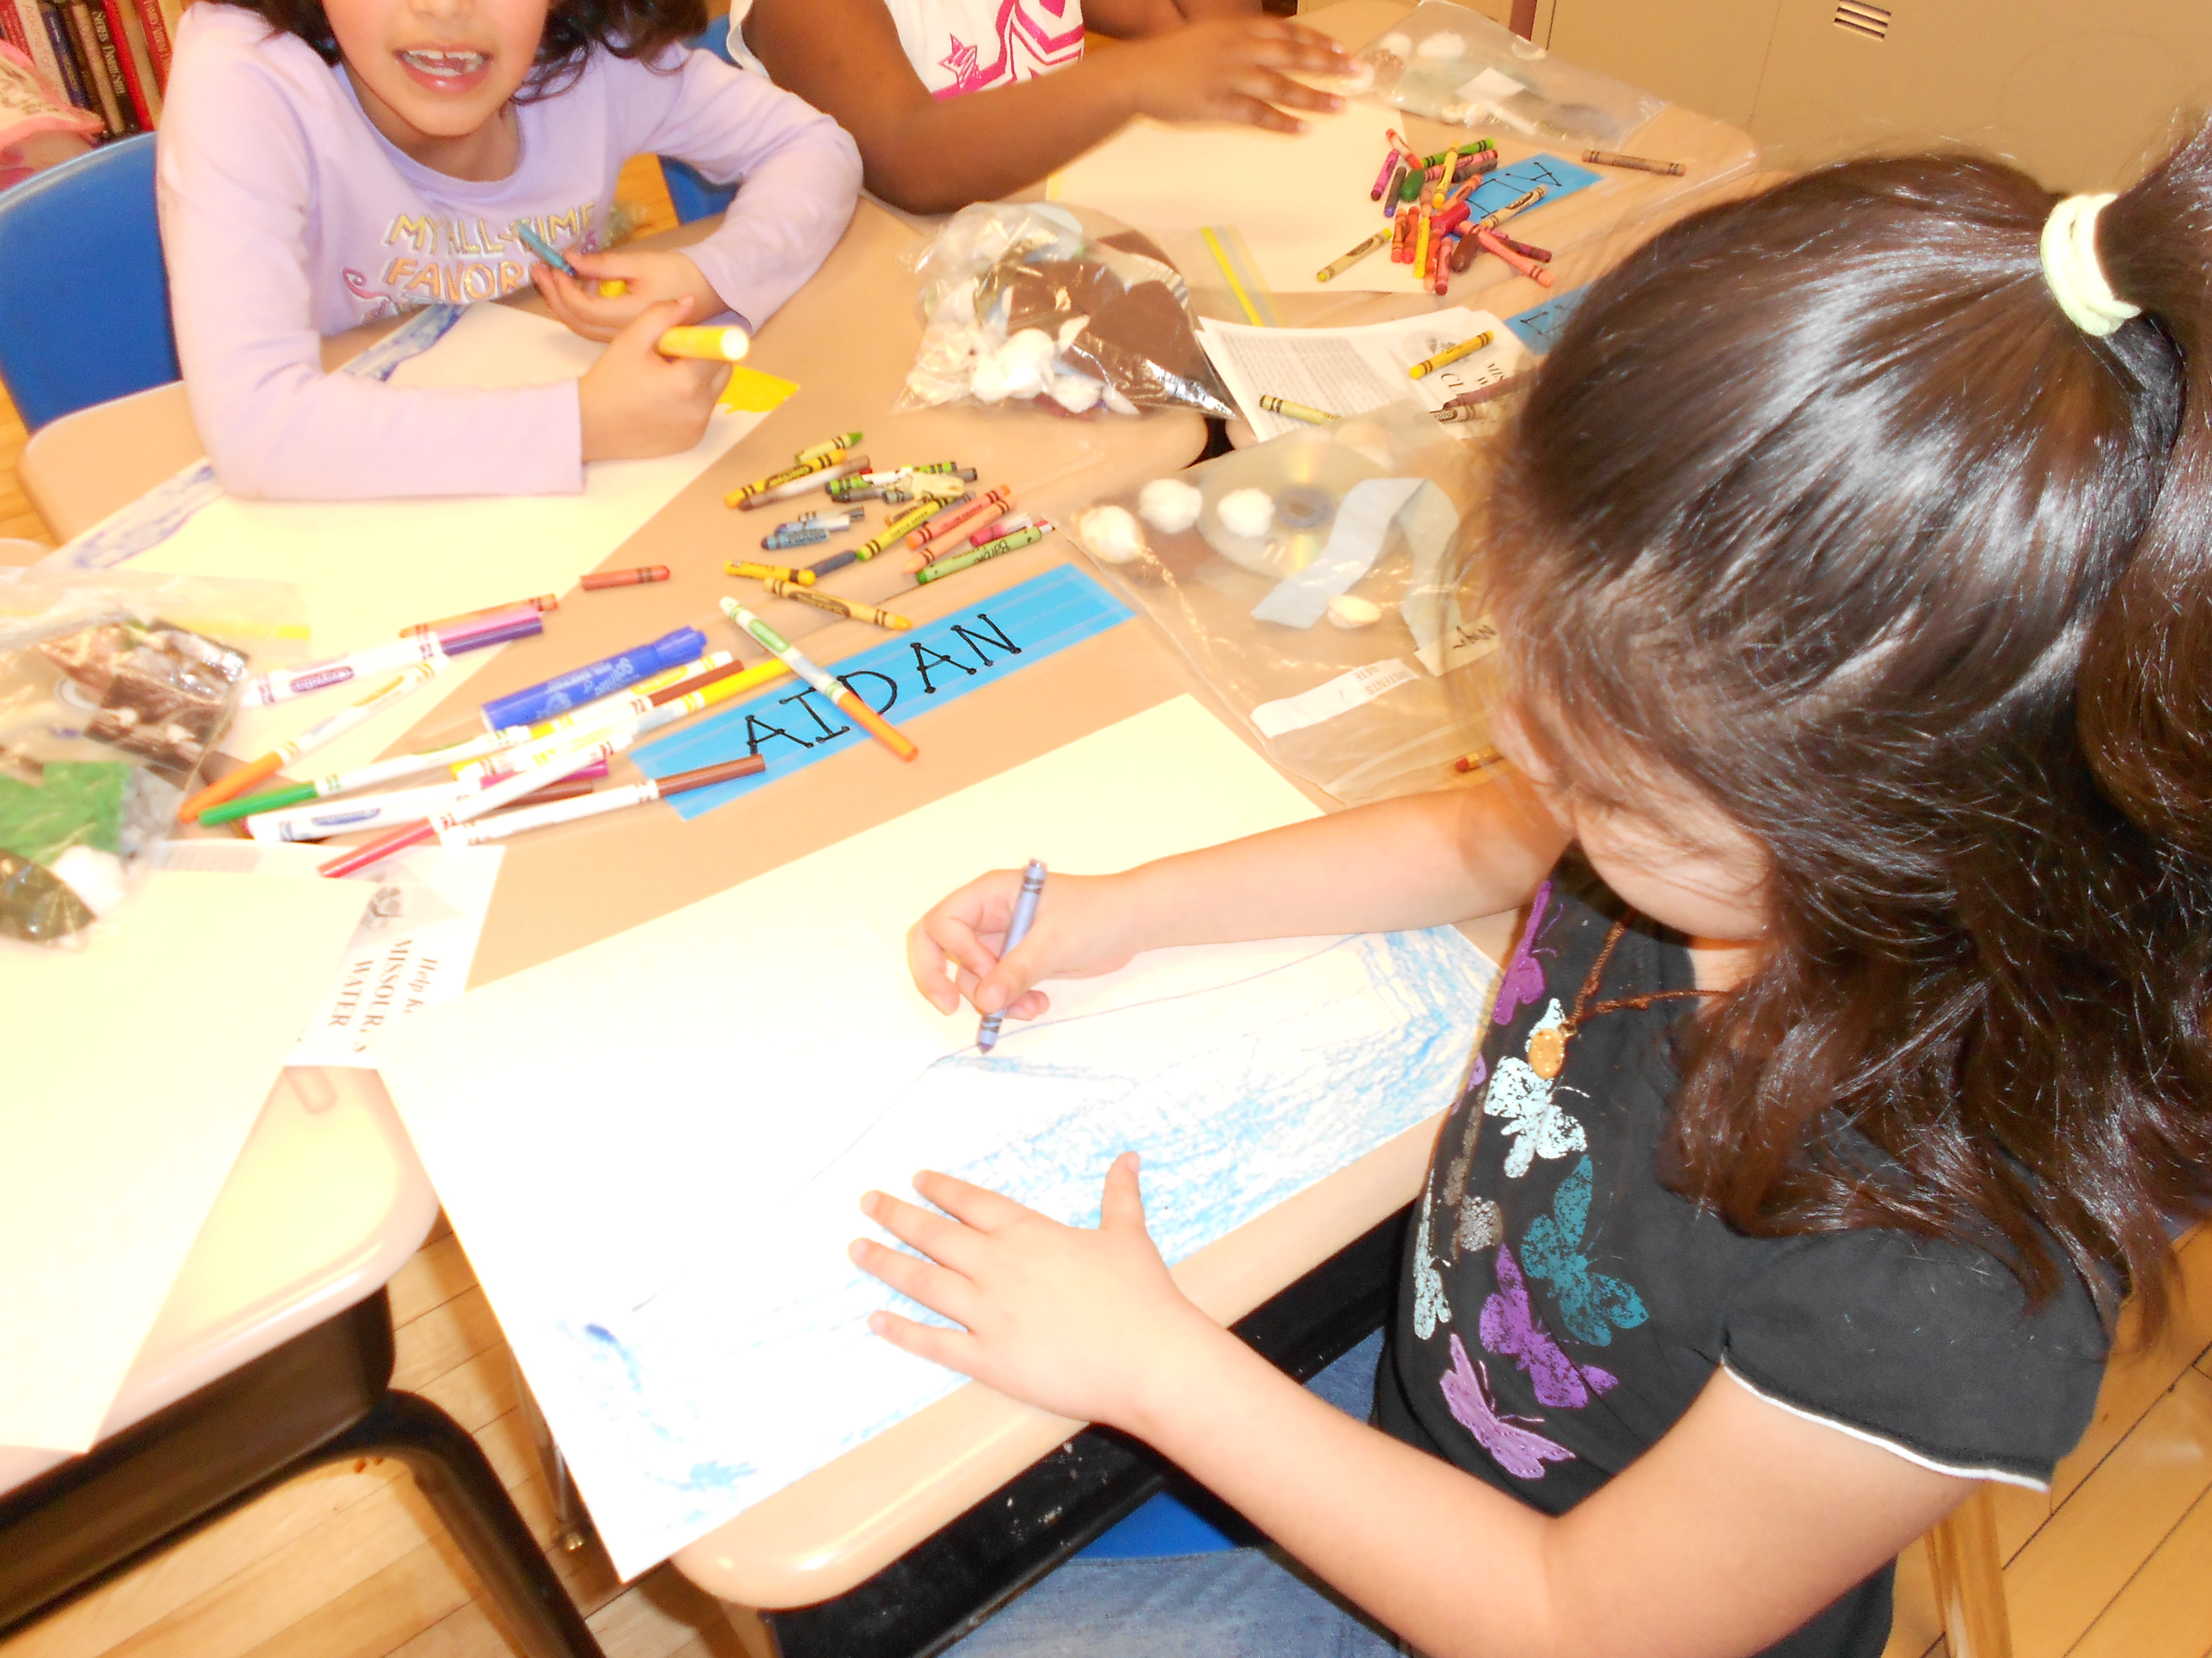
PRR Basics
“Class, class!” “Yes, yes!”
Quiet when walking place to place in the building
One person talking at a time during learning time
Quiet indoor voices in the PRR classroom area

Slide 11

Consequences for
Behavior Issues
Think Sheet - parents get a copy
Time out from an activity
Loss of Nook time
Loss of a field trip

Slide 12
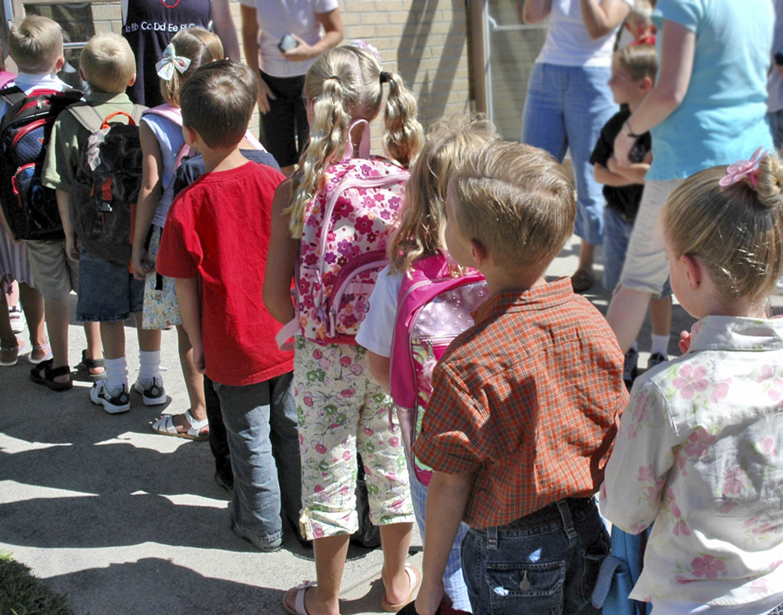
Discipline Policy
PRR follows Lincoln and Blackhurst School discipline policies for student behavior. Inappropriate school behavior will be recorded and students will meet with the PRR teacher, PRR director, and parents. Appropriate consequences will be determined.
Notes:
PRR is a FUN extension to the school day but we must have everyone's cooperation (express this to the children)

Slide 13
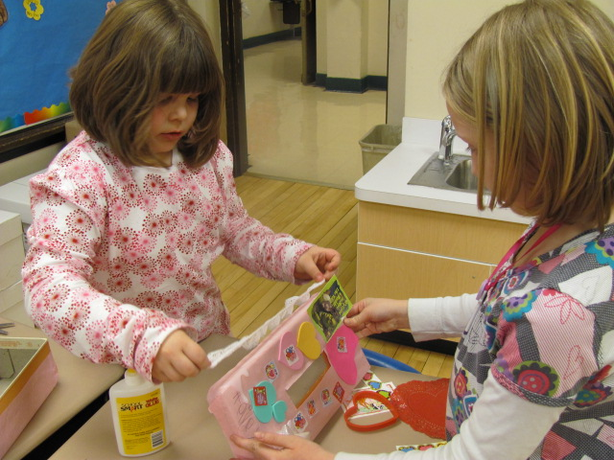
Helpers
There will be helpers of the day.
Notes:
Discuss with your students how you plan to have helpers each day.

Slide 14
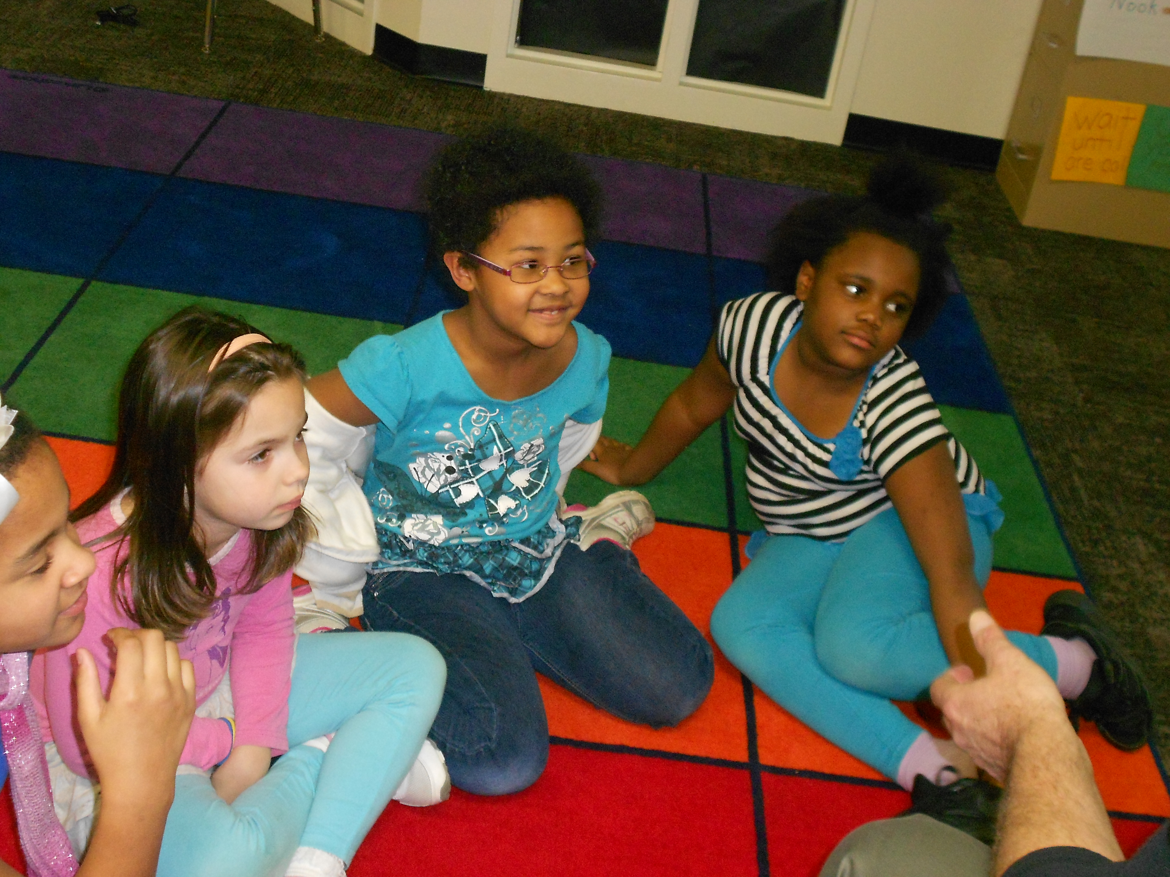
Special Seats and Carpets
Each PRR Kid will have a special seat and place to sit on their personal “magic” carpets!

Slide 15
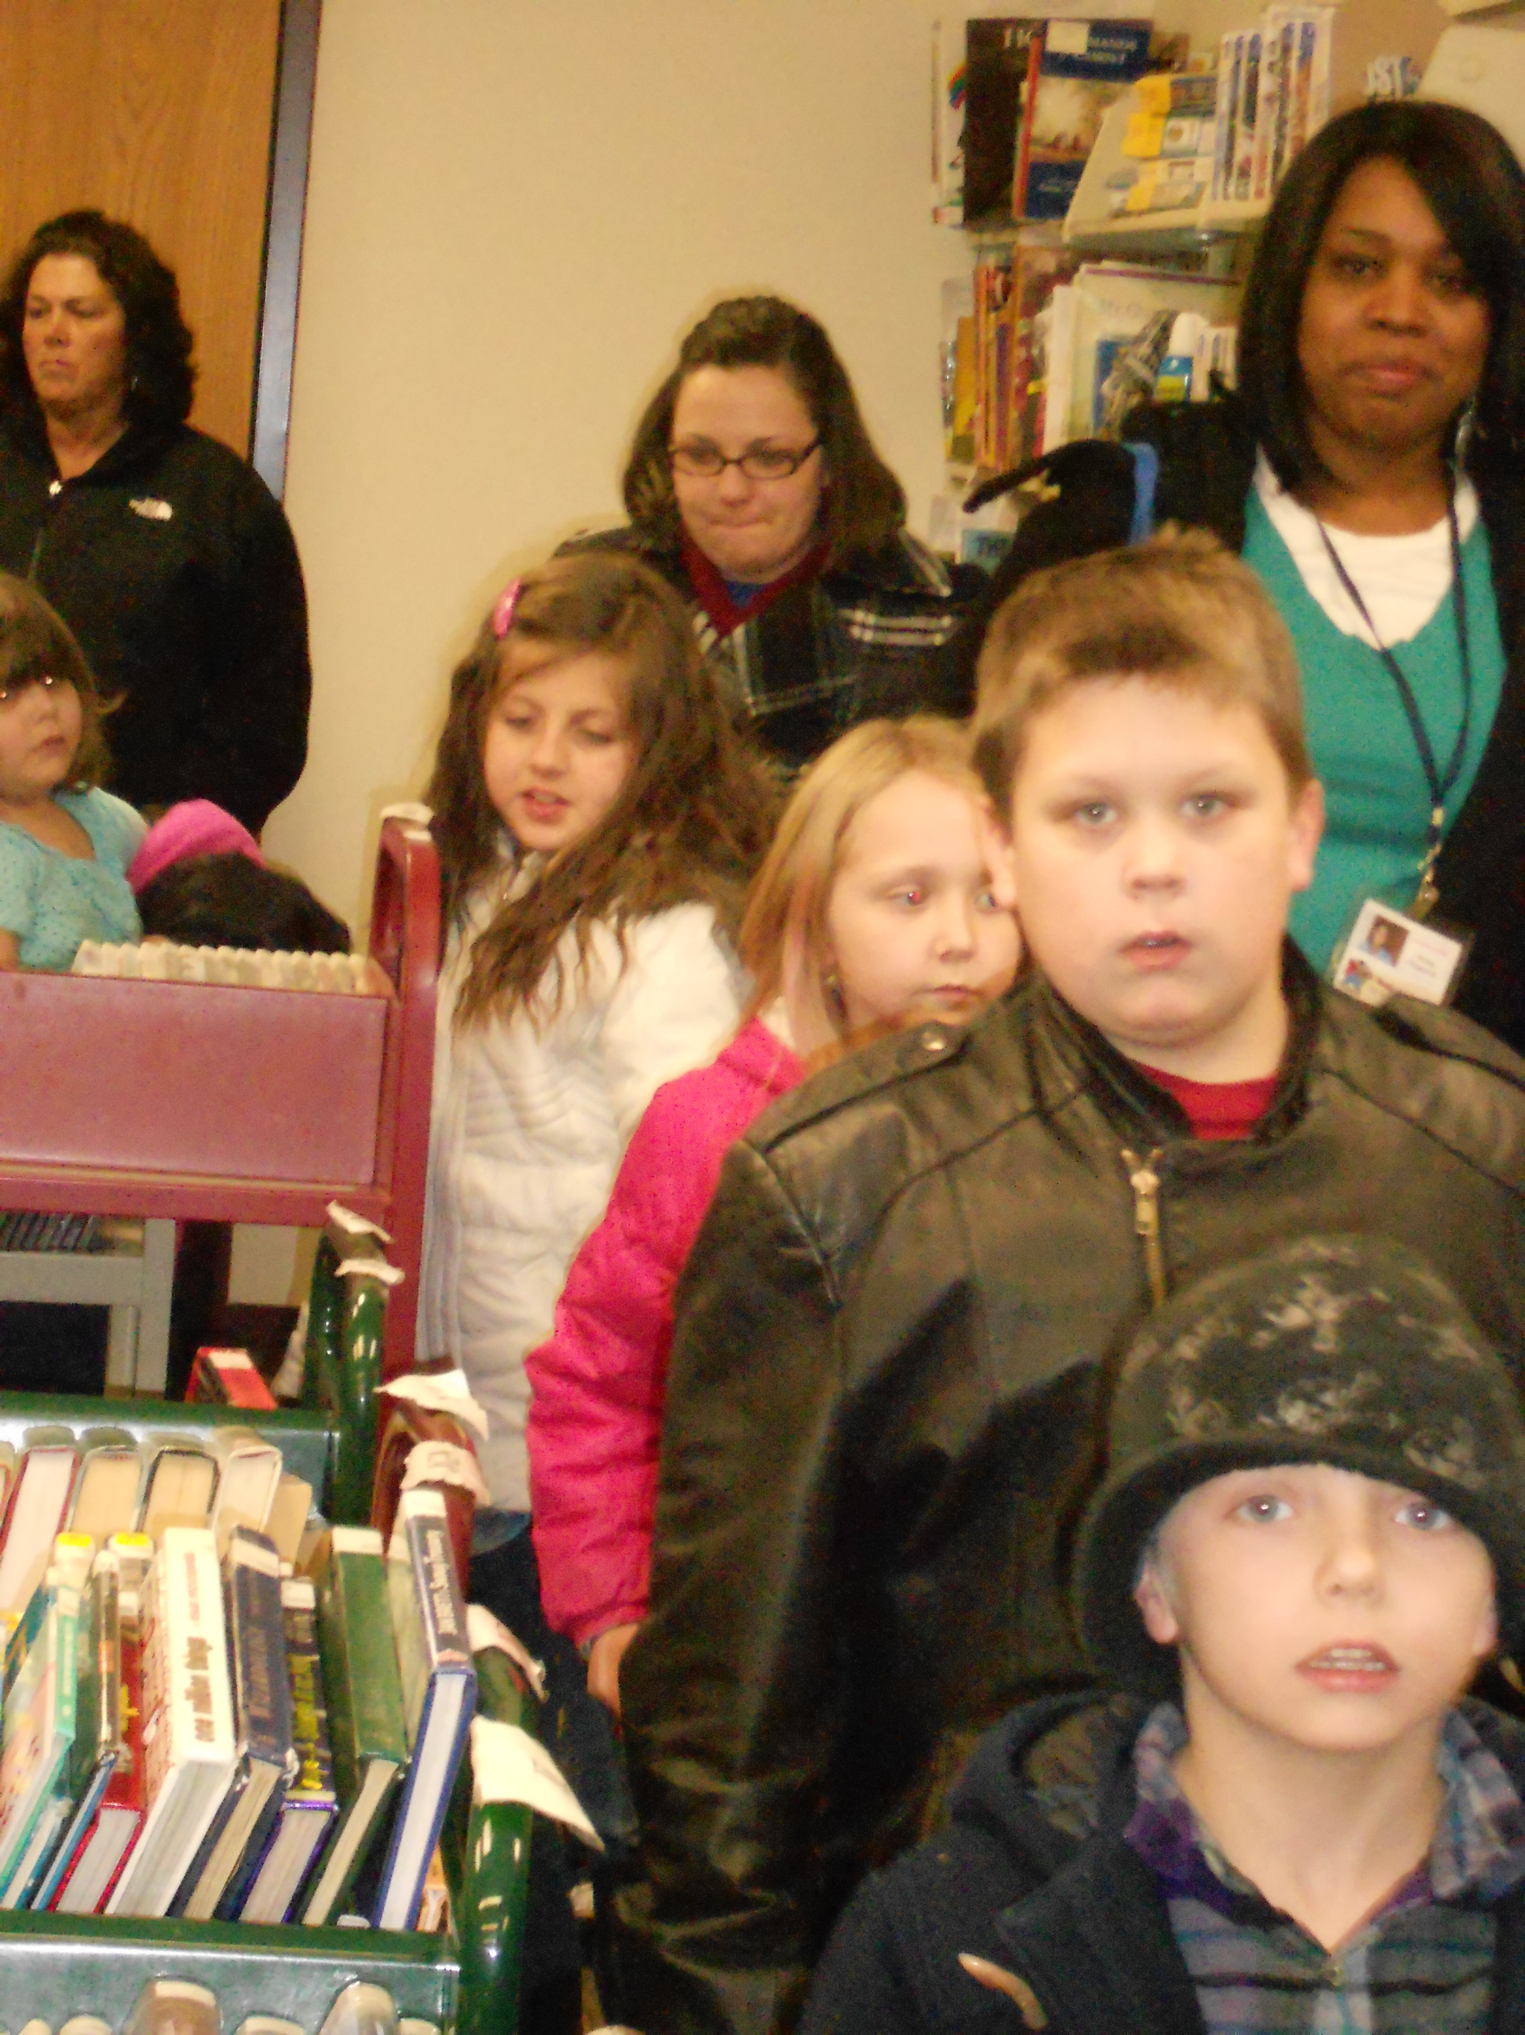
Walking in the Halls
WALK
Single-file line
KHAFAOOTY
Be silent
Remember:
The TEACHERS are
Working!

Slide 16
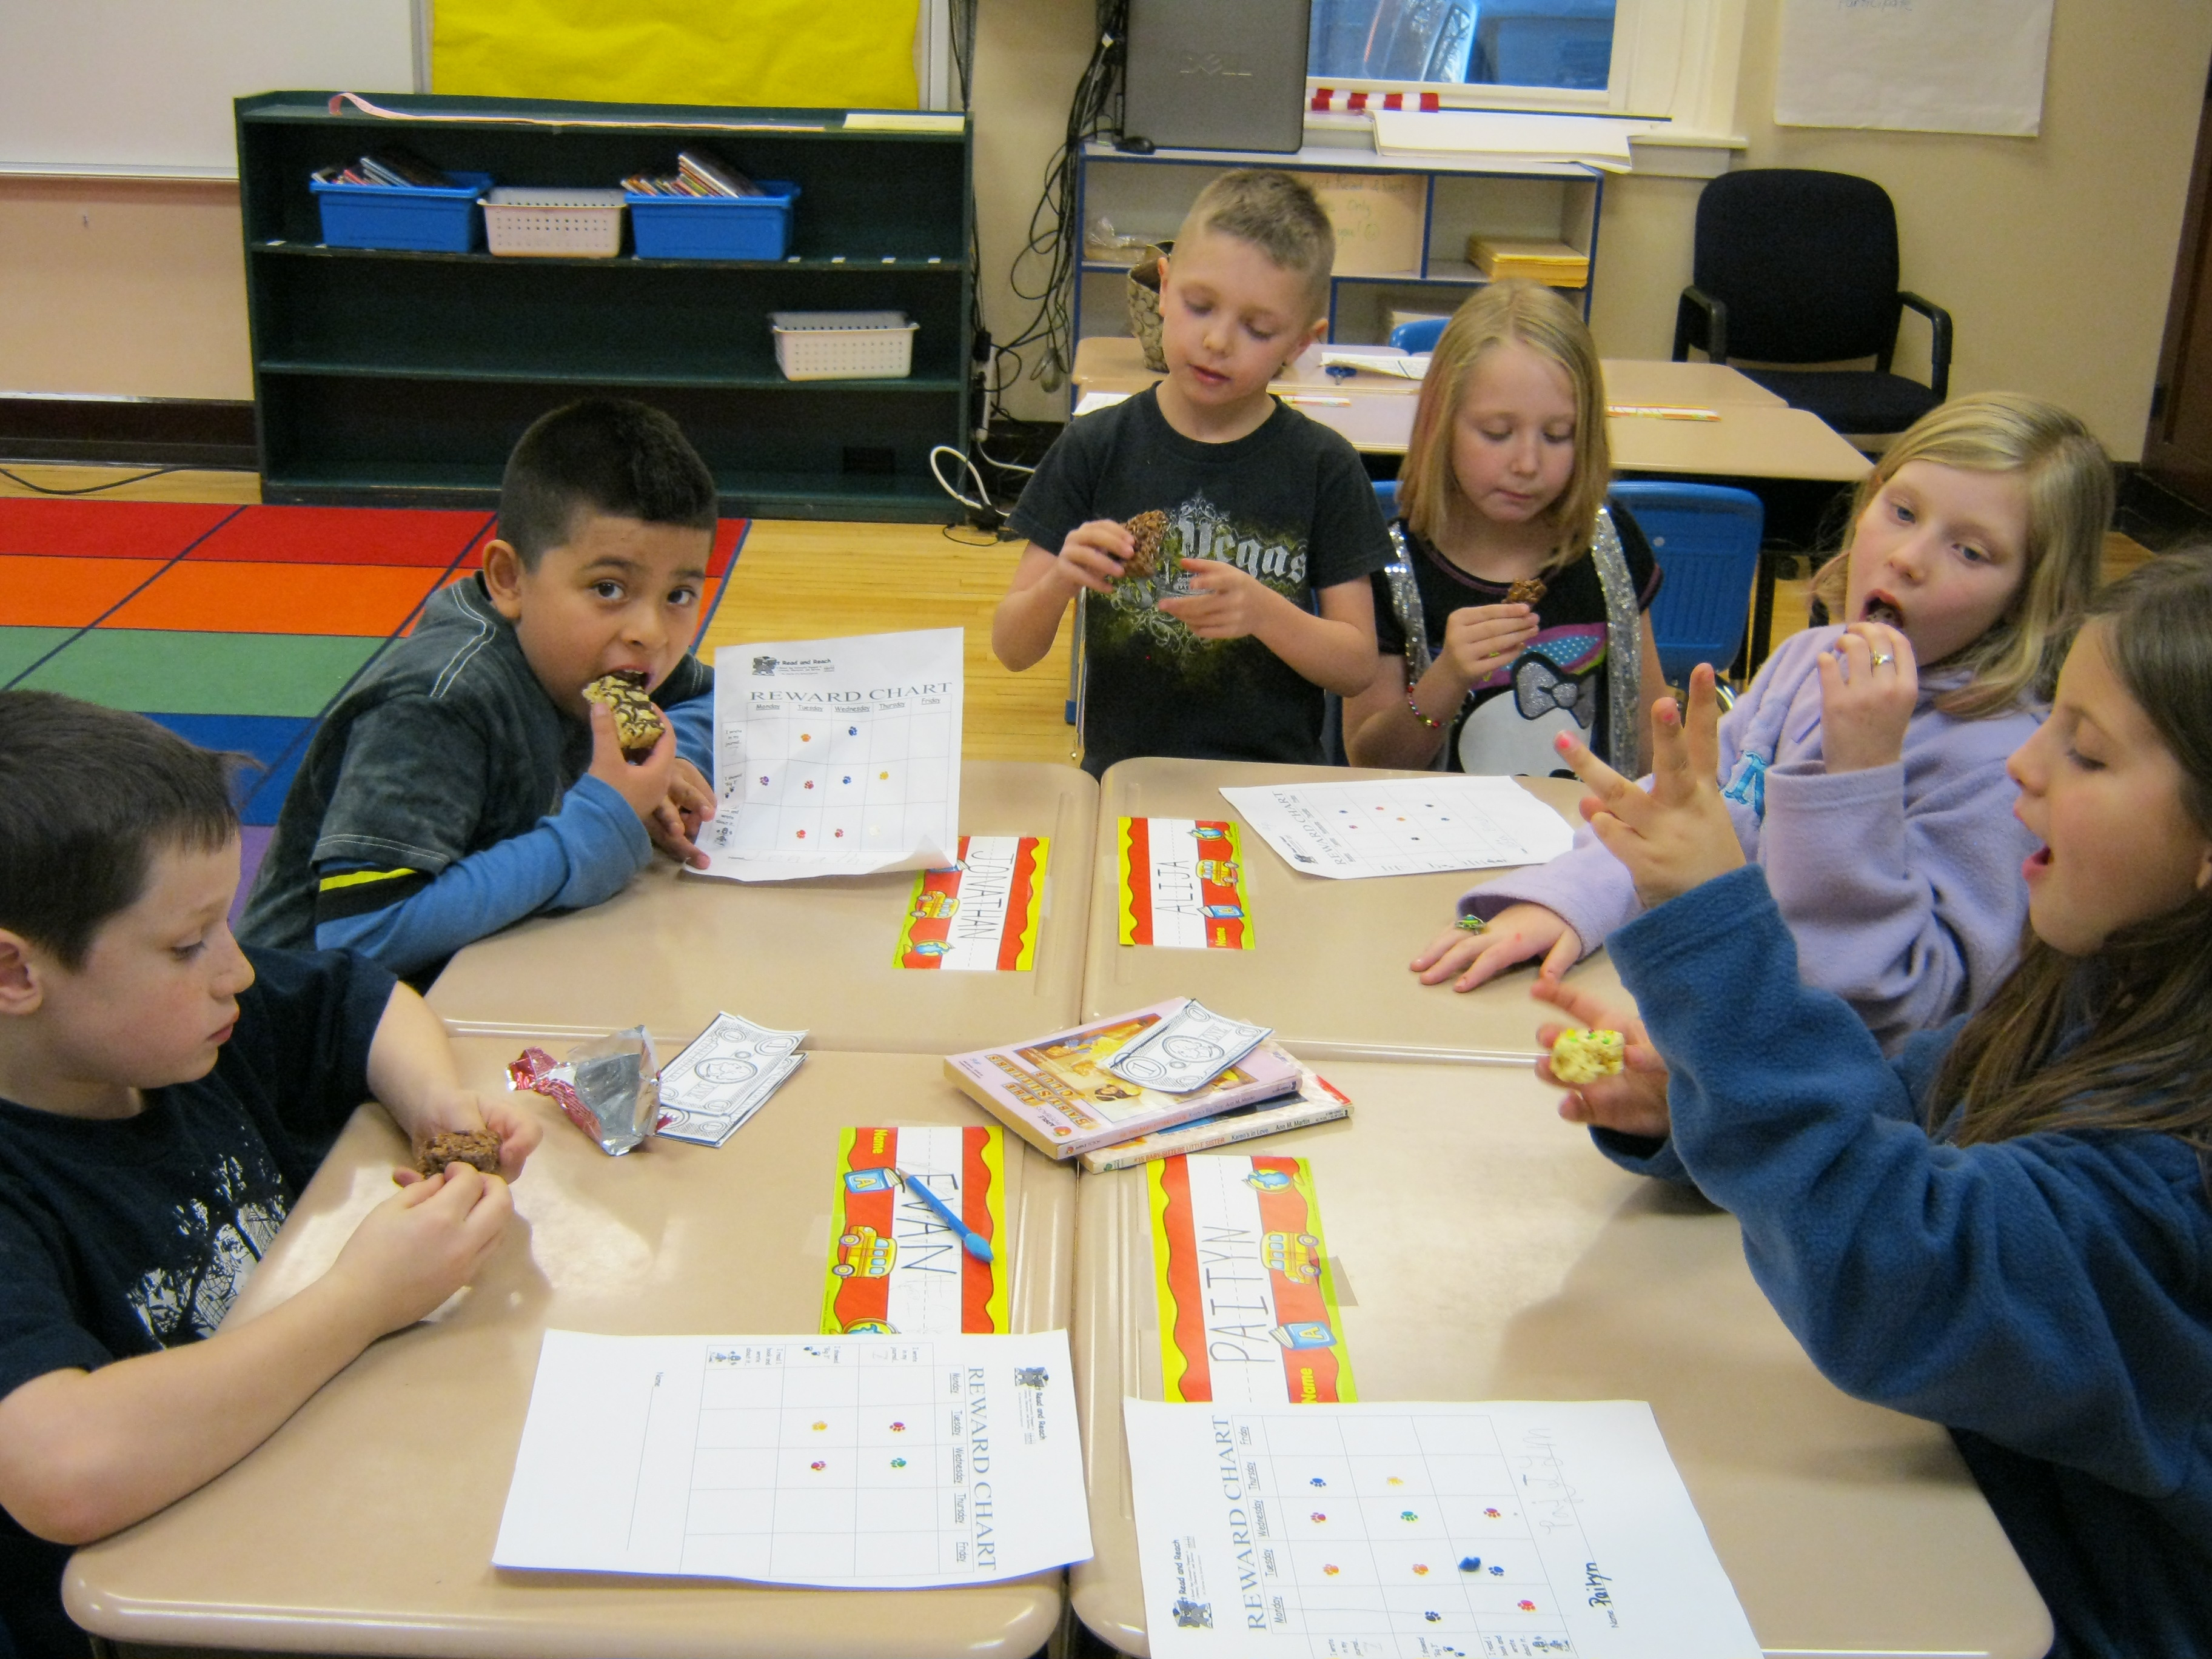
Snack time
Snack will be served at tables
Clean hands
Wait for the helper to
bring your snack
Say "Thank You!”,
“Please”, “No Thanks”.
Clean up your trash
when finished

Slide 17
Outdoor Time
Line up when instructed
Follow activity choices
BIG 3!
Use "I" messages to settle disagreements
Tell PRR teacher if you are hurt
Line up when whistle is blown
Re-enter building quietly

Slide 18
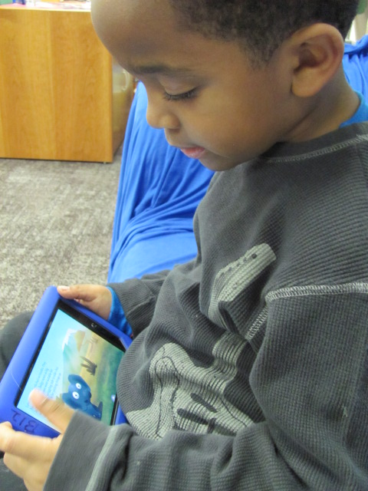
Nook Time
Use your assigned Nook
Find a quiet spot
Follow activity choices
Carefully clean your Nook
screen with special dry cloth
Return Nook to its
assigned spot
Take care when using your headphones

Slide 19
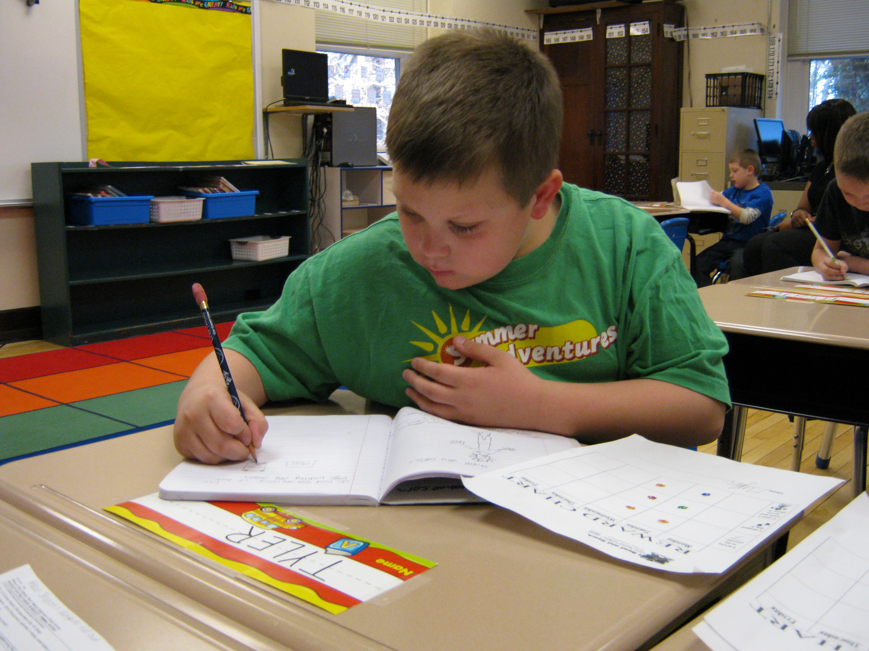
Homework Time
Be responsible for your assignments
Use time wisely
Ask questions if you don't understand
It's quiet time, let other students do their work!

Slide 20
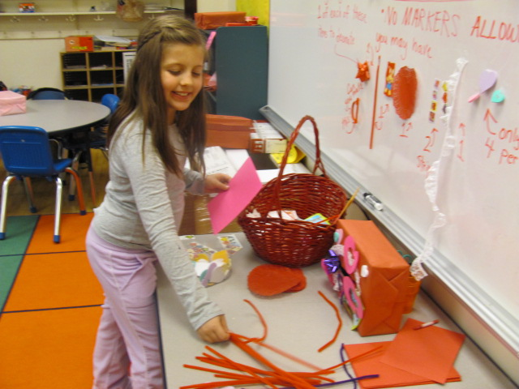
PRR Games, Activities, and Supplies
Be responsible
Be respectful
Let helpers do their jobs
Follow activity choices
Return items in good
order to their assigned
spot

Slide 21
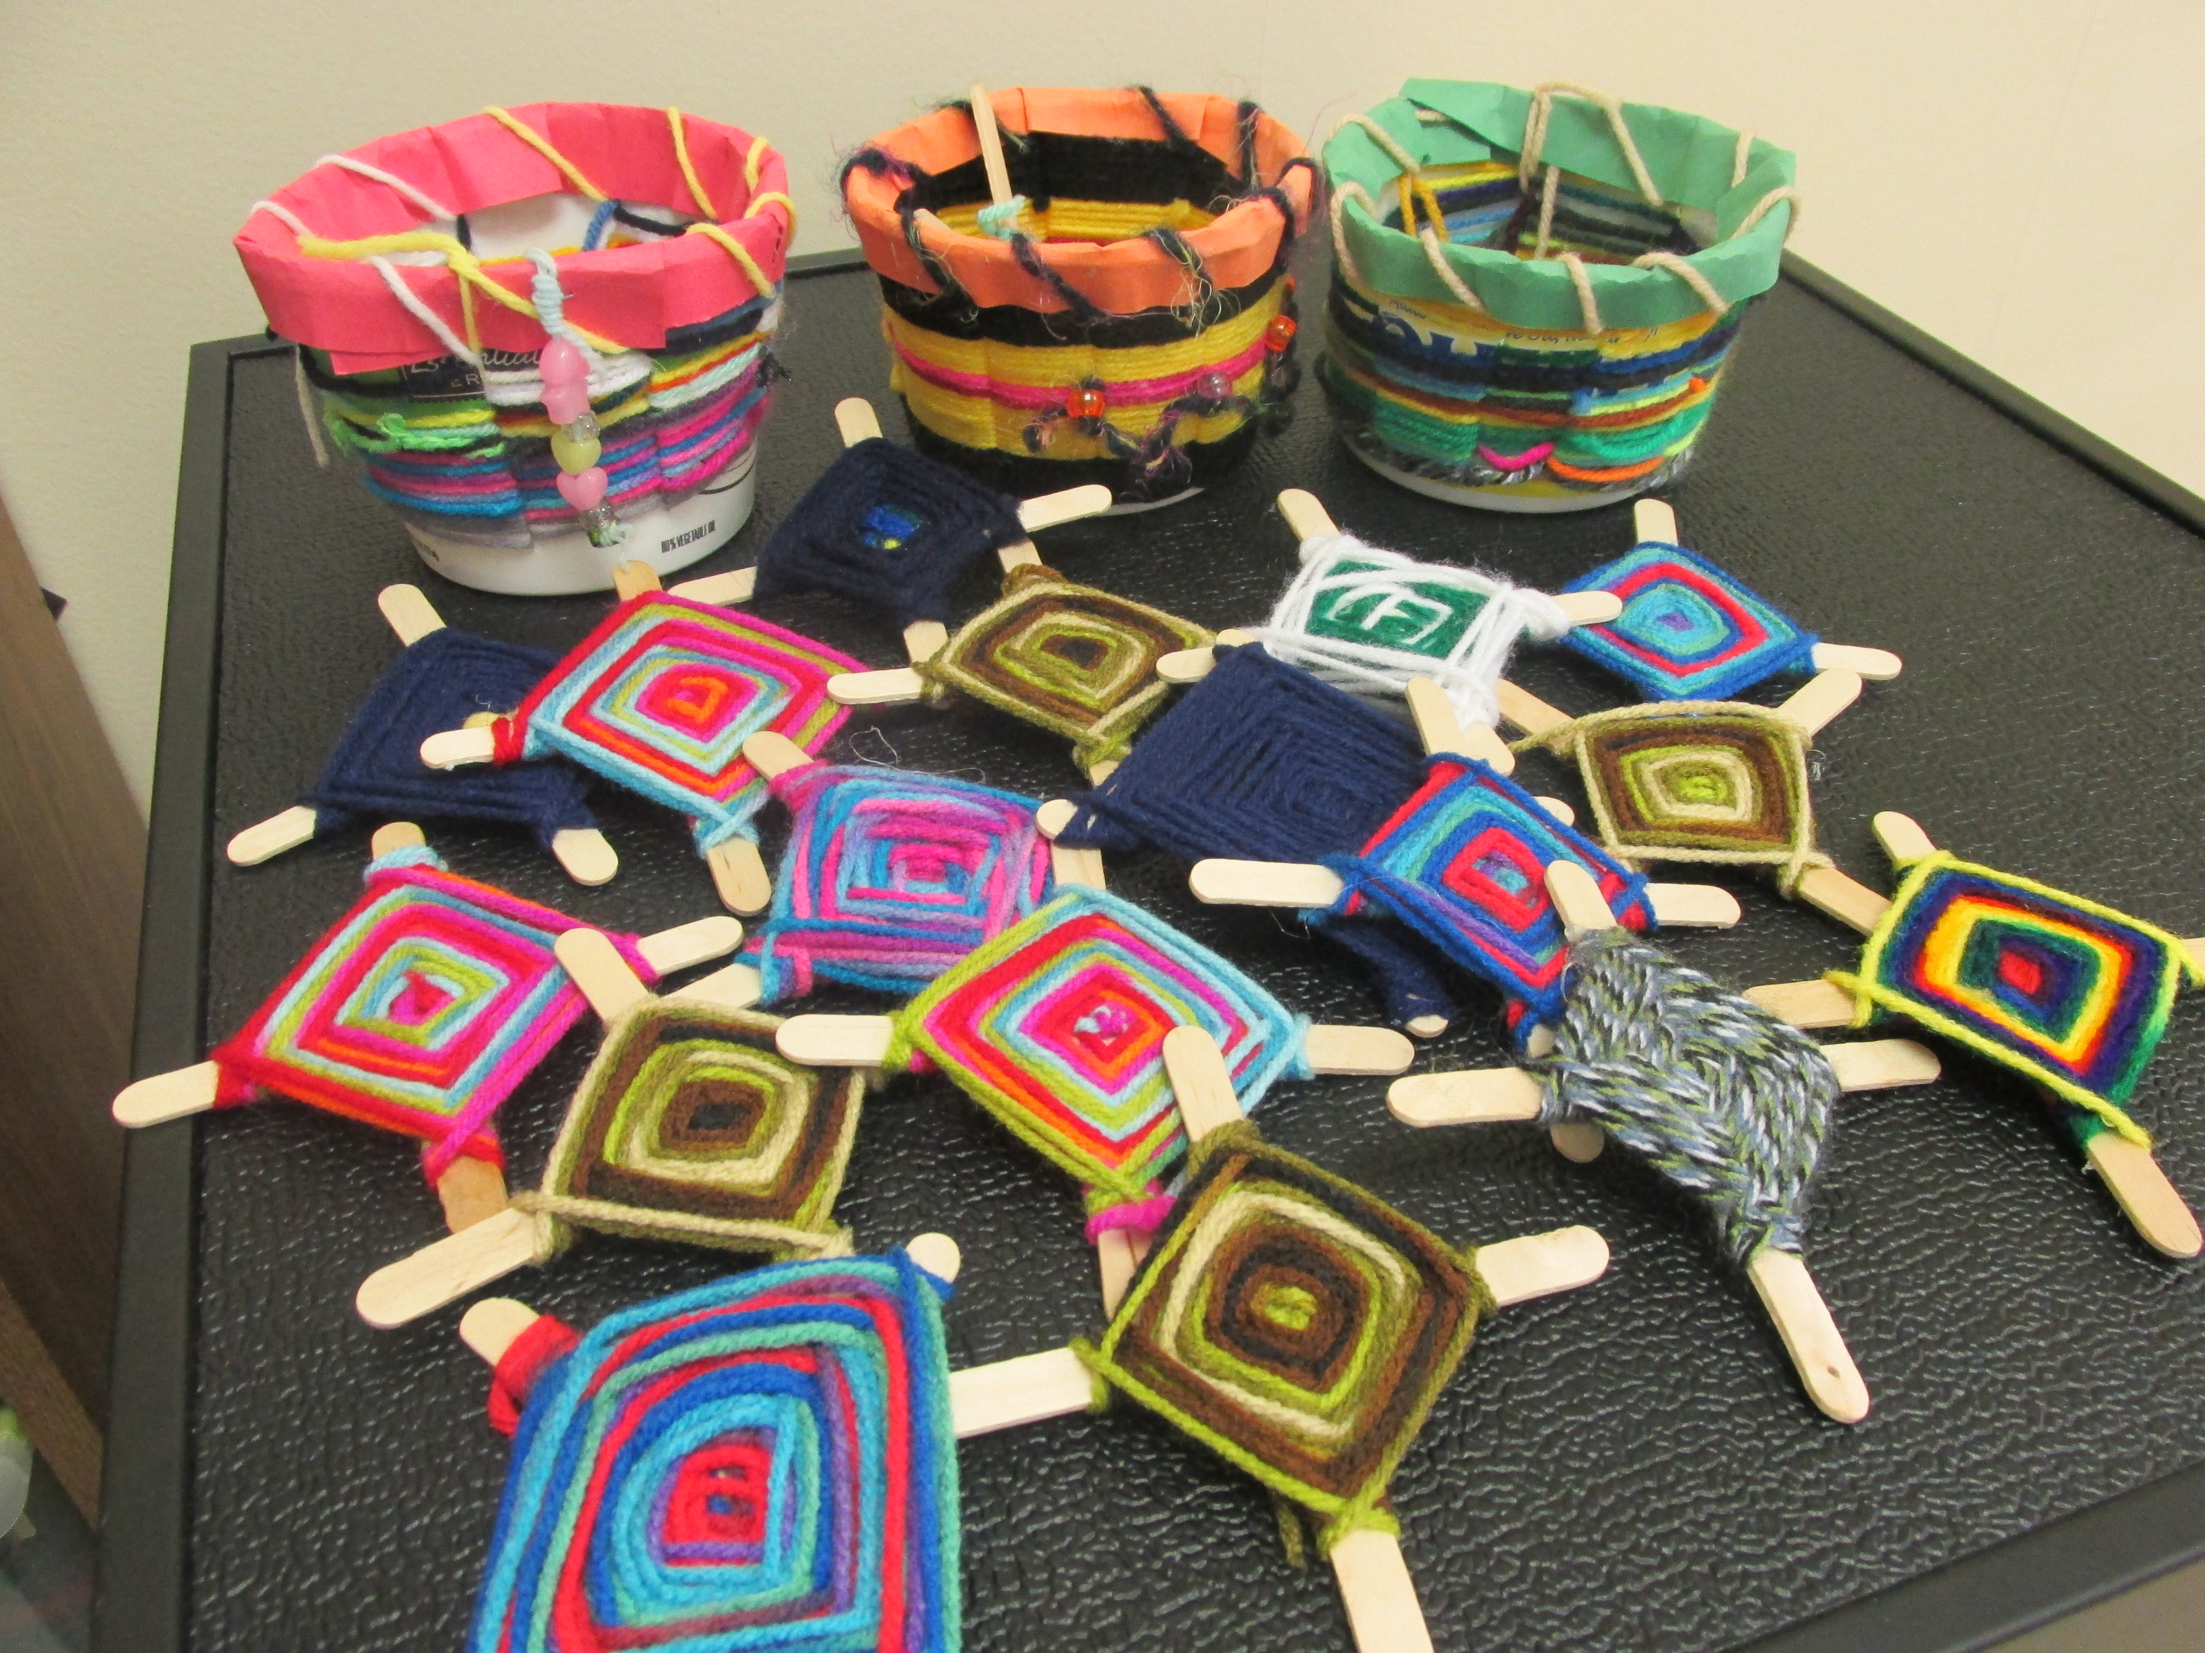
Make 2014-15 a GREAT YEAR!
Abraham Lincoln said, “Good readers make good leaders….”
Last year PRR Kid’s Project Peanut Butter Project raised over $1200 for malnourished children of Malawi, Africa! That saved over
48 boys’ and girls’ lives!
Thanks to PRR, kids had
Dr. Manary’s Peanut
Butter to help them
get well!!

Slide 22
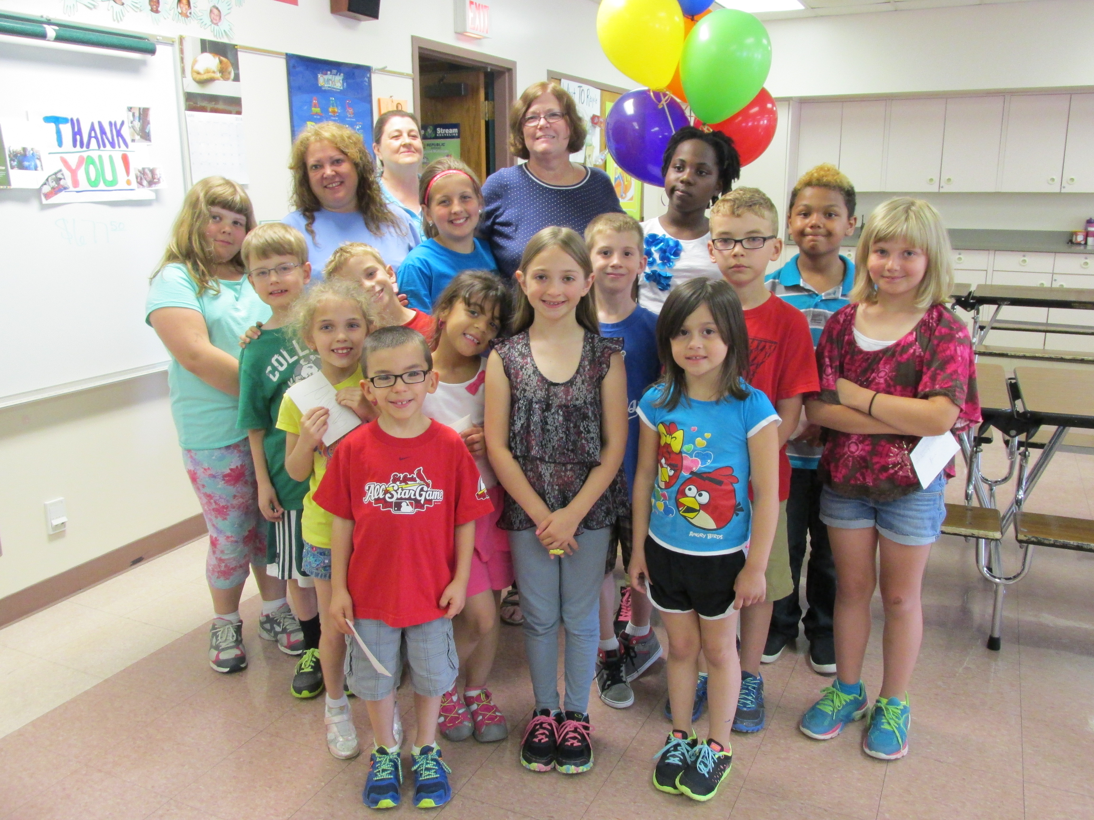
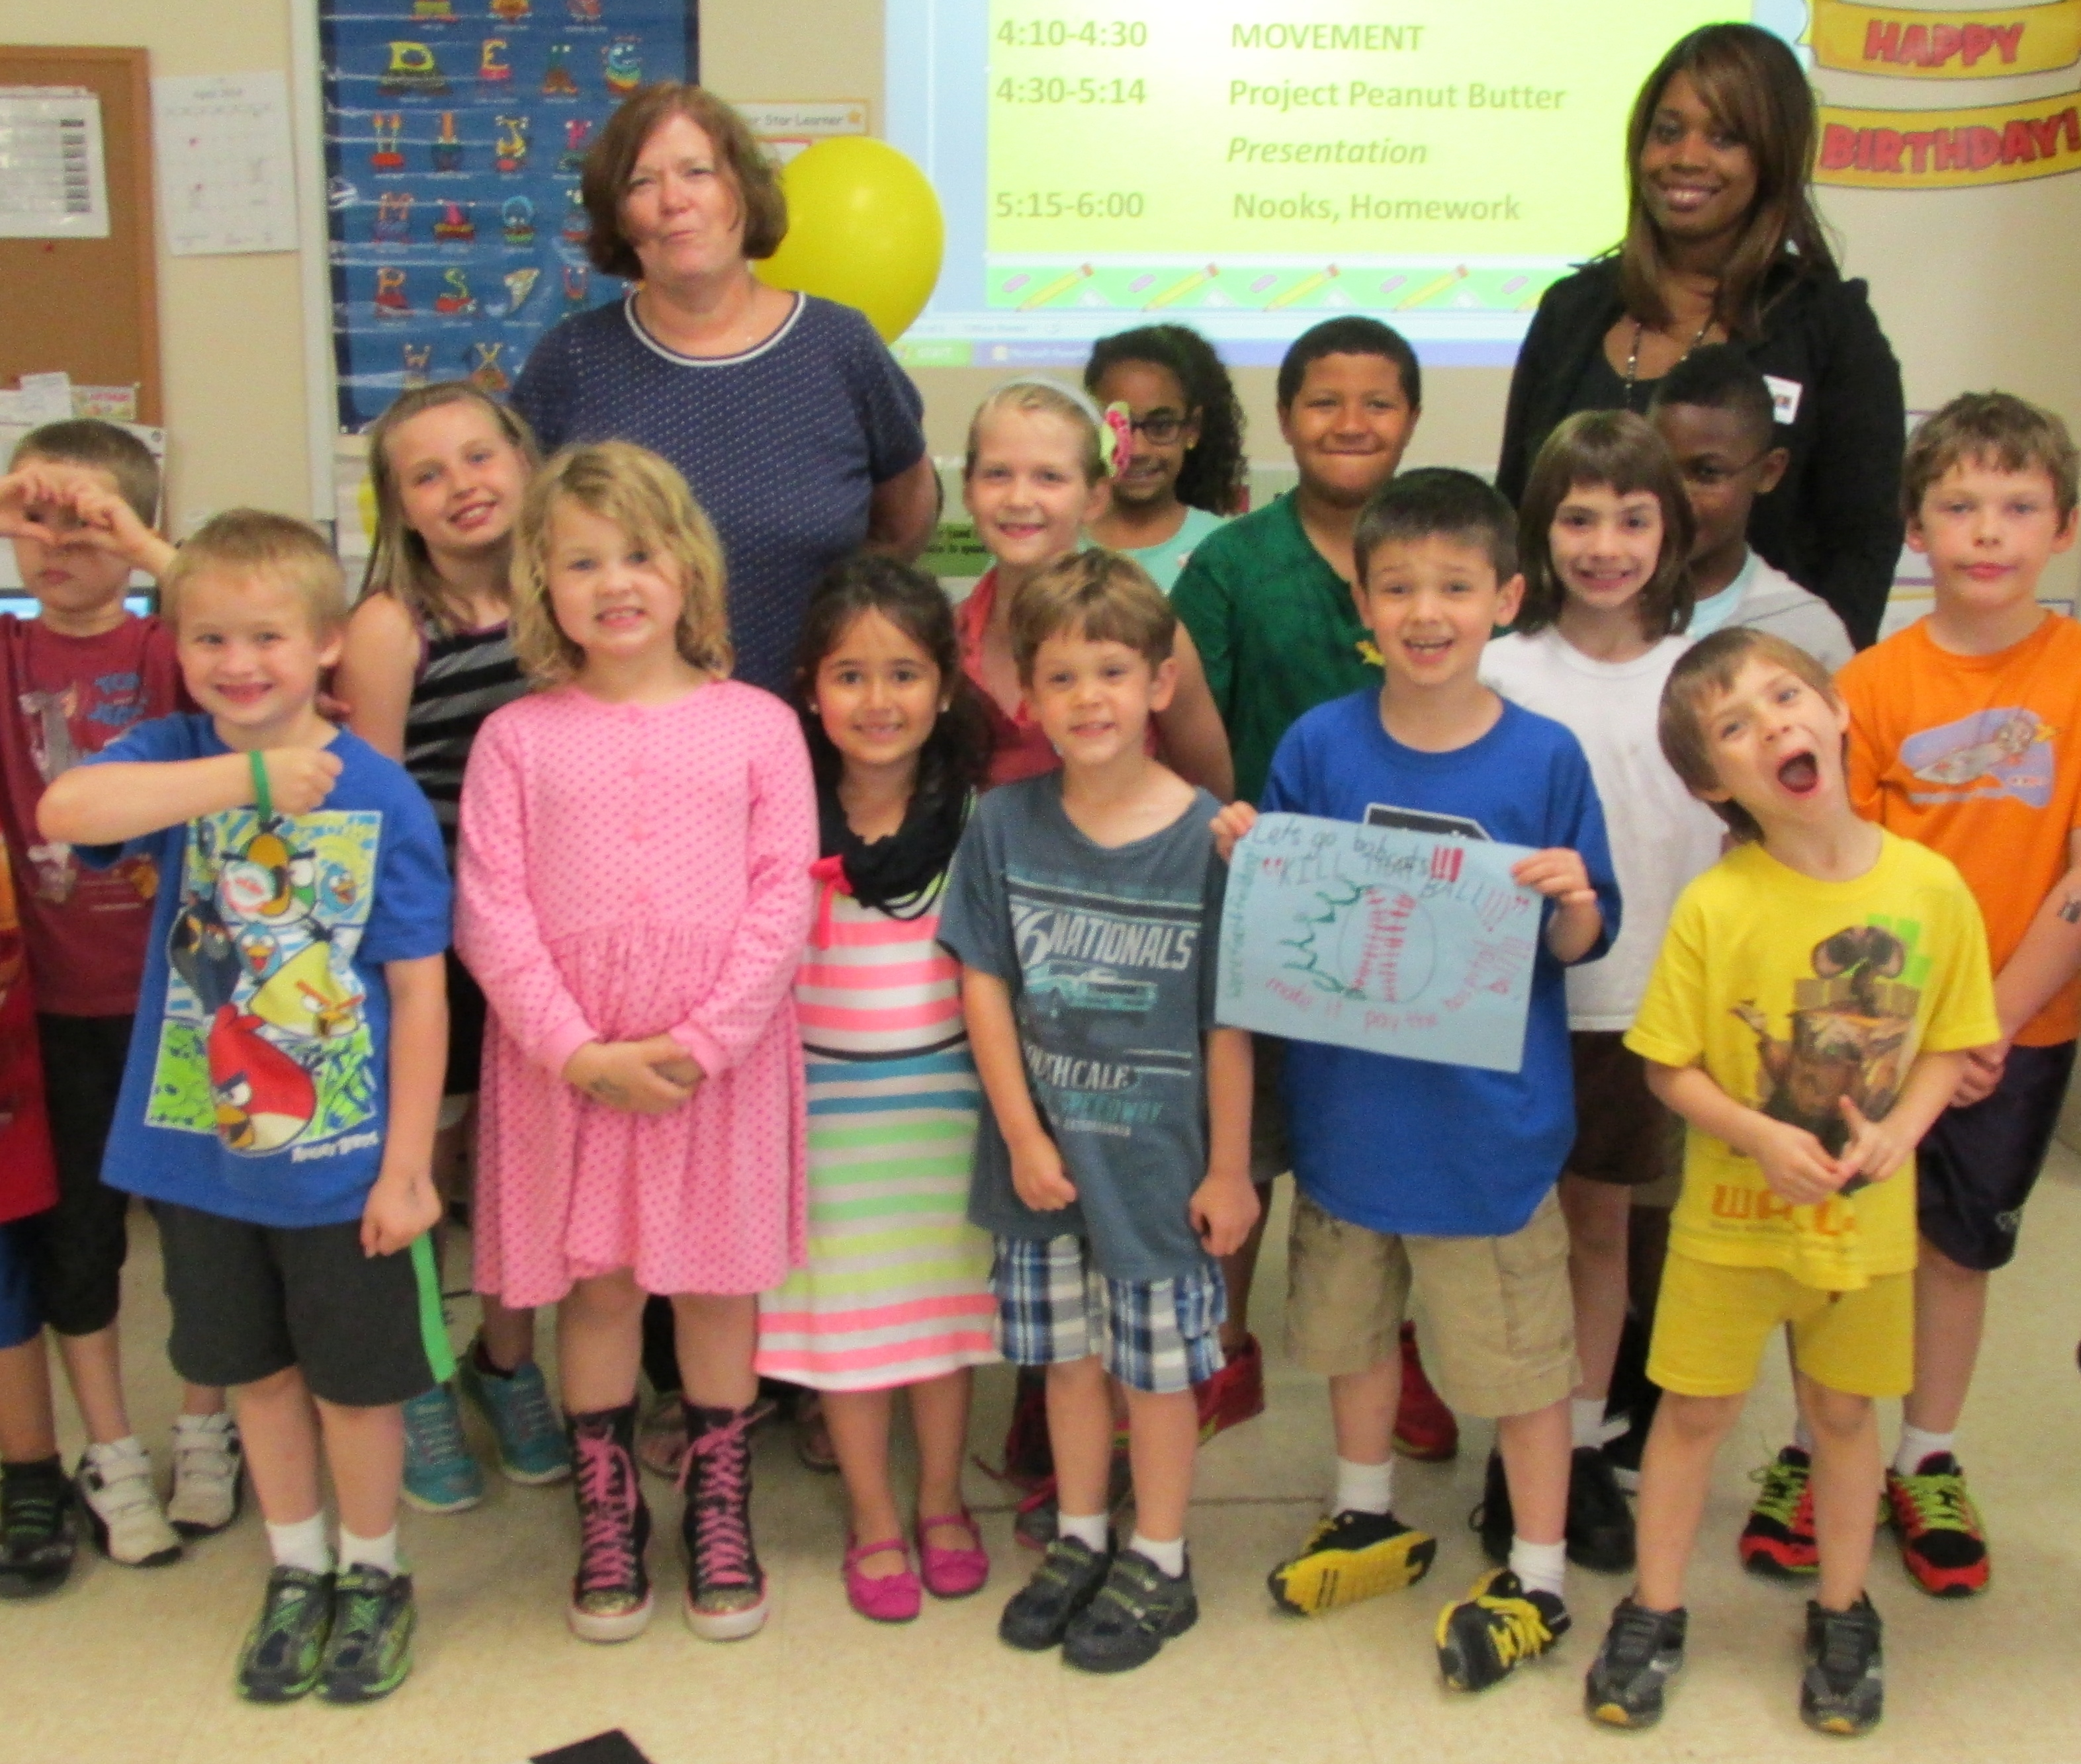
Join the PRR Team!
You can make a big difference
in your school and community!

