Slide 1

Special Guests and PRR Kids
“We read, we lead, we serve.”

Slide 2
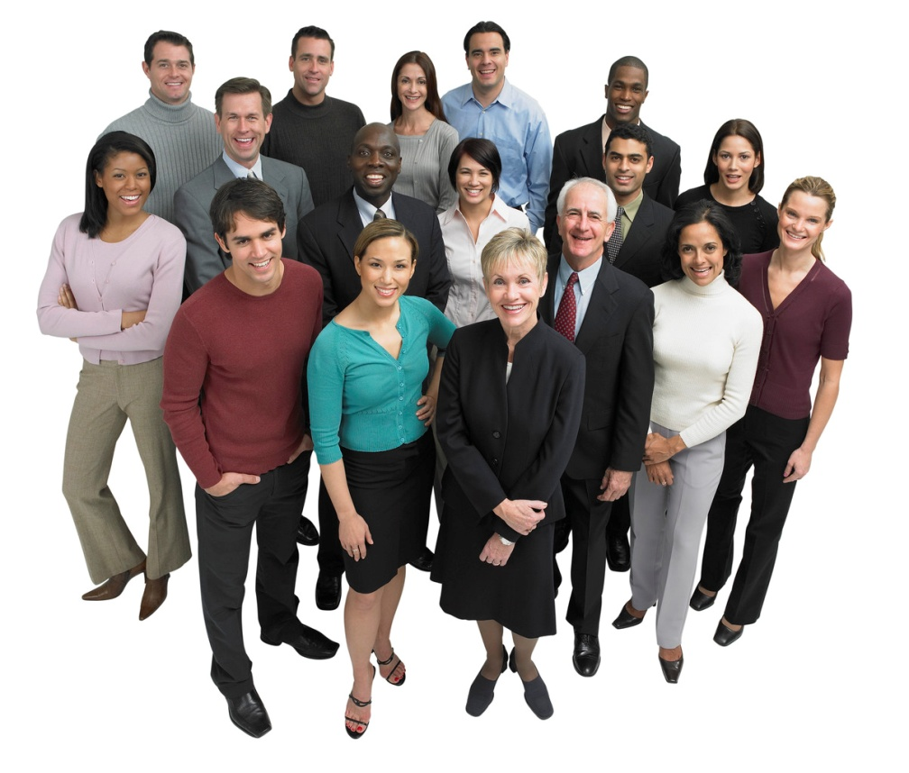
This is a BIG WEEK in PRR!
We will have several visitors to PRR
Some visitors will be in the AM
And some will be in the PM

Slide 3
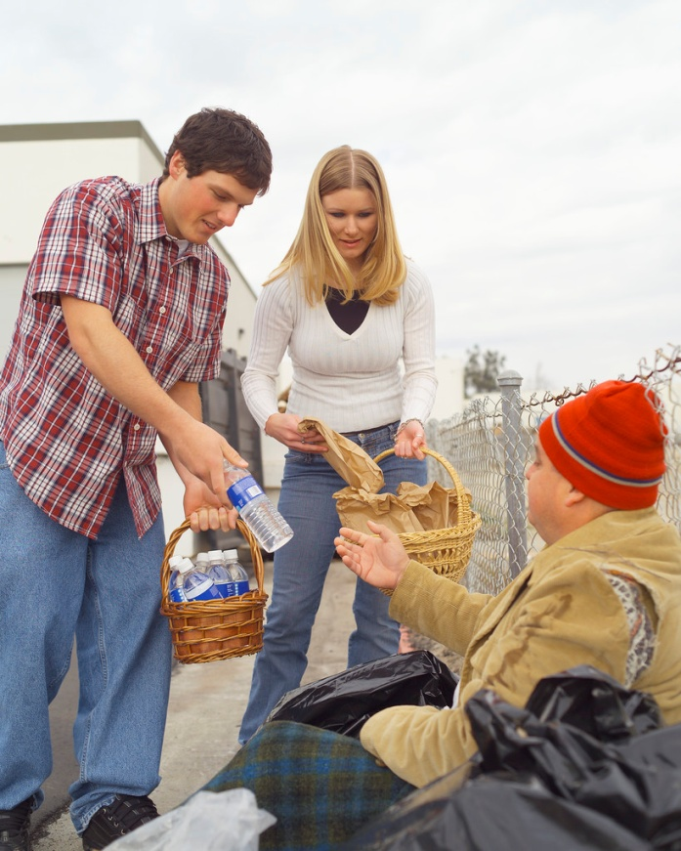
Special Guests to PRR
People who visit PRR are “volunteers”.
What is a “volunteer”?
Why are “volunteers” valuable
to St. Charles? Why are they
important to PRR?

Slide 4
Special Guests to PRR are Volunteers!
Volunteers do not get paid for doing a job.
Volunteers give their time and talents to their community.
Volunteers help other people, animals, and other good causes because they want to serve others.

Slide 5
How should PRR treat
Guests to PRR?
What are some things to think about when PRR has special guests?
Can you name four things?
Make a class list of your four ideas and post it on the PRR class wall.

Slide 6

How does Big 3 fit in when Guests come to PRR?
Take one minute and talk about thiss big idea as a team.

Slide 7
Special Visitors to PRR
One special visitor to PRR this week will be:
Fire Captain Shalom Shoaf
She is a fireman and soon to be a new MOM!
Captain Shoaf wants to share information with PRR about Fire Safety

Slide 8
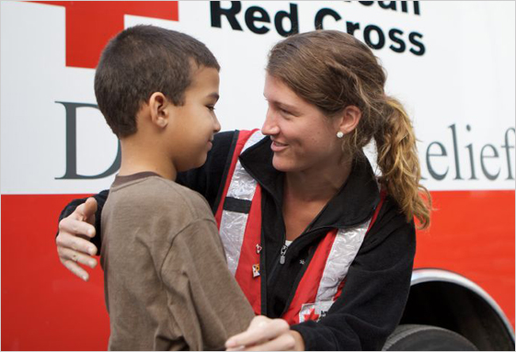
Special Visitors to PRR
Another guest to PRR will be
Mr. Sebastion Lury.
Mr. Sebation works for the American Red Cross. The Red Cross helps people all over the world in times of emergencies.
Mr. Sebastion will be visiting AM PRR several times to talk about different kinds of emergencies and how to be prepared to stay safe!

Slide 9
Special Visitors to PRR
Two visitors will be coming to PRR more than once in the afternoons.
They are Mr. Glenn and Miss April.
Mr. Glenn and Miss April are citizens from the St. Charles Community. They have been trained by the Fire Dept. and the U.S Government to be experts in being prepared for an Emergency. They belong to the CERTs Team.

Slide 10

What is a CERTs Team?
The CERTs Team learn about all the dangers that can happen to a community.
The CERTs Team goal is to keep people SAFE by helping other people learn about safety!
“CERTs” stands for:

Slide 11
CERTsTeam
People who train for the CERTs Team have gone through weeks of very specialize training. They have a certificate that says they have learned emergency procedures.
They are experts in safety!
The CERTs Team is coordinated by the
St. Charles Fire Department.

Slide 12
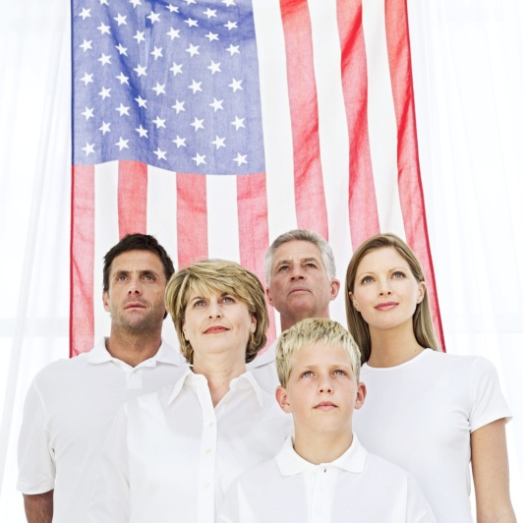
CERTs Training for Kids!
The CERTs Team believes it is very important for kids to learn to be prepared in an emergency so they can help themselves and others stay safe.
They have a special CERTs Training for Kids called “Sam I Am Ready!”

Slide 13

CERTs Training for Kids
Mr. Glenn and Miss April will be visiting PRR every week for over a month to teach us the “Sam I Am Ready” program.
They have many things to teach all of us in PRR about Fire Safety, Weather Storms, Hazardous Chemicals, Pets in an emergency and more!

Slide 14

CERTs Training for Kids
When PRR Kids finish the “Sam I Am Ready” training, we will be able to help in an emergency at home or school.
This is called being a leader at school and in the community!
It’s an important job!

Slide 15
Introducing PRR to Special Guests
It is polite to introduce yourself when meeting someone for the first time. This makes people feel welcomed!
When you introduce yourself you should tell a couple of things about yourself:
Your first name
Your grade you are in

Slide 16
When the PRR Guest is ready to leave PRR…
How can PRR show our guests we appreciated them giving up their time to come to PRR to help us learn something new?
What will make our guests want to come back again to PRR?

Slide 17
Practice for tomorrow!
Take a couple of minutes as a group and practice introducing yourself to the PRR Guests that are coming tomorrow.
Each PRR Kid should stand up and tell their name and grade in a speaking voice.
This will help you know what is expected of you tomorrow. This will help you know what PRR guests expect of us!

Slide 18

Our Goal for this week in PRR:
Work as a team to learn and enjoy
the PRR Guest Speakers this week.
Welcome our guests.
Show your appreciation to the PRR guests.
You are a “Bucketfiller” when
you do all these things!!

Slide 19

PRR’s Motto:
We read, we lead, we serve!”
Working as a team will make our guests
feel welcomed!

