Slide 1

What is
Character Education,
the PRR way?

Slide 2
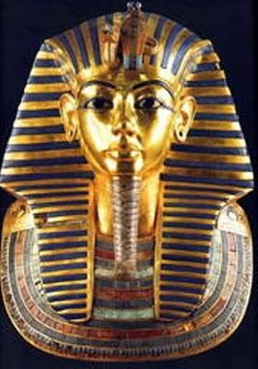
The Egyptian use of the word character means "to shape, to form, to build."

Slide 3
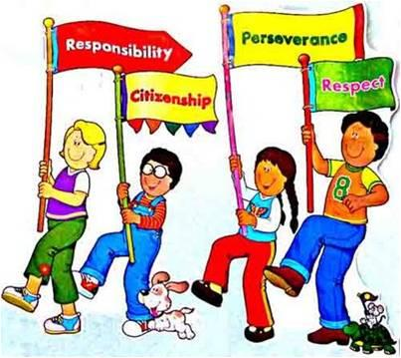
The PRR Way
In Project Read and Reach we will “build” character using the Big 3 in our program
PRR will be Character Leaders for the rest of the school.
PRR is going to set an example of what it means to be BIG 3.

Slide 4
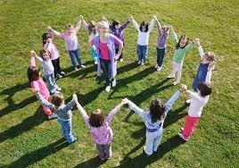
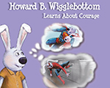
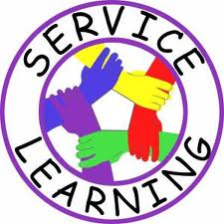
Building Character the PRR way
Fun and engaging activities
Story books

Slide 5
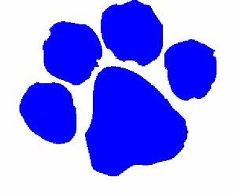
THE BIG 3
Be Safe
Be Respectful & Responsible
Be Ready to Learn
"ROAR!!"

Slide 6
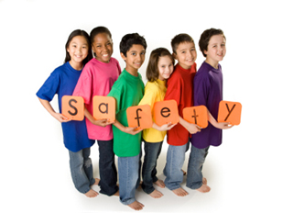
SAFETY
What are some ways we can be safe in the building?
What are some ways we can be safe on the playground?
What are some ways we can be safe outside of school?

Slide 7

Respect
Showing kindness
Showing respect to everyone
Being bucket fillers!
How can you show respect to others?

Slide 8
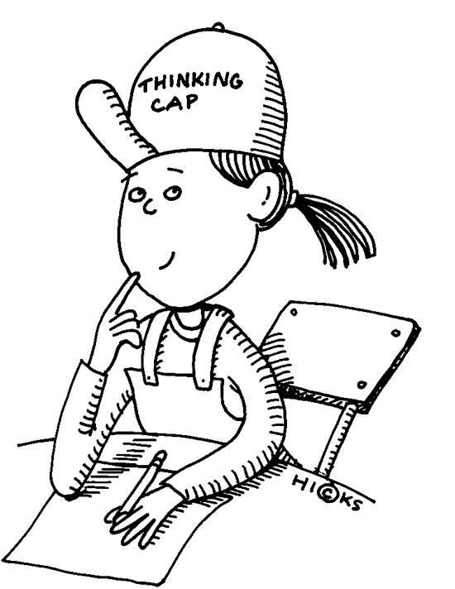
Responsibility
Making smart choices
Taking care of your belongings
Doing your job
What are some ways that you can show you are responsible?

Slide 9
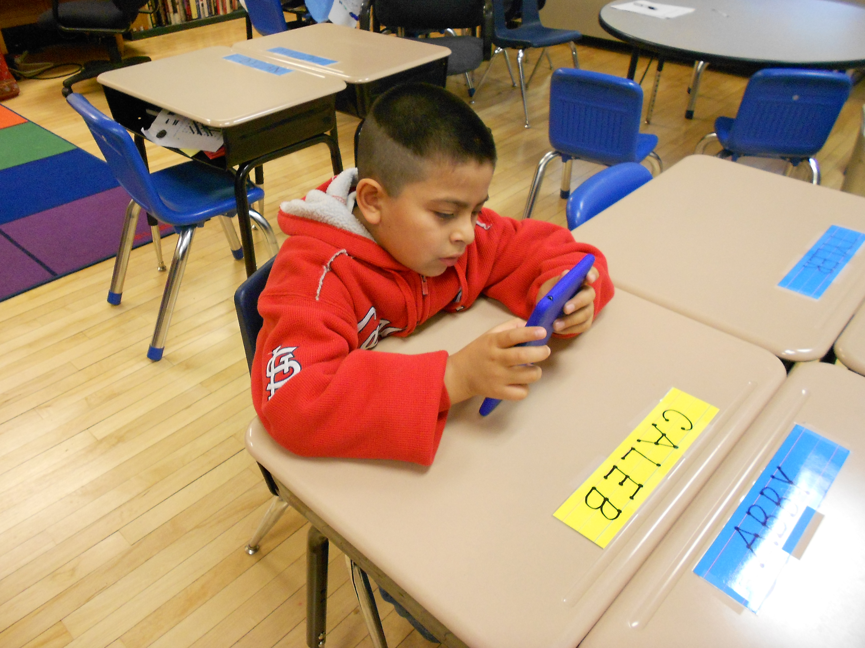
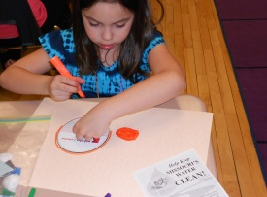
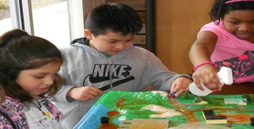
Learners
In PRR we learn lots of things
We have to be learners and listen when our PRR teachers or guest teachers are speaking
We must complete all activities to be better learners, but the activities are lots of fun!

Slide 10
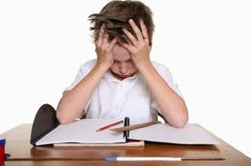
Learners aren’t perfect
In PRR we realize that at times you might make a mistake
The teachers want you be successful so we are always here to help
If you are having trouble making smart choices. We may ask you to complete a “think sheet”

Slide 11
Think Sheets
Sometimes we make mistakes or not so good choices
When this happens our PRR teachers might ask us to complete a think sheet

Slide 12
Are you ready to be a character leader?

