Slide 1

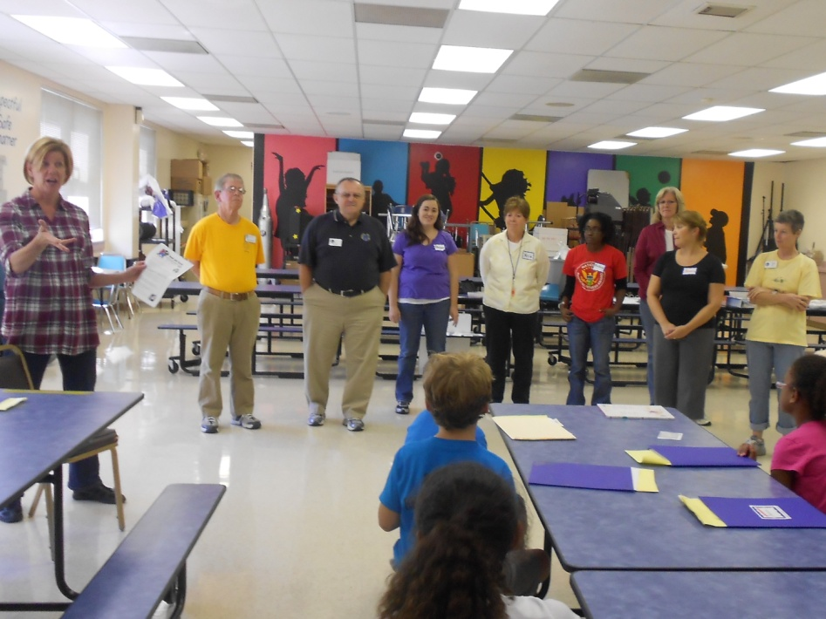
Starts Today in PRR!

Slide 2

What is CATCH Healthy Habits?
CATCH Healthy Habits is a special program on making healthy choices for your body.
Catch Healthy Habits is taught by a team of Oasis Volunteers. They will visit PRR every Wednesday afternoon for 8 weeks!
Remember a volunteer is a person who gives up their time to help others!

Slide 3
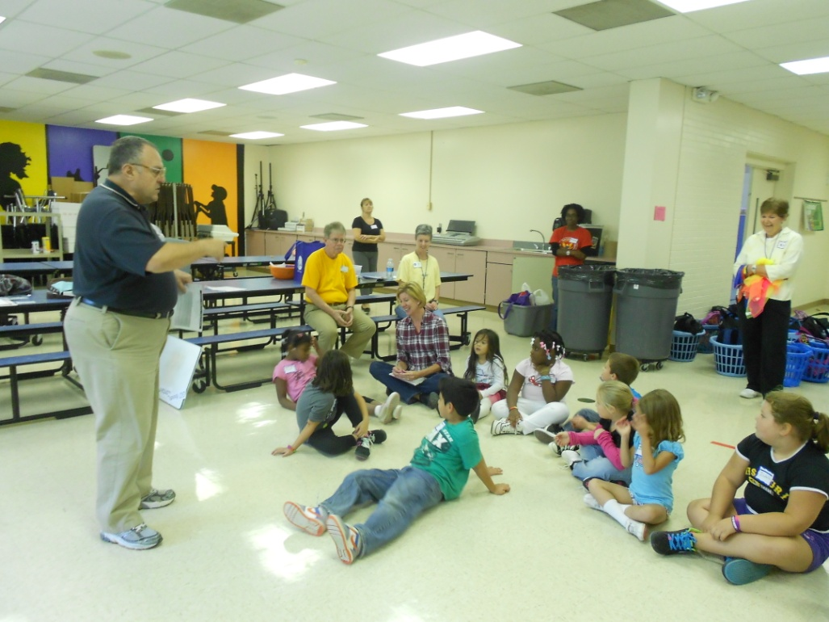
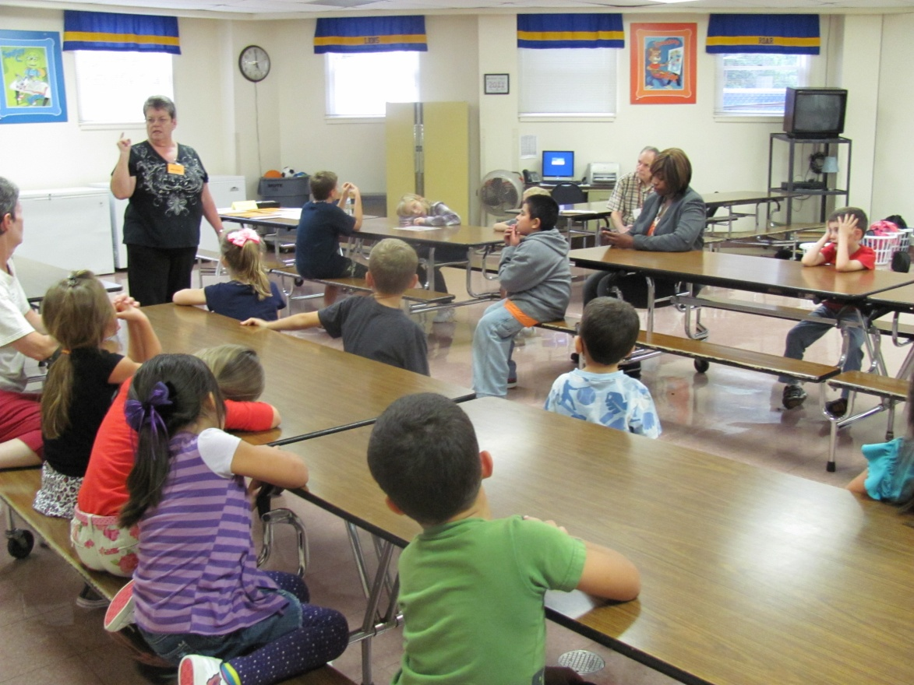
Special Lessons and Stories
CATCH Healthy Habits volunteers will share a short lesson and tell a story each week.

Slide 4
Special Foods
CATCH Healthy Habits volunteers will make PRR a special food snack each week. They will teach us how to make the snack and explain why it is healthy or nutritious.

Slide 5
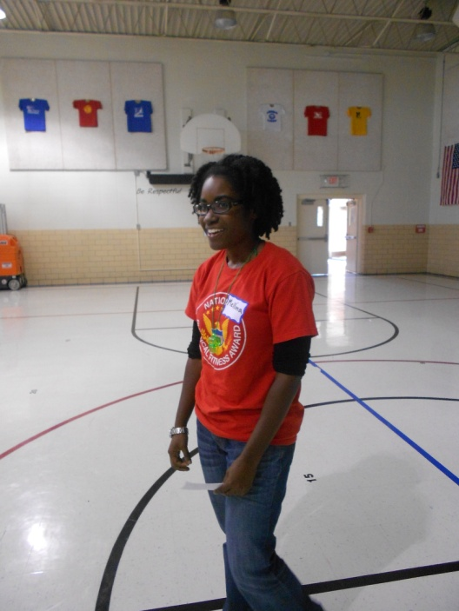
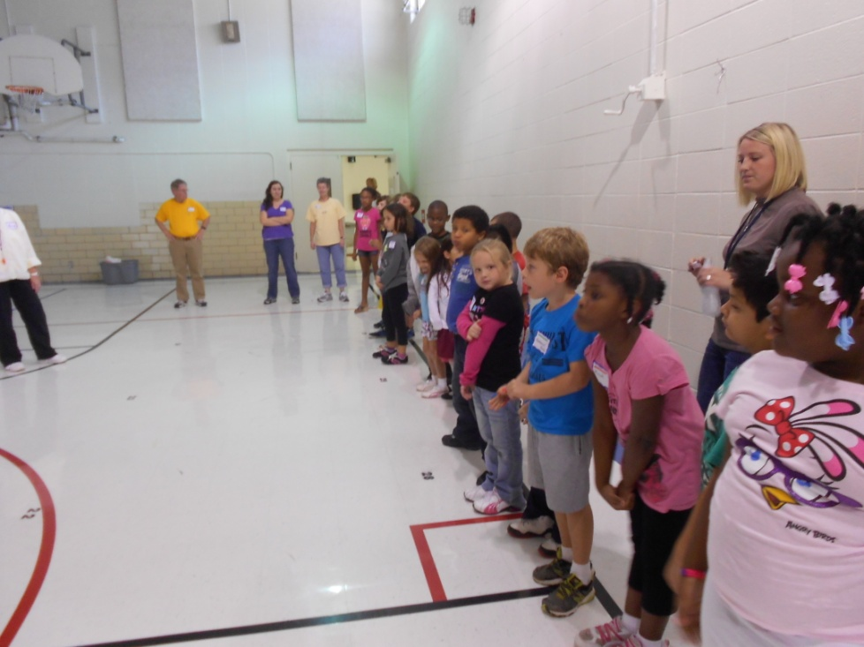
Movement Time!
Each week Catch Healthy Habits Volunteers will teach PRR Kids special movement activities to make our bodies get stronger and more fit. Movement time will be in the gym or outside.
CATCH Healthy Habits has fitness equipment like hula hoops, balls, bean bags, and other items. Take good care of them!

Slide 6
BIG Three!
Be safe, Be respectful, Be ready to learn!
By showing Big Three, PRR will show the CATCH Healthy Habits Volunteers how important and appreciated they are for helping us become healthier students!
Remember – CATCH Healthy Habits is a fun, special privilege in PRR. Let’s get started!

