Slide 1
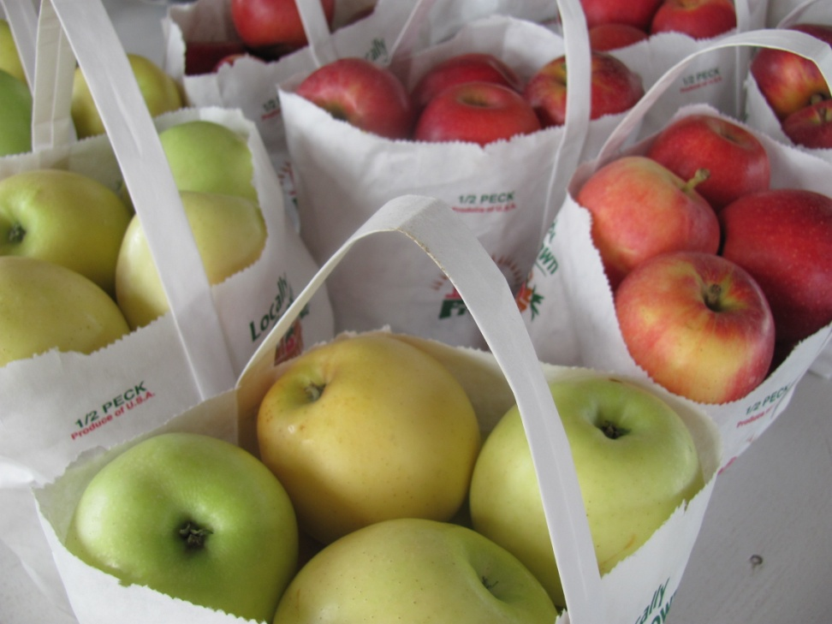
Project Read and Reach’s First Field Trip 2013-14
Herman’s Farm Orchard

Slide 2
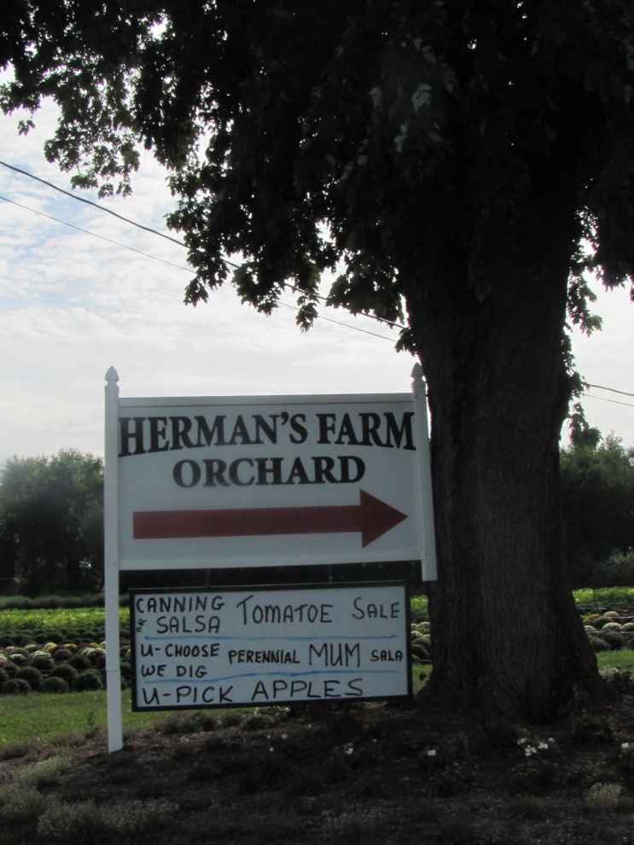
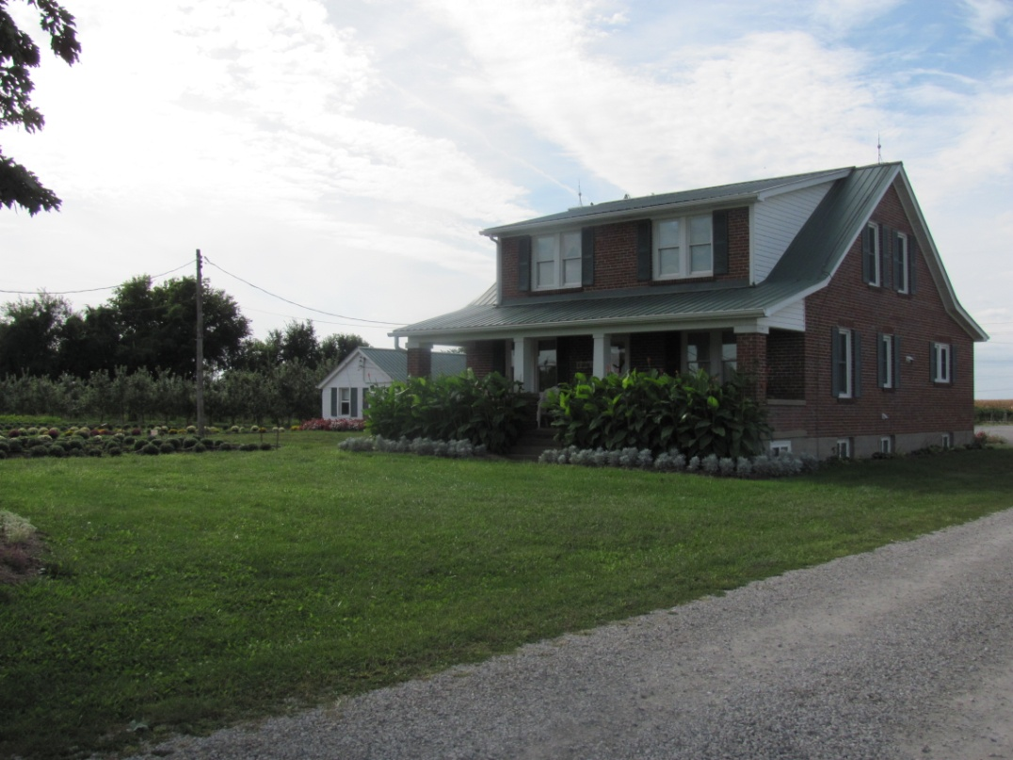
PRR’s going on a field trip today!
We will be visiting Herman’s Farm Orchard
just outside of St. Charles.

Slide 3
Riding the Bus
We will be going by bus. All students in Lincoln and Blackhurst PRR will be going together on the same bus.
All PRR Leaders will be going too!
It will take about 15 minutes to get there.

Slide 4
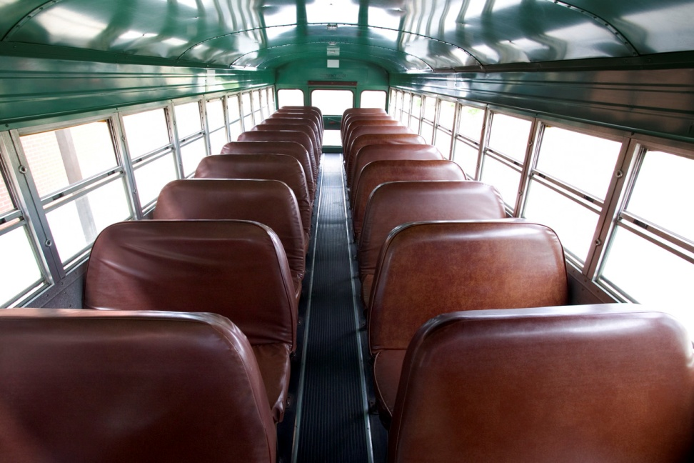
Bus Safety – Be Prepared
Sit facing forward on your pockets
Quiet talk allowed
“Class-class” means listen to PRR teacher directions
Must ride in assigned area of the bus

Slide 5
When we first get to Herman’s Farm
We will have a short meeting with Miss Elsie, Mr. Tom,
and Miss Leslie.
We will learn about the farm and the owners.
We will find out if they will need to divide us into two groups.
We will learn the rules of Herman’s Farm Orchard so everyone
can have fun!

Slide 6
We will be doing serveral things!
Part of the time will be a learning time.
Part of the time will be a “doing time”.
Part of the time will be a play time!

Slide 7
Learning time about Apples
Mr. Tom will teach us all about how farmers grow apples and how apple trees make new apples every year.
Important word - ORCHARD

Slide 8
Apple picking time
PRR will learn the correct way to pick apples from apple trees.
PRR kids will get to take home the apples they pick in the orchard.
We will have a special apple snack when we return to school.

Slide 9
Hayride Time!
Mr. Tom will take PRR Kids on a “Hay Ride” around the farm. He might have to do this in two groups to give everyone a turn on the wagon.

Slide 10
Snack Time
PRR will meet in a special indoor area part of the time.
Here we have our normal PRR snack.
We might have some drawing activities too while we wait our turn to do certain activities.

Slide 11
Play Time! Be Safe!
Herman’s Farm Orchard has a play area for kids too!
PRR will take turns on the playground.
We will have to ask if it is okay for us to climb on the haybales.

Slide 12
Rules on the Farm
Sorry, the tractors and tricycles are for the Preschoolers only!
Leave them parked please.

Slide 13
Bathroom Breaks
There are only outdoor bathrooms. One for boys and one for girls. We will use hand sanitizer after using the bathroom. Try to go at school before we leave please!

Slide 14
What will Miss Elsie and Mr. Tom Expect of PRR Kids?
How will we show respect to the people at the farm?
How can we show PRR Kids are Learners?
What are three things we can do that Mr. Tom and Miss Elsie will just love?

Slide 15
Remember – Field Trips In PRR are a Privilege!
Big Three PRR Students will get to participate in all activities.
Big Three PRR Students earn the privilege of going on future field trips in PRR!!
Make it a great day!!
Be Safe, Be Respectful, Be Ready to Learn!

