Slide 1
It’s time to teach our families about Emergency Preparedness!
As part of our Emergency Preparedness Service Learning Project, all PRR Kids will have a chance to make a special book for our families to prepare them for emergencies and disasters that can happen at home.

Slide 2
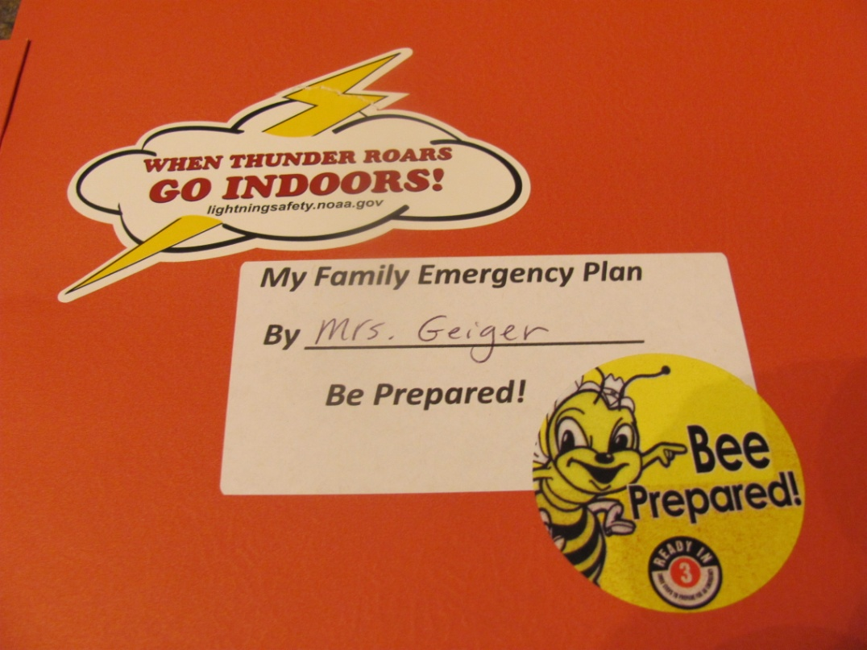
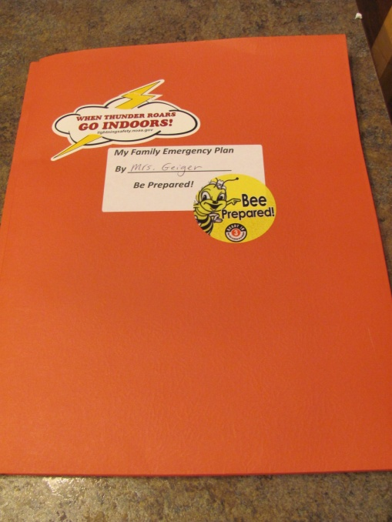
Make a cover for your
Emergency Plan Book:
Tell who made the book
(your name)
Add a couple of stickers

Slide 3
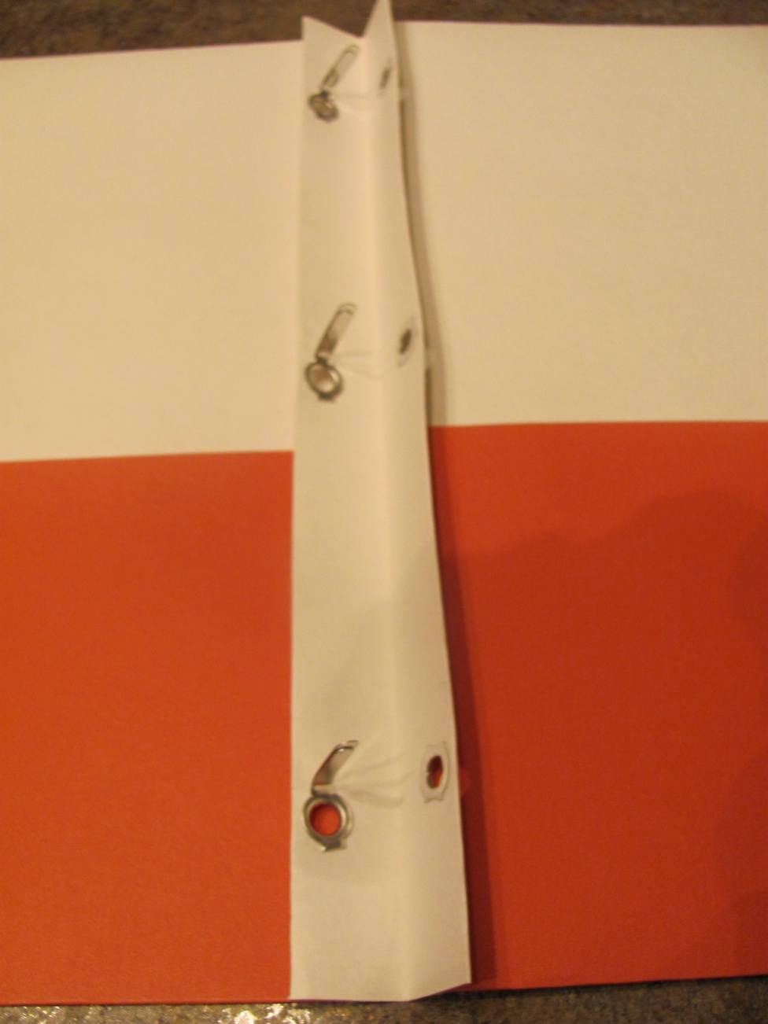
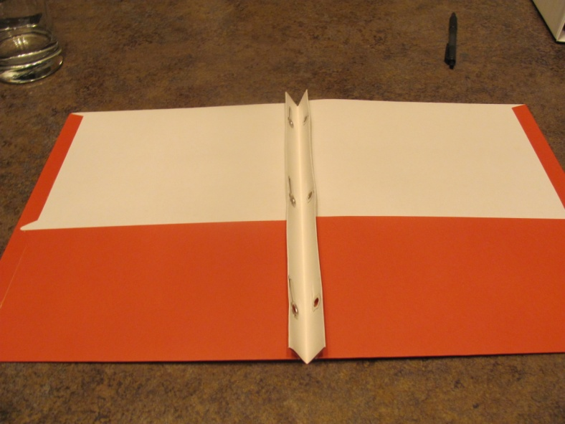
Some tips on how to put your book together:
Get your book ready to put in the pages. Bend the 3 prongs so they stick up in the middle of the book.

Slide 4
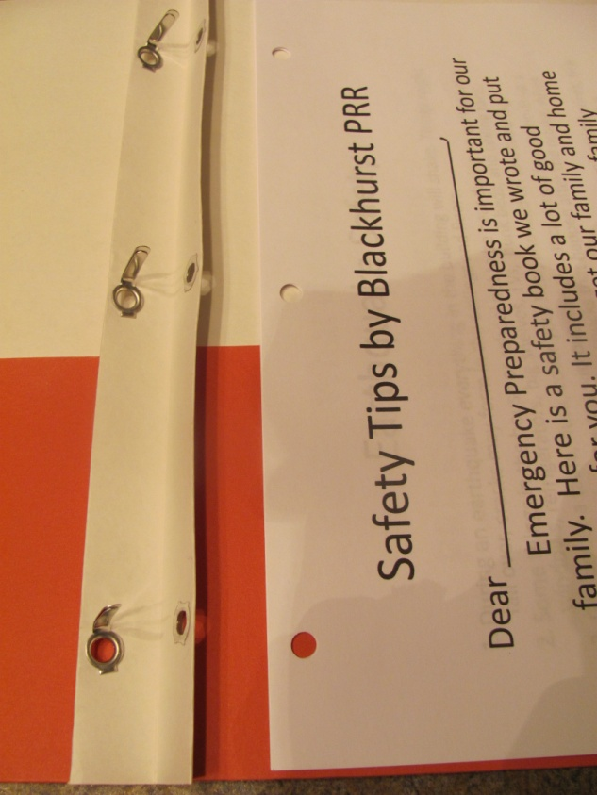
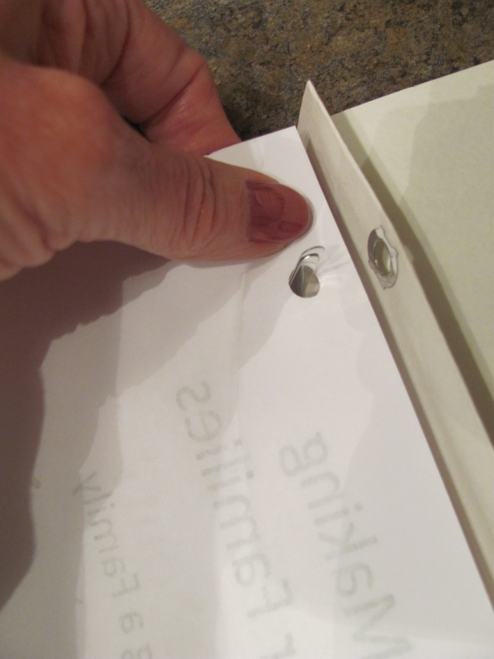
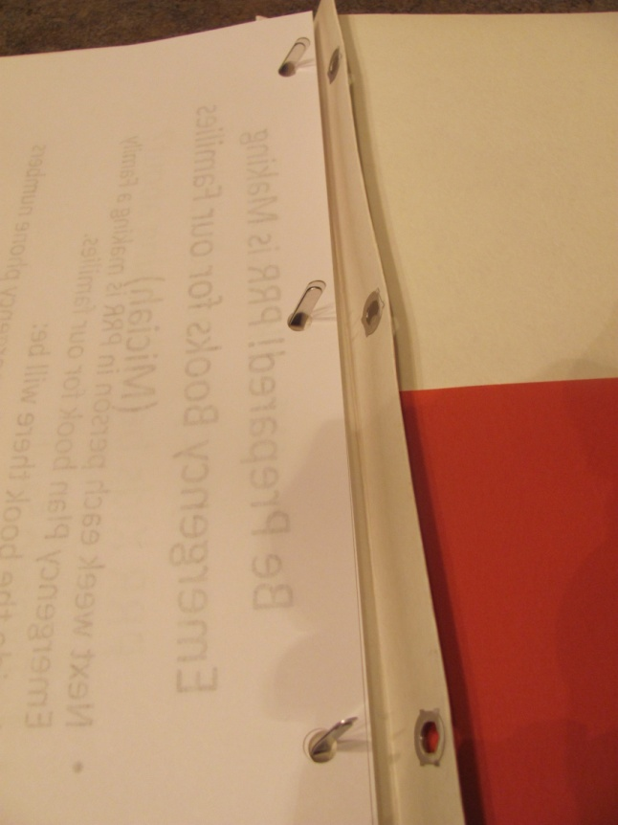
Put the 3 prongs through all pages with holes

Slide 5
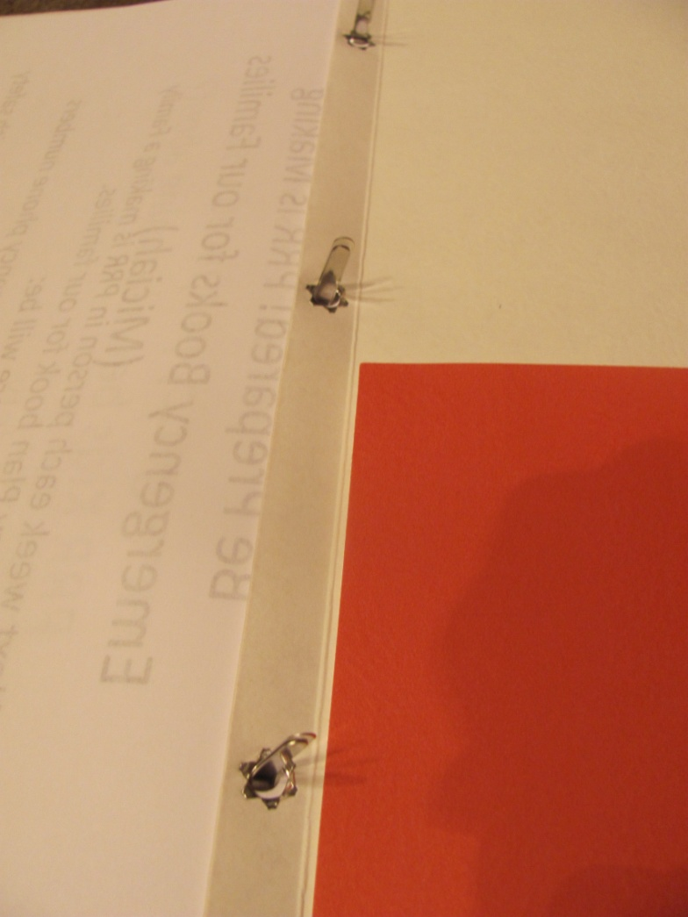
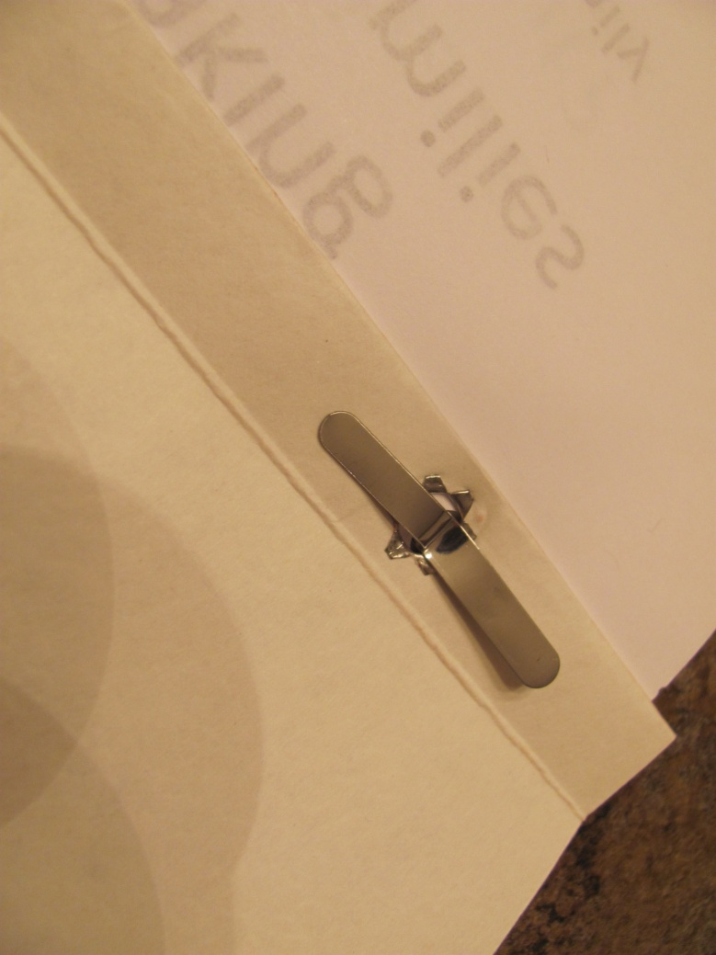
Fix the prongs to lock in the pages:

Slide 6


Helping Others!
Little Kids may need help from big Kids. It may be hard for them to get the pages on the 3 prongs!

Slide 7
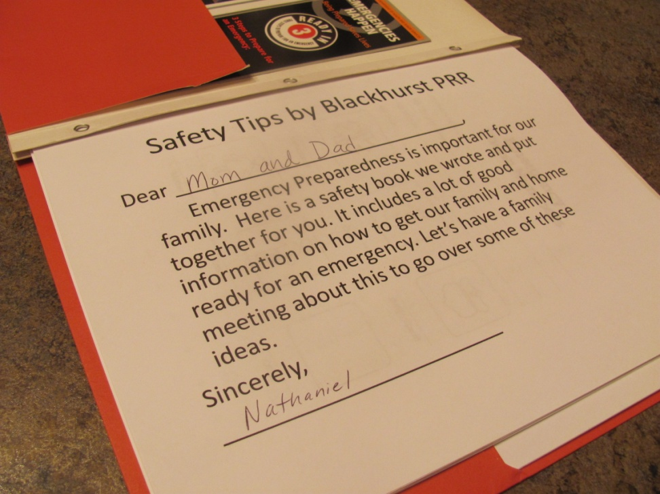
What pages will go in the middle of the book?
PRR kids wrote about Emergency Preparedness safety tips for the Lights On Afterschool celebration.
These have been printed out for your book.

Slide 8
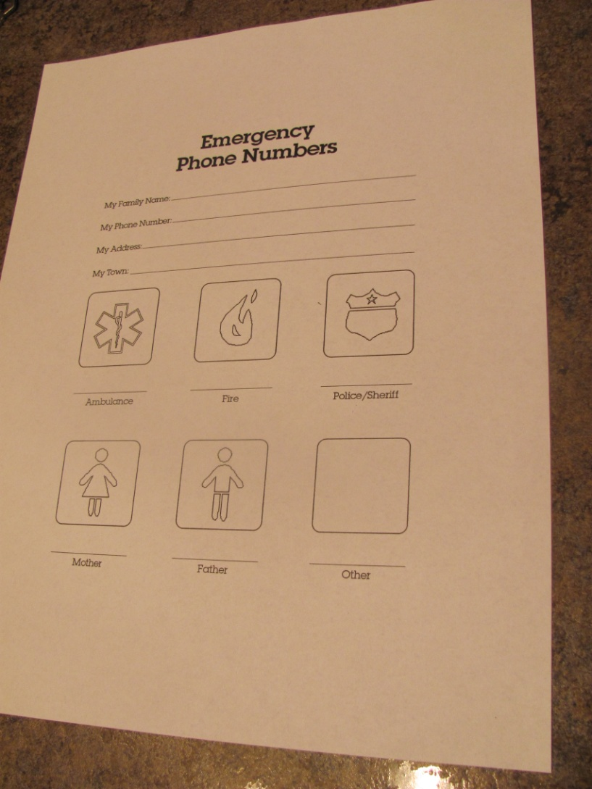
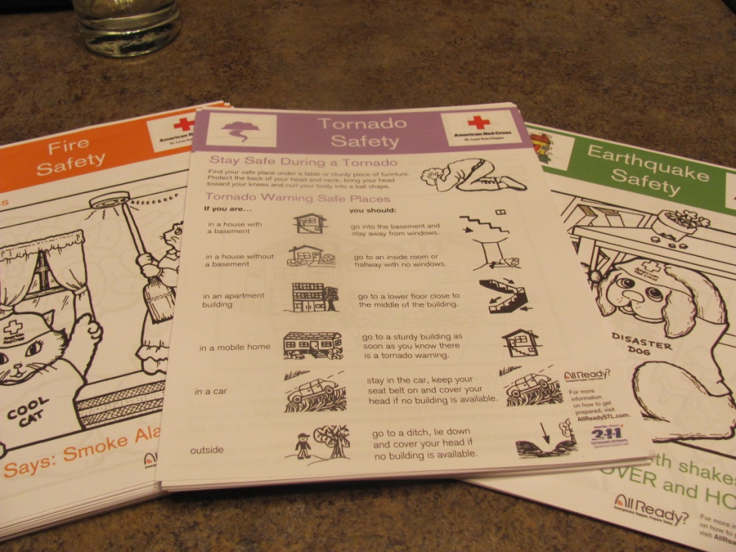
More pages for the middle of book from Mr. Sebastion
American Red Cross

Slide 9
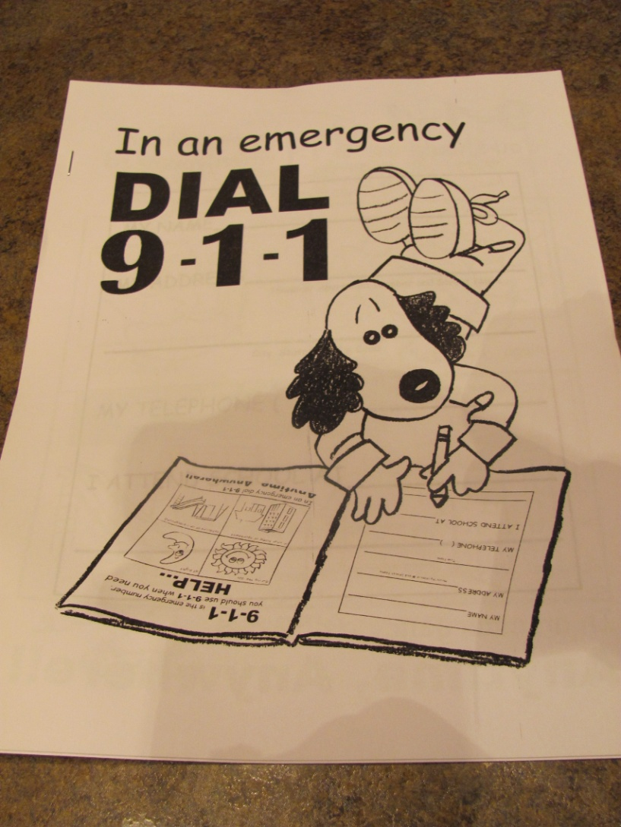
For the pockets of your book:
There is a 9-1-1 Coloring book. You may color it in with crayons after you get your book put together. Color in neatly so your family can read about calling 9-1-1.

Slide 10
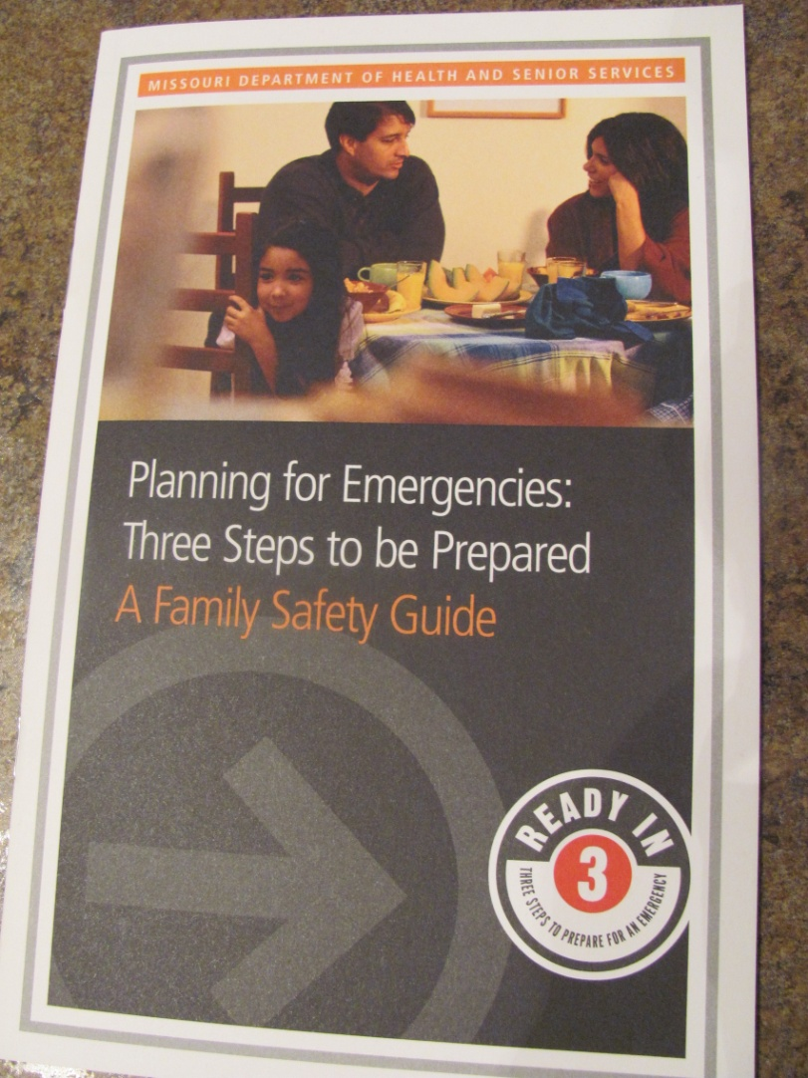
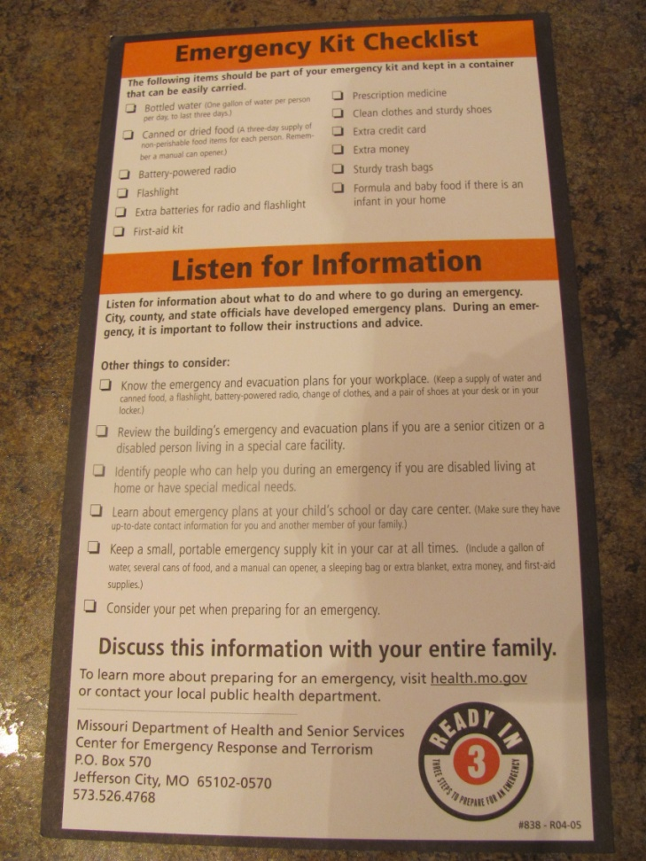
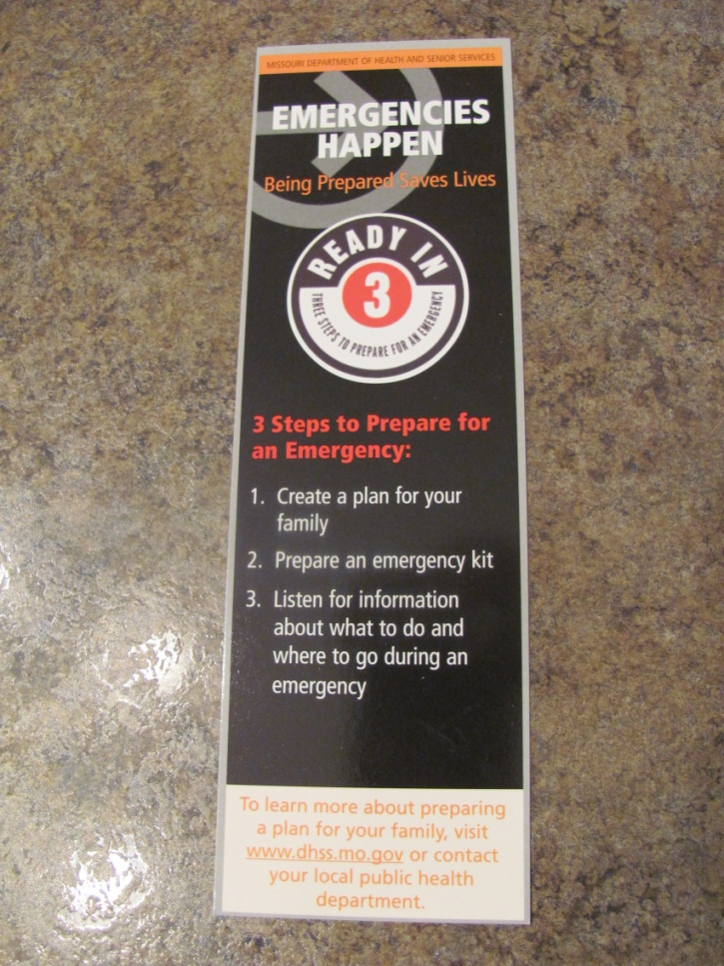
More for the pockets:
Good information from the State of Missouri

Slide 11
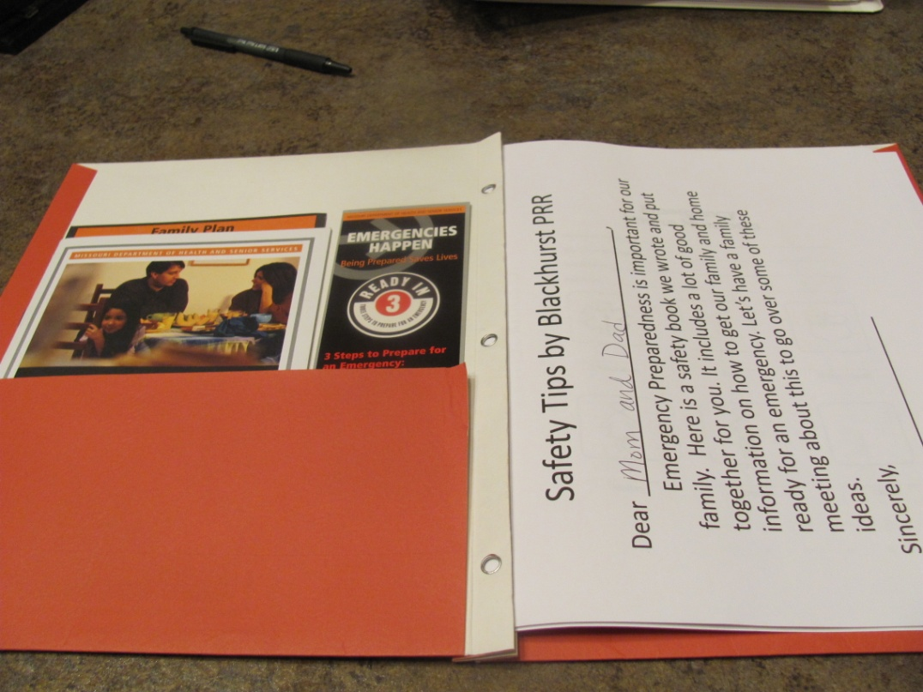
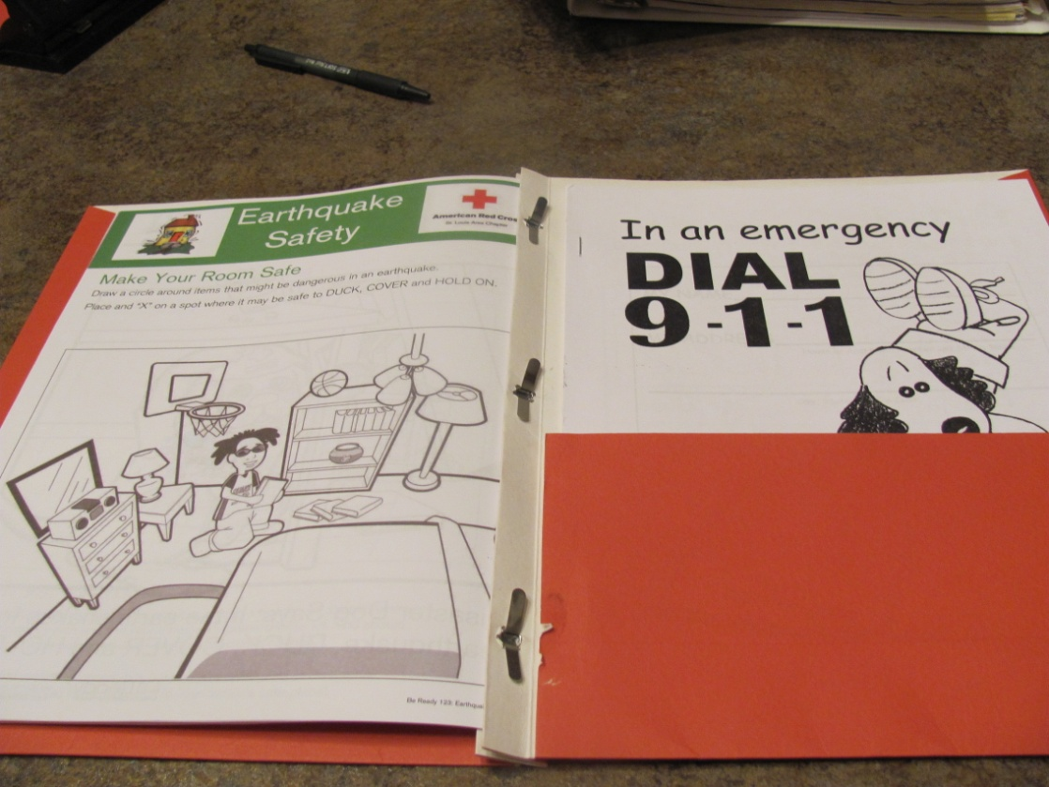

Slide 12
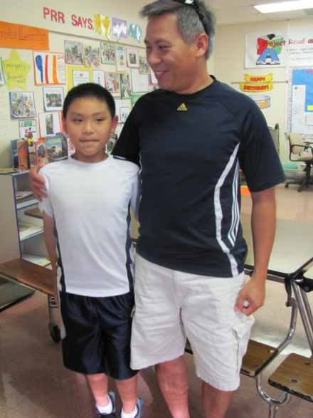
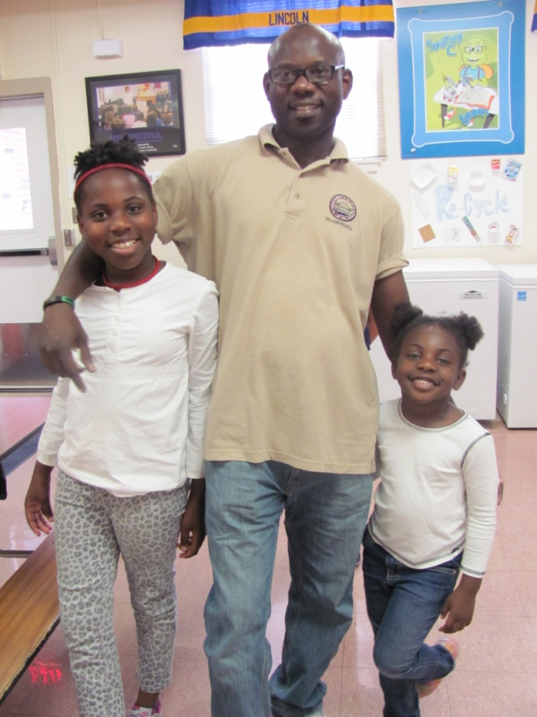
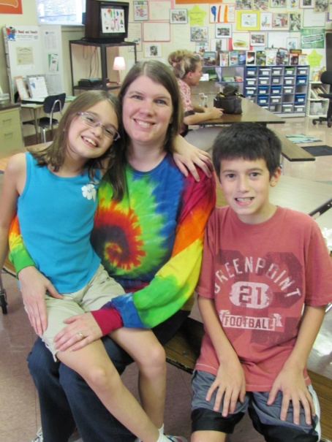
Now Your book is Done!
We will present our books to Moms and Dads at PRR’s Fall Festival!
Your job is to show this book to your family. Tell them about the importance of having a Family Plan for Emergencies that might happen at home.
Be Prepared!

