Slide 1

Dr. Martin Luther King, Jr.
Dr. King was an African American who lived over 50 years in ago. He believed black people and white people were not treated equally. He worked peacefully to help change laws in our country to make life fair for all Americans. Dr. King is remembered for his powerful words in speeches he gave around the country. His most famous speech is the “I Have a Dream” speech from 1963 in Washington D.C., our nation’s capitol. Because of Dr. King and others, in 1964 a new law was voted in; it was called the Civil Rights Act. This law gave all Americans equal rights. We celebrate Dr. King’s birthday each year in January because he helped change American life for the better for all Americans!

Slide 2
St. Charles Celebrates Dr. King’s Life
Through “I Have a Dream” Art Contest
The City of St. Charles is sponsoring an art contest to celebrate Dr. King’s life and his good work for all Americans.
The contest is called the “I Have a Dream” art contest. Anyone in PRR can make an artwork about Dr. King showing what Dr. King’s famous “I Have a Dream” speech means to you.

Slide 3
“I Have a Dream” Art – Must Haves:
Art must have your name and a title for your artwork on the back in PENCIL!
There must be a word, a phrase, or a sentence from Dr. King’s “I Have a Dream Speech” in your artwork.
(What is one strategy you can use to make sure all words are spelled correctly?)

Slide 4
“I Have a Dream” Art Guidelines:
“I Have a Dream” Art can not be traced.
“Dream” Art can not be copied off of a book. (Someone else made this art, the MLK art must be your own idea).
Art can be in pencil, marker, watercolors, crayon, or colored pencils.
Artwork should be flat and not smaller than 12 by 18 inches. Used the white art paper in PRR.

Slide 5
I Have a Dream Art Contest
PRR will select 3 MLK “I Have a Dream” artworks from each school for the art contest.
The City of St. Charles will judge all of the MLK “I Have a Dream” artworks. Winners will be announced in January.
Last year 2 students from PRR had their work selected! They were honored at a city council meeting at City Hall. Here are some photos.

Slide 6
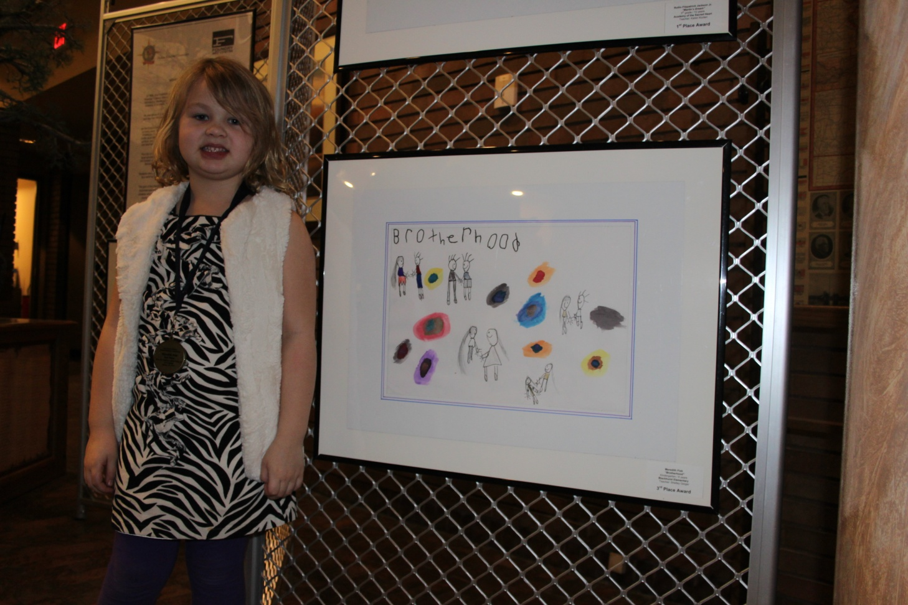
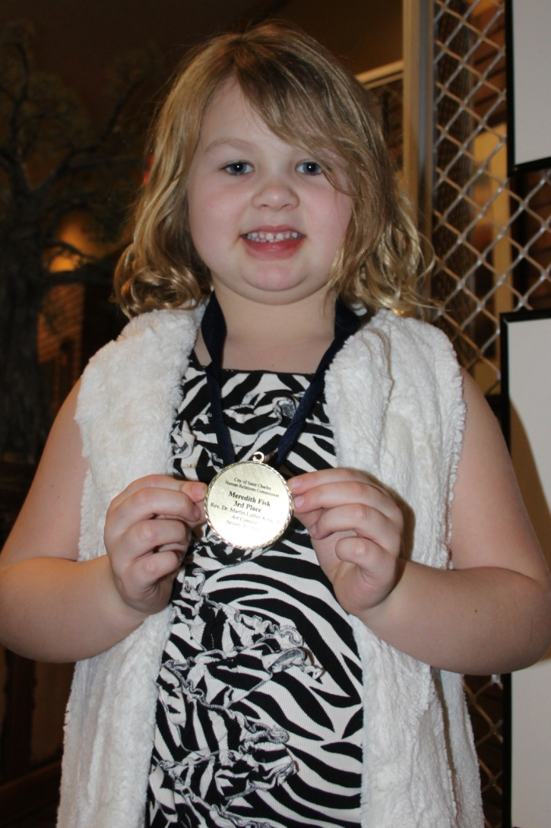
Blackhurst School – Meredith
“Brotherhood”

Slide 7
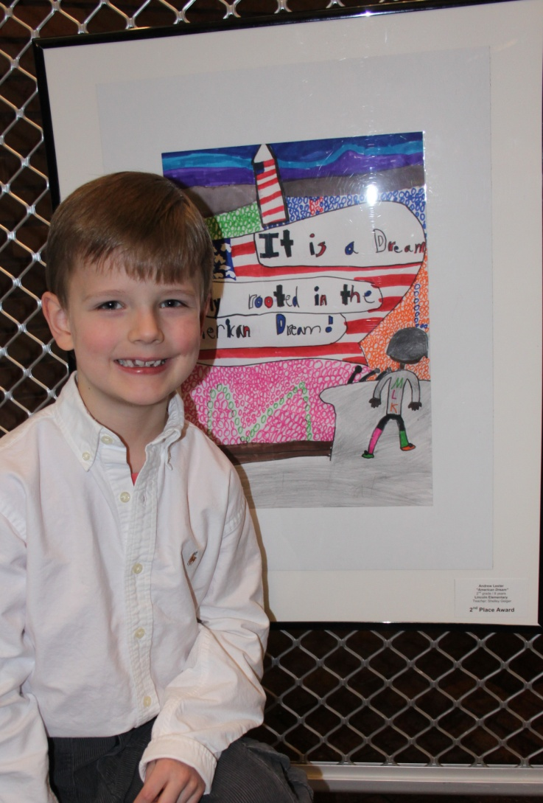
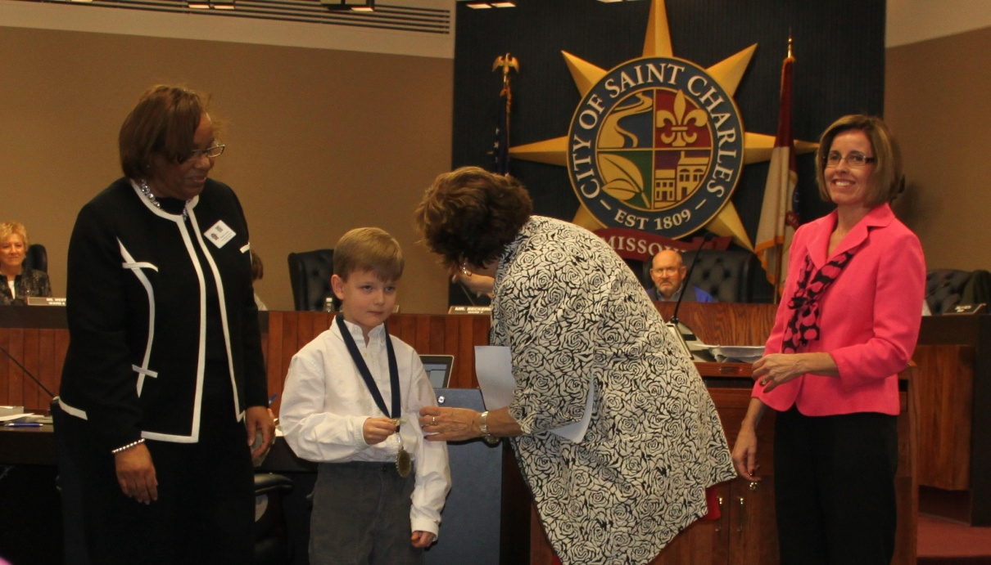
Lincoln School – Andrew
“The American Dream”

Slide 8
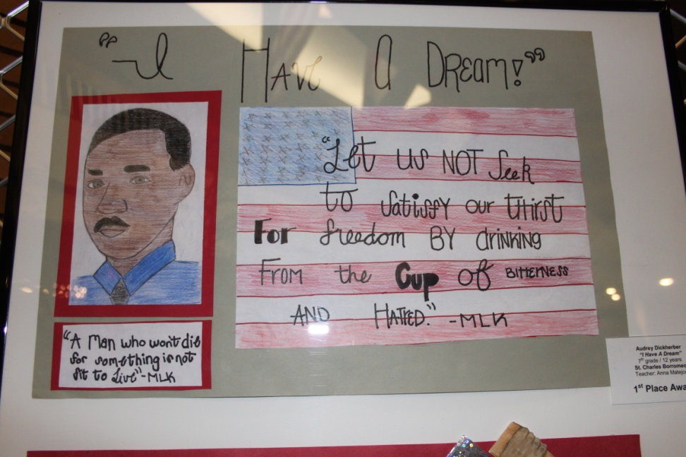
Before you begin your art work
Listen to a story about Dr. Martin Luther King’s life called “Martin’s Big Words”.
Find out some of Dr. King’s words from his “I Have a Dream” speech.

Slide 9
Your “I Have a Dream” Art
Decide which Dr. King words from his “I Have a Dream” speech to use in your art. It can be one word, a phrase, or a whole sentence.
Decide how to show your Dr. King idea through a picture.
Plan your art in pencil.
Add color.

Slide 10
Deadline is next Friday!
You can work on this project at PRR during free time and if you have your homework done, during homework time.
Good Luck!!

