Slide 1
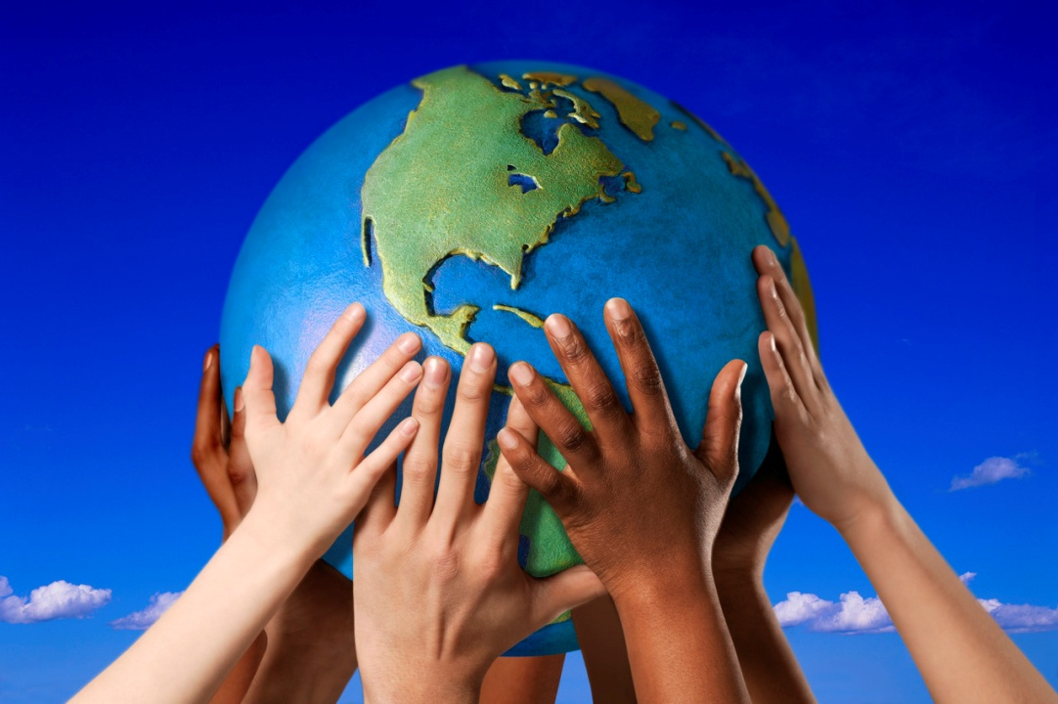
New Service Learning Project:
“People Everywhere”

Slide 2

People Everywhere
Do you know anyone from another country?
Give some examples.
Do you think life in their country is different from life in the United States?
What are some differences you can think of?

Slide 3
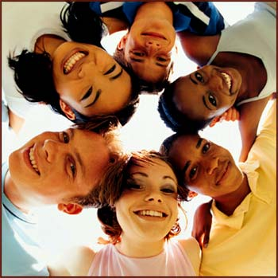
People Everywhere
Service Learning Project
Project Read and Reach will be learning about people of different cultures.

Slide 4
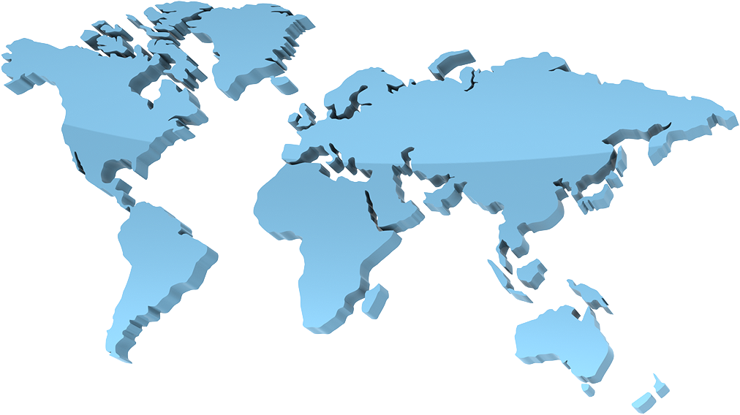
The Big Question!
Why is it important for people to learn about
people from other places?
We will be exploring this question and idea in the coming weeks!

Slide 5
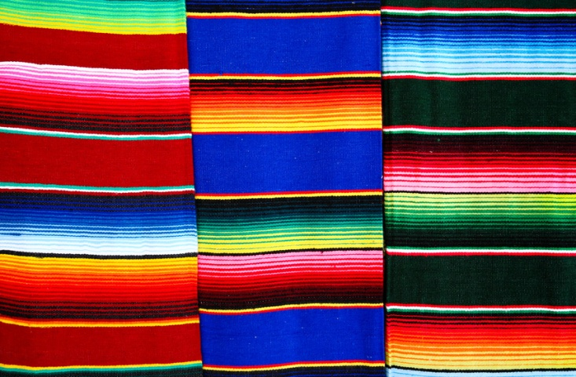
Important Words
When learning about people of other lands some important words to know are:
Culture
Traditions
Language
Stories
Art
Music
Clothing
Food
Geography

Slide 6
Important Word: Culture
Culture is a word for people's “way of life”, meaning the way they do things. Culture is seen in people's music, art, writing, stories, clothes, cooking and religion, and in what they do in their daily lives.
For example, Chinese culture means “the way of life” in China. American culture means the way of life in the United States.

Slide 7

Important Word: Traditions
A tradition is a practice that is done over and over during a particular season or time.
For example – My family has a tradition on birthdays of having cherry pie instead of a birthday cake.
Our country has a tradition of shooting off fireworks on the Fourth of July to celebrate the birthday of the United States.

Slide 8
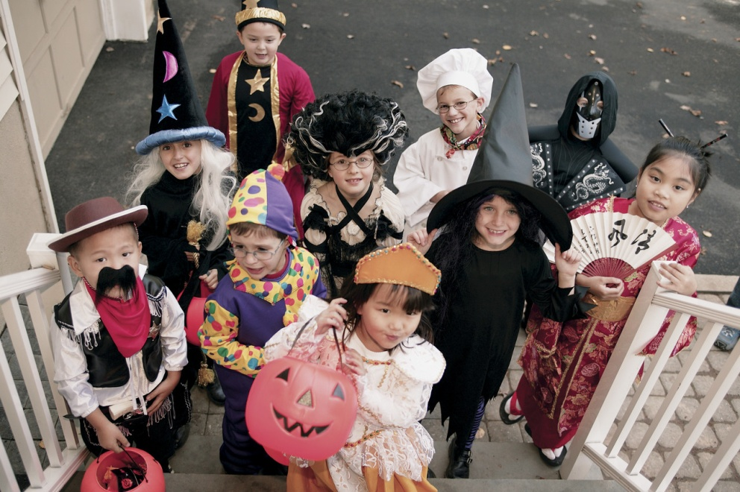
Cultural Traditions
Some traditions are “cultural traditions”. These are traditions that a group of people from the same place or country might practice. These traditions are passed on from one generation to the next so the traditions last for years and years.
Can you name a cultural tradition from our country?
Can you name a cultural tradition from a different country?

Slide 9
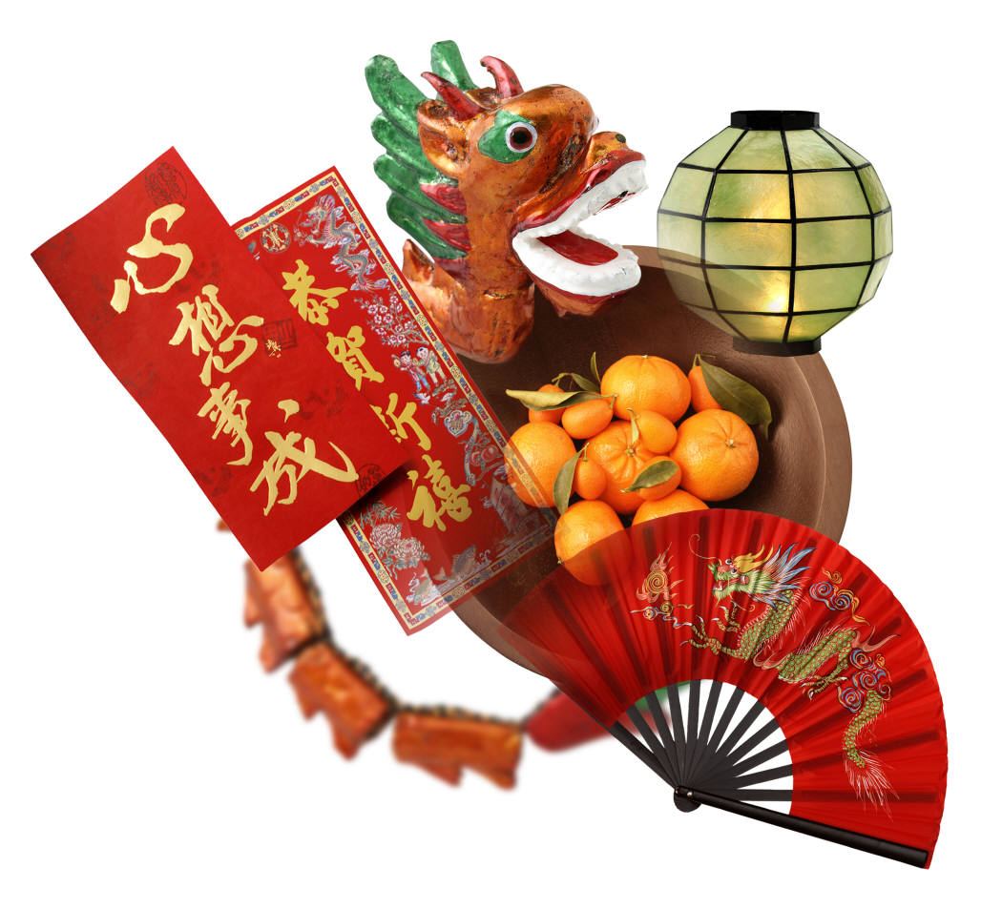
People Everywhere
We will try and learn about people of the world by experiencing:
Their Stories
Their Art making
Their Music and Dance
And by meeting and talking with real people from other lands to learn about their way of life in their home lands.

Slide 10
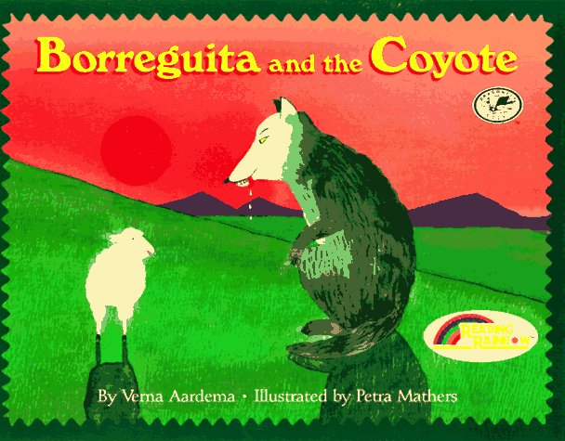
“Borreguita and the Coyote”
Here is a sneak preview of our first culture we will be looking at.
This is a story from another culture that has been told to children
for many years.

Slide 11
What to look for in the story:
What are some words that are new to us found in this story?
Is this a true story or a folk tale?
What country or culture of people do you think tell this story to their children?
What does the land look like in this country?

