Slide 1
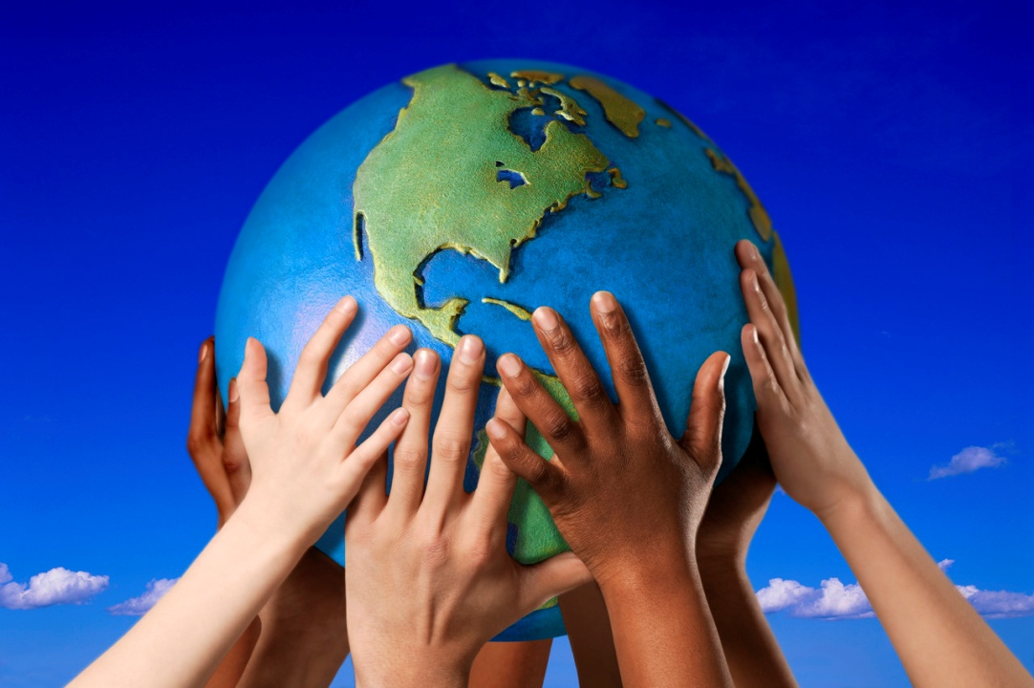
New Service Learning Project:
“People Everywhere”

Slide 2

People Everywhere
Do you know anyone from another country
Do you think life in their country is different from life in the United States?

Slide 3

People Everywhere
Service Learning Project
Project Read and Reach will be learning about people of different cultures from other countries.

Slide 4
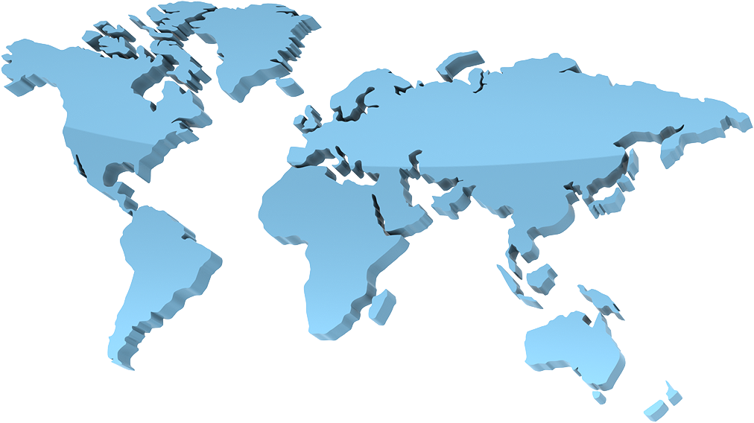
The Big Question!
Why is it important for people to learn about
people from other places?
We will be exploring this question and idea in the coming weeks!

Slide 5
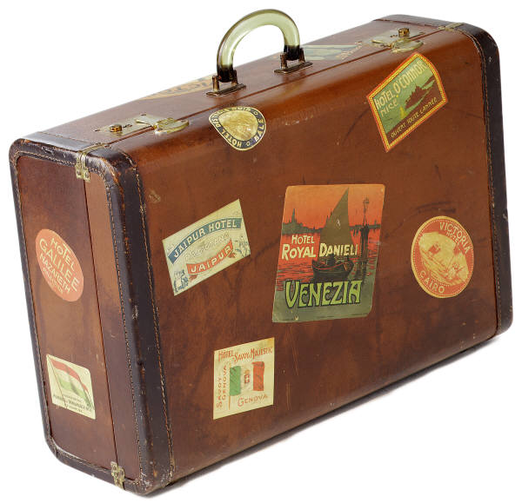
A Pretend Trip Around the World!
Learning about other people and their culture is like going on a trip to that country or place.
We will be collecting information about people who visit Project Read and Reach to remember where they came from and some things about their cultures.
We’re going to need a suitcase if we’re going on a trip!

Slide 6
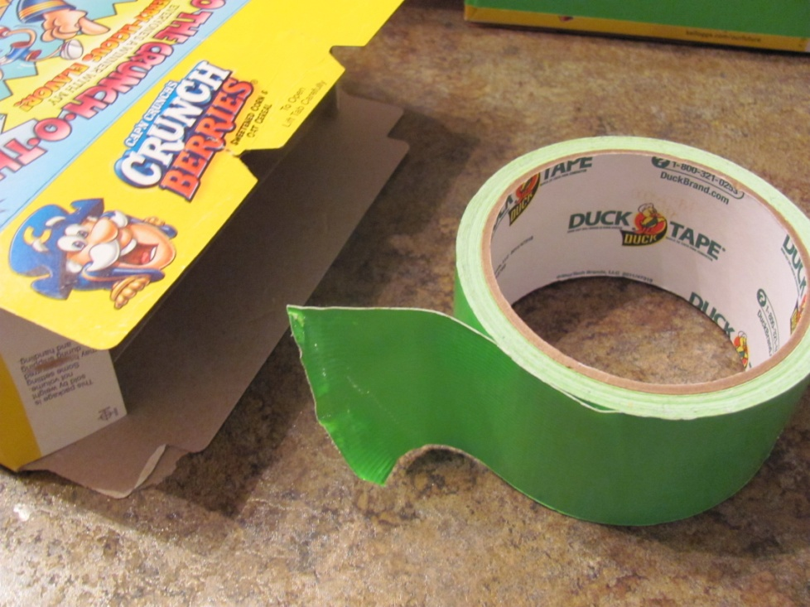
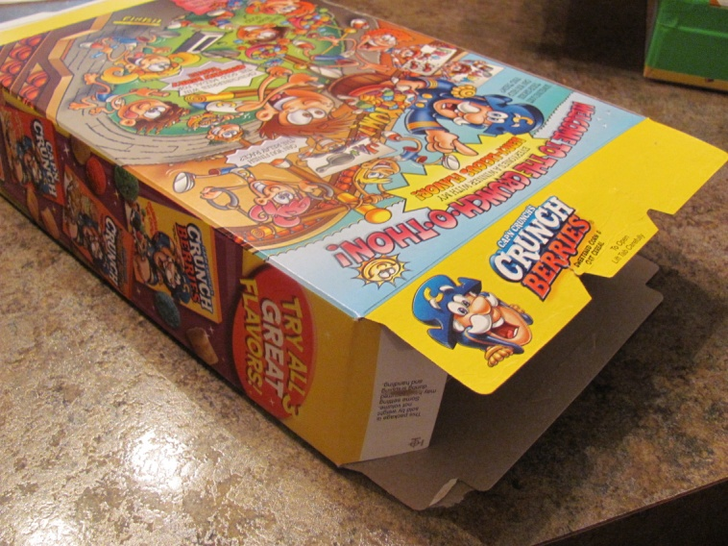
How to make a 3-D suitcase!
We will need: a cereal box, scrap cardboard, tape, scissors, glue and a stapler.

Slide 7
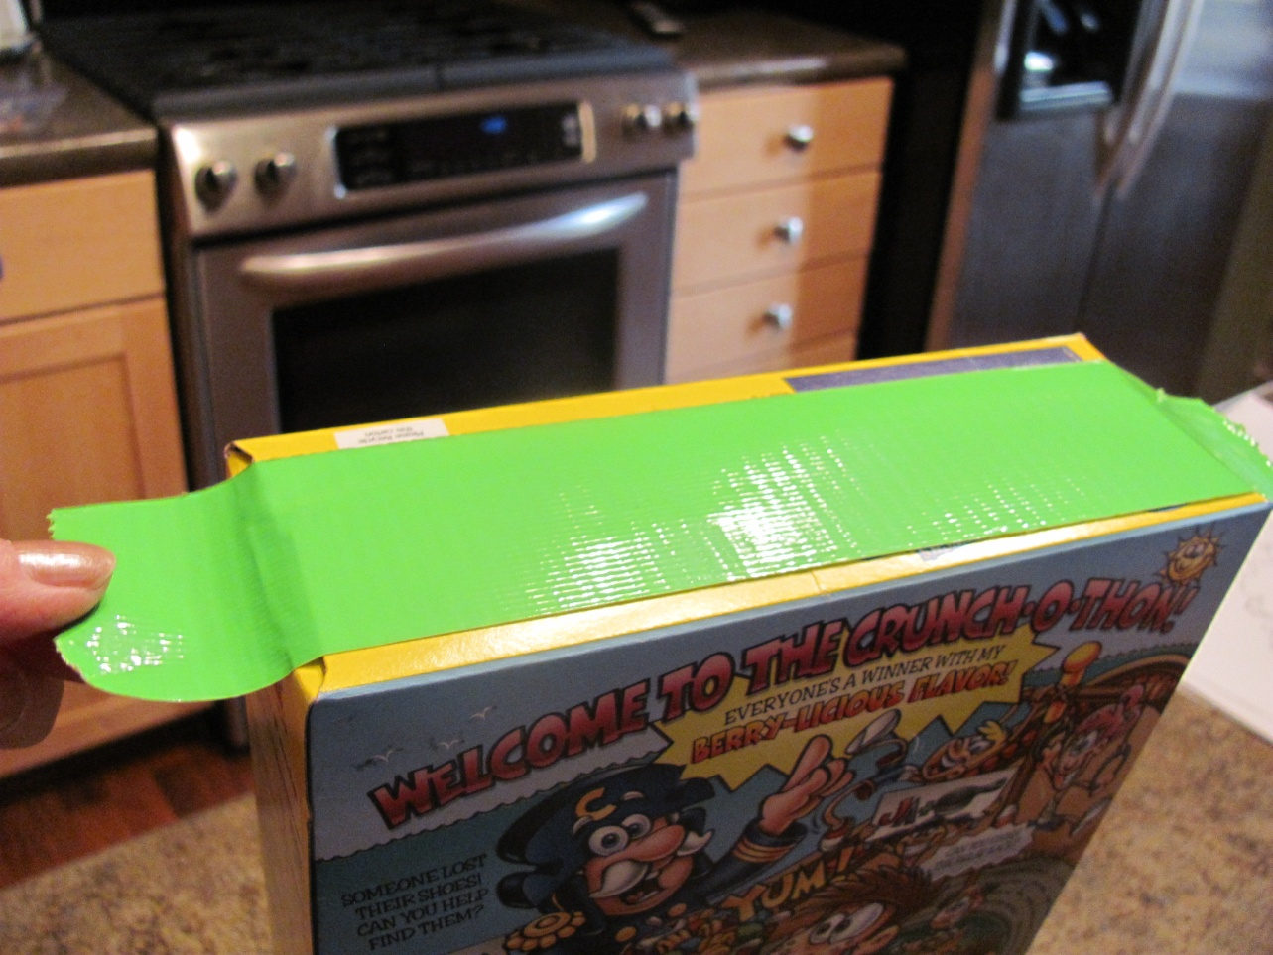
Step 1
Tape both ends of cereal box shut.

Slide 8
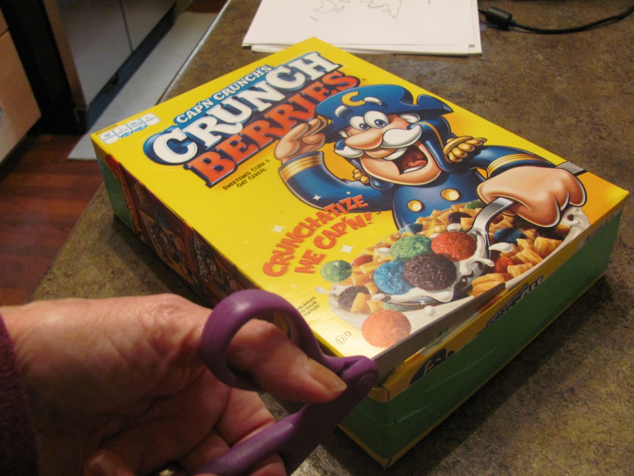
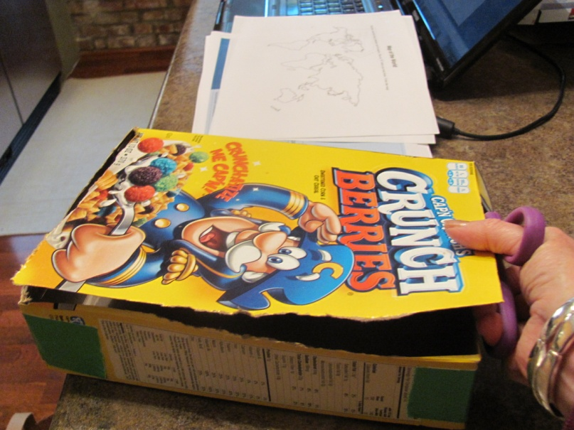
Step 2
Cut open suitcase lid on 3 sides Leave one side uncut so the lid can open and close.

Slide 9
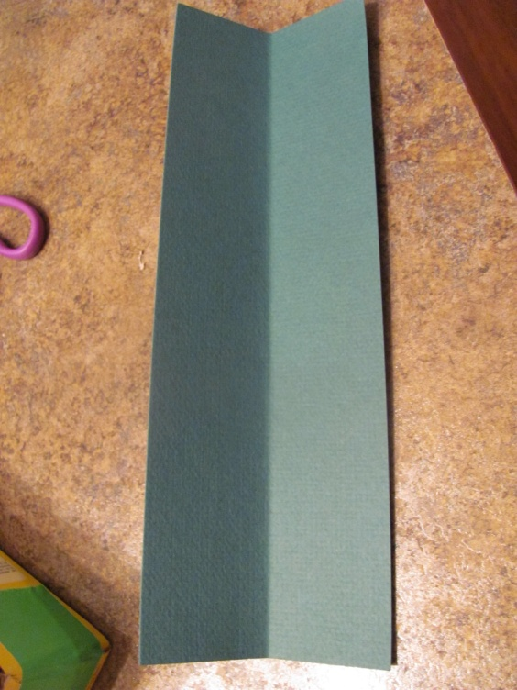
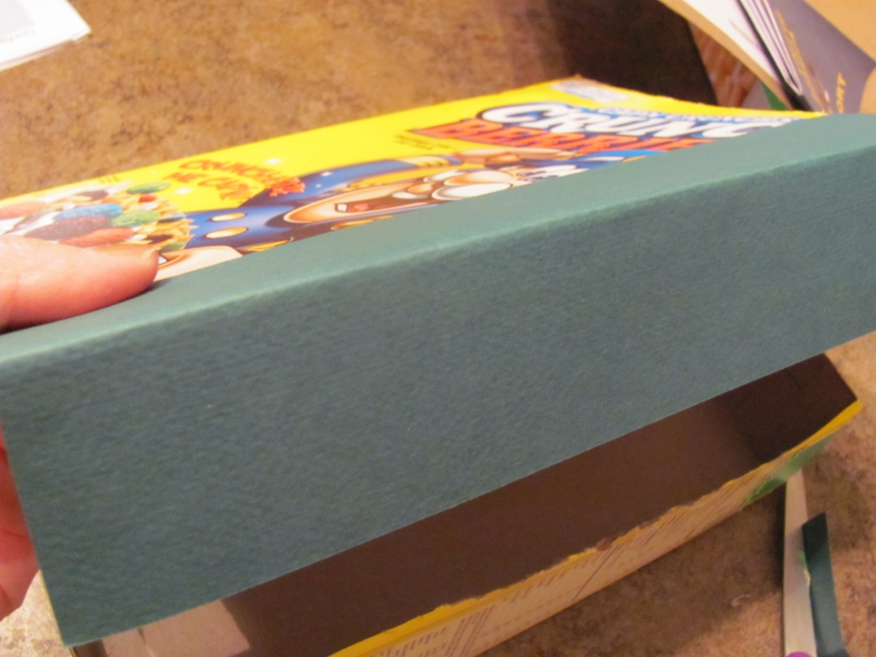
Step 3
Fold a flap for the suitcase’s lid and glue it on with white glue. The flap will tuck inside the suitcase and help keep it closed.

Slide 10
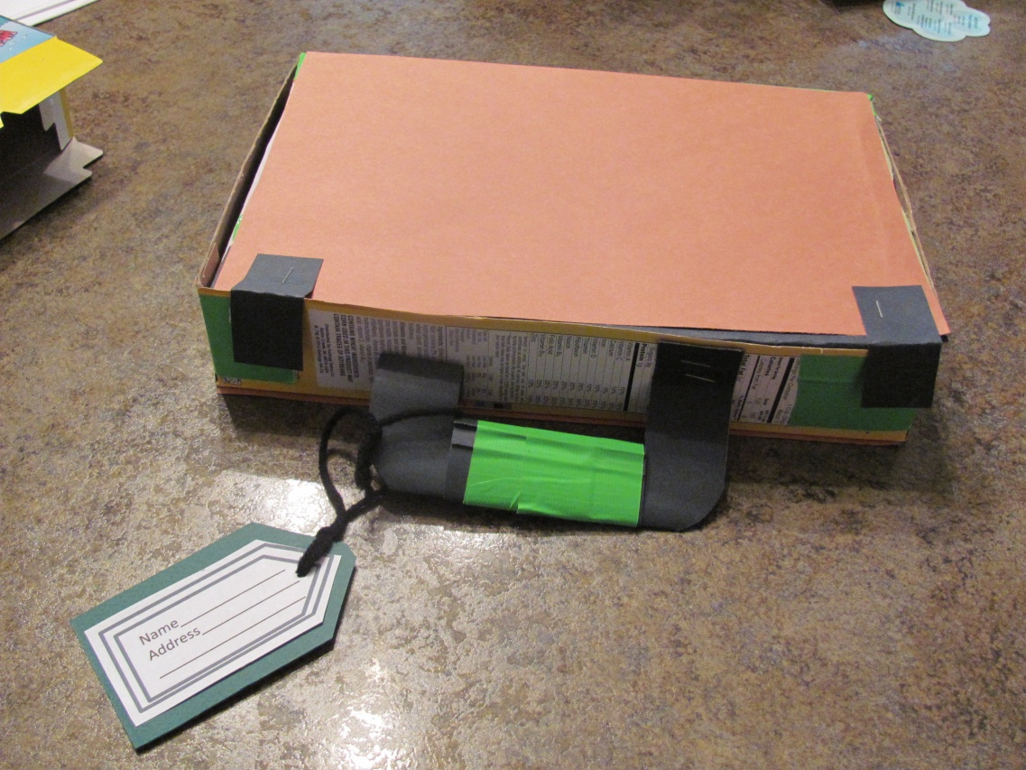
Step 4
Cover top on bottom of suitcase with construction paper. Cut out a handle for the suitcase and staple it on.

Slide 11
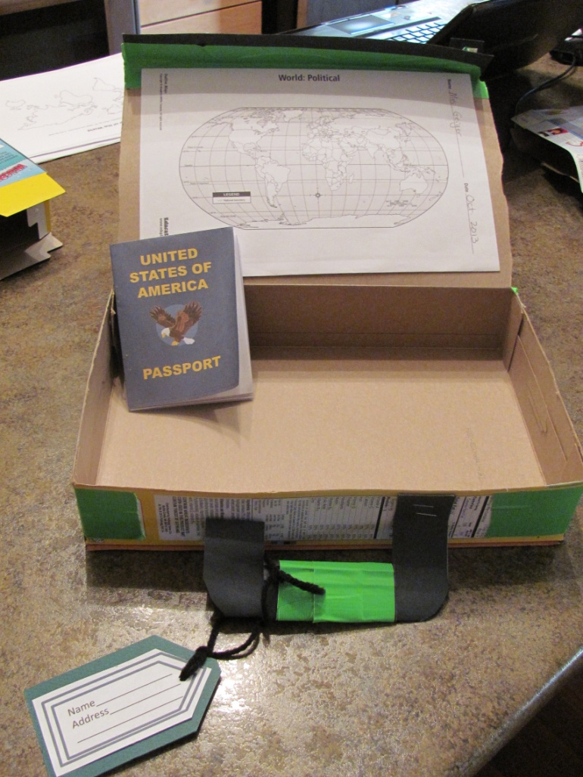
Little Extras:
Make a luggage tag and a passport for your suitcase. Glue a map of the world to the inside of the suitcase’s lid.

Slide 12
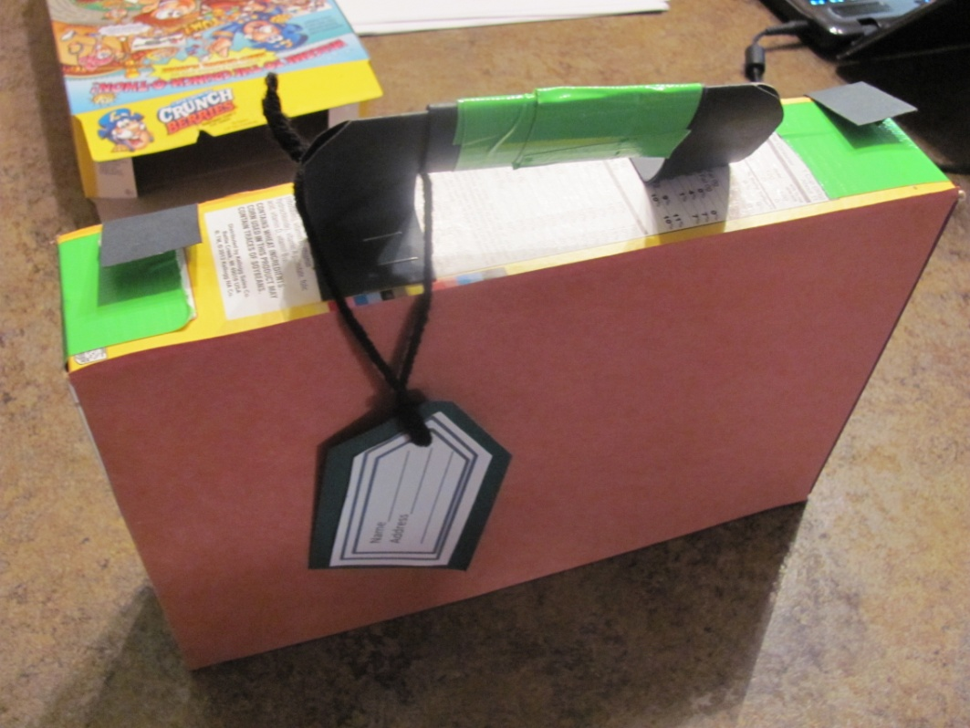
Finish up:
Put you name inside your suitcase and on your luggage tag. Color maps and flags of other countries and save them inside your suitcase.
Our first country we are going to is Mexico!

