Slide 1
What is the PRR Valentine Express?

Slide 2
What is Valentine Express?
For the last four years, PRR student conducted a Postal Service for the whole school to help deliver Valentines between classes.
Many of you may remember doing this.

Slide 3
How does Valentine Express Work?
Each classroom and special teacher and staff will need a Valentine’s Express (V.E.) mailbox.
There will be a main mall box located in the front hallway.
Why will the main hall need a main mail box?

Slide 4
Who delivers the mail?
PRR will deliver all the mail each day to the correct classroom address.
It is free to mail a Valentine at school.
What kind of system will PRR have to figure out to make the Valentine Express work?

Slide 5
How to address a Valentine*
Each Valentine will need 2 things on the envelope:
To: ( the person’s name the valentine is for)
Where: ( the name of the class room or place where the valentine is to be delivered)
* if any info is missing, the valentine will not be delivered!

Slide 6
Classroom Addresses Examples
KH – is Ms. Horton’s Kindergarten
1B – is Ms. Blackburn 1st grade
4G – is Mrs. Kapeller’s 4th grade

Slide 7
Other Important Addresses
For other important people in the school, please send the valentine to their room. For example:
Art Room – for your art teacher
Music Room – for music teacher
Office – for the office ladies
Nurse – for the nurse
Café – for the cooks and café workers
Gym – for PE teacher

Slide 8
This is for School Valentines ONLY!
Don’t try and mail a Valentine to your Grandma in the School Valentine Express! You will have to use the real mail to do this! Why?
Don’t mail Valentines to people in your own class in the Valentine Express! This will create too much mail! Deliver those yourself in your classroom.

Slide 9
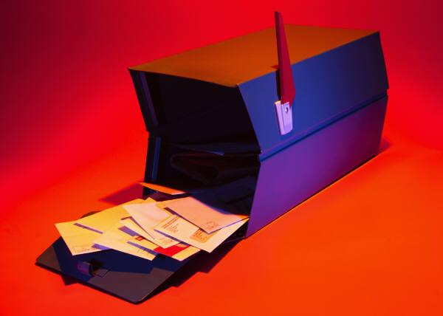
When does Valentine Express Start?
PRR will begin delivering the Valentine Mail starting Monday, Feb. 8 - Friday, Feb. 12.

Slide 10
How will the whole school know PRR is doing this?
PRR Kids will have to tell the whole school about Valentine Express.
What are some good ways to do this?

Slide 11
Everybody’s Help! – Teamwork!
Every person in PRR will get a job!
Your job choices are:
Make and decorate at least one mailbox.
Make posters for Morning Assembly
Sort and deliver fliers
Collect, sort, and deliver the mail everyday next week.

Slide 12
Time to get to work!
We need everybody’s help to make this project a success at Blackhurst school.
Use the supplies available and be creative to make posters, and mailboxes for our project!
Everyone in PRR can help in morning assembly on Friday tell the school about how Valentine Express will work!

